Slide 1
Karine Perraut (CNRS/INSU)
with contributions of
F. Martinache, D. Mouillet, G. Perrin, R. Bacon, J.L. Beuzit, E. Chapillon, E. Choquet, J.G. Cuby, H. Flores, T. Fusco, M. Gérin, I. Guinouard, F. Hammer, B. Neichel, J. Pety, M. Puech
INSTRUMENTAL RESEARCH

Slide 2
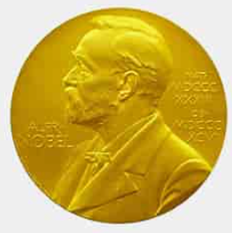
the specific context of astronomy and astrophysics
Conceptual technological
breakthroughs
SHARP – 4 mas
NACO – 0.5 mas
GRAVITY – 30-50 µas
No on-the-shelf instruments
Need to develop new concepts
R&D and cutting-edge devices
➔ Challenges, creativity, long-term developments, partnerships
Mastering the whole development chain
On-sky performance validation
➔ Feedbacks from/for the community at large
R&D and instrument developments feed each other
Major and fast improvement of performance
➔ Long-term instrumental sectors
[GRAVITY Collaboration 2018]

Slide 3
Part of a Long-term strategy based on a national coordination …
Long-term
National Roadmaps
CNRS/INSU - Astronomy & Astrophysics (AA) and CNES Prospectives every 5 years
« Facilities/intruments » and « R&D » are main sections of the exercise
Roadmap implemented by the CNRS/INSU Spécialisée in AA (CSAA)
National oversight committees (CNRS/INSU)
Working groups, notably for ELT (adaptative optics, multi-object spectrographs)
Share of expertise and of the know-how
(Bi-)annual project and resource reviews with the involved french teams
National Programs and Specific Actions
Fostering and structuring the community by science themes
Critical mass (Large Programs, trans-instrument views, …)
Commitment
Reactivity
Manufacturing
Studies
Community
Science

Slide 4
… And on strong Partnerships at all scales
European/International consortia
Technological Platforms
ESO
French institutes Astronomy Astrophysics
Existing technologies used for astronomy
Dedicated developments
French academic experts
(optics, signal processing, cryogeny, materials, …)
Cutting-edge companies
Close collaboration
Transfer/use in other domains
Start-ups

Slide 5
Funding
Technological funds
(CNRS RTB, CARNOT)
OPTICON/Radionet – ESO R&D Program
Local LabEx (Lyon, Grenoble) *
Thematic Labex (FOCUS) **
Regional funds (DIM, …)
Technological Plateforms
ERC, ANR
ESO
French institutes Astronomy Astrophysics
Fond Unique Interministériel (FUI)
France Relance *
PIA-3 PIA-4 France 2030 *
French academic experts
(optics, signal processing, cryogeny, materials, …)
Cutting-edge companies
^{* stimulus packages}
PIA – Programme d’Investissement d’Avenir

Slide 6
The Research infrastructure (RI) « Instrum eso »
Part of a broader context that grows in complexity,
RI « INSTRUM ESO » is a key tool of coordination
To secure the construction of the instruments in the optical domain
To support R&D activities for future instruments
To ensure the consolidation and sustainability of the know-how
To ensure the overall consistency of developments
To guarantee that instruments serve at best the community at large
Funded in 2005
15 French Partners
Coordination by CNRS
Budget: 850 k€ in 2022

Slide 7
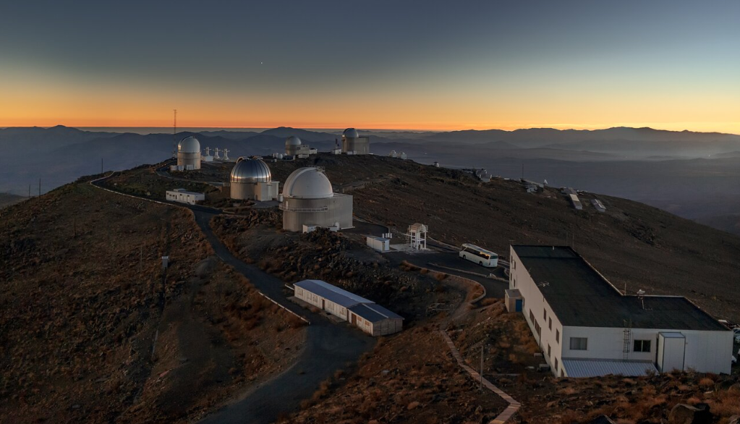
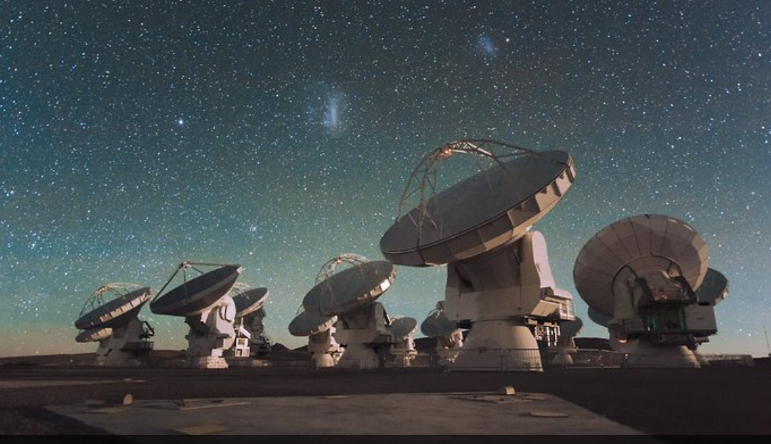
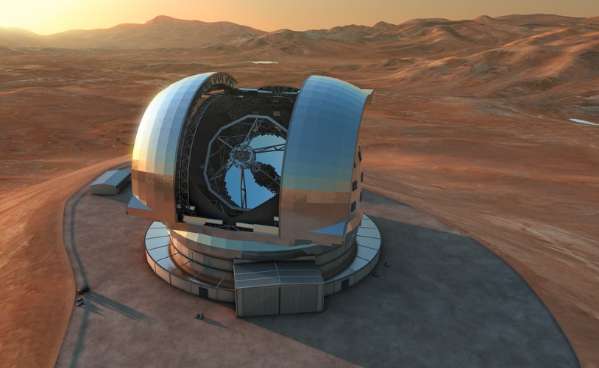
ESO provides a development FRAMEWORK and triggers innovation
La Silla
ESO as an observatory
Infrastructures that host instruments, including visitor ones
(PIONIER, ExTra, CONCERTO, HiRISE)
ESO as a community
With common roadmaps, scientific discussions
ESO as a partner
Within consortia, FPx/H2020/Horizon Europe/ORP proposals
Chajnantor
Armazones
Paranal

Slide 8
FRENCH INSTRUMENTAL research within the eso frameworK
R&D
Well-identified and historic sectors
Adaptive optics and high contrast imaging
Optical long-baseline interferometry
Spectroscopy
[Integral Field and Multi-Object Spectrocopy]
Transverse expertise
Optical design and manufacturing
Instrument control
Detectors
Signal processing
Concept
Data
On-sky validation
Science

Slide 9
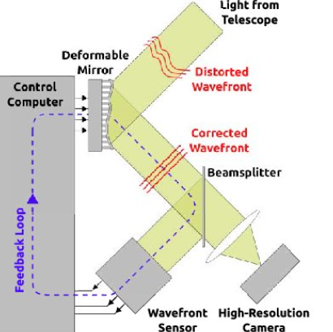
Adaptive optics and high-contrast imaging
Instrument concept, manufacturing, tests, and commissioning
Data reduction pipeline, advanced post-processing
Exoplanets, protoplanetary disks, solar system bodies, Galactic Center, stars
Ophtalmology, advanced microscopy, …
Concept
On-sky
MACAO (Tip-Tilt), COME-ON(+), ADONIS (PI), NAOS (PI), SPHERE (PI), MICADO, HARMONI (co-PI), MORFEO
On-sky testbenches (CANARY, PAPYRUS)
Components: Deformable mirrors, fast and low-noise detectors, coronagraphic masks, RTC
➔ CILAS company, AlpAO and FLI start-ups
System: wavefront control, dedicated testbenches
R&D
Data
Science

Slide 10
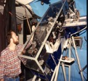
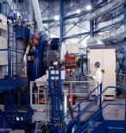
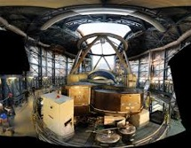
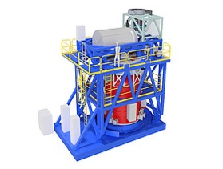
The long-term CNRS-ONERA-ESO partnership
1990 2002 2014 2024+
COME-ON NAOS SPHERE HARMONI
SPHERE+ PCS
First adaptive-optics system for astronomy
(3.6-m telescope)
First adaptive-optics for the VLT 8-m telescope
VLT Planet Finder
Adaptive-optics for the ELT 39-m telescope
Concept demonstrator
Operational instruments
Classical adaptive optics
Toward ultimate performance

Slide 11
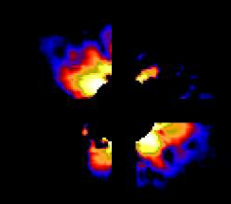
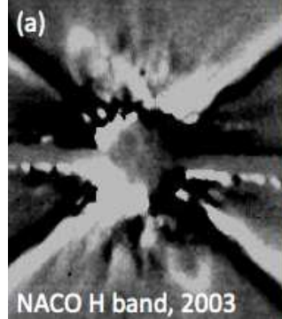
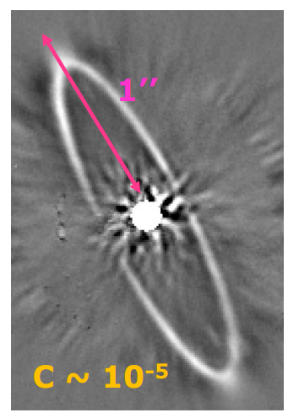
Improving the contrast – HR 4796A
1990 2002 2014 2024+
COME-ON+ NAOS SPHERE HARMONI
SPHERE+ PCS
HR 4796A
[Mouillet+1997, Augereau+1999]
[Private communication]
[Langlois+2014]

Slide 12
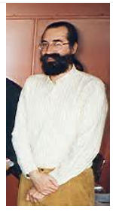
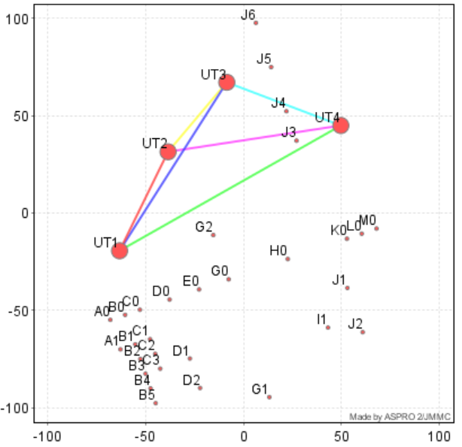
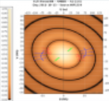
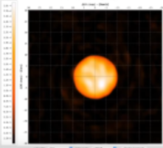
Optical long-baseline interferometry
Concept
On-sky
Instrument concept, manufacturing, tests, and commissioning
VINCI, MIDI (co-PI), AMBER (PI), PIONIER (PI), GRAVITY, MATISSE (PI), GRAVITY+
Components: single-mode fibers, integrated optics
➔ Le Verre Fluoré company, CEA-LETI
System: nulling and aperture masking
Data reduction pipeline, JMMC tools (from observations to modelling and images), Expertise Center, VLTI schools
Galactic Center, Active Galaxy Nuclei, exoplanets, protoplanetary disks, stars, solar system bodies
J.M. Mariotti
R&D
Data
Science

Slide 13
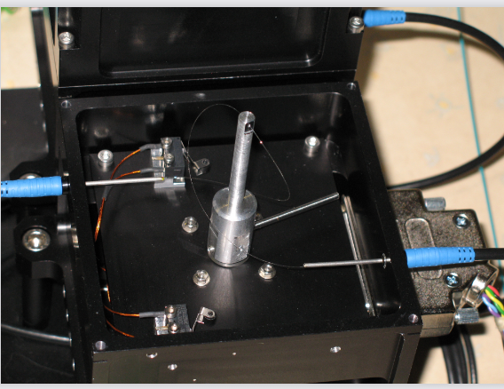
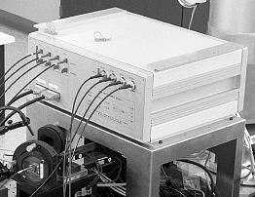
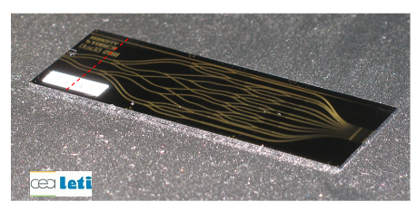
ASTROPHOTONICS to improve accuracy and precision
Spatial filtering: clean up the wavefront, do high-precision interferometry
Singlemode fibers (VINCI, AMBER, PIONIER, GRAVITY)
Integrated optics (PIONIER, GRAVITY)
Stability, flexibility, compactness (cryogeny, combination of more telescopes)
Large Magellanic Cloud
The 1%-precision diameters with PIONIER contribute to a LMC distance determined with a precision of 1%
GRAVITY fluoride fibers
[Pietrzynski+2019]
GRAVITY chip manufactured by photolithography
VINCI fluoride fiber combiner

Slide 14
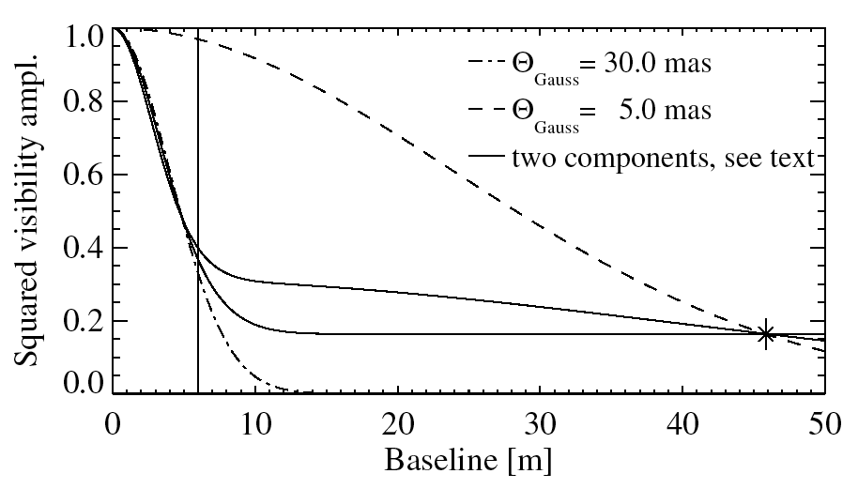
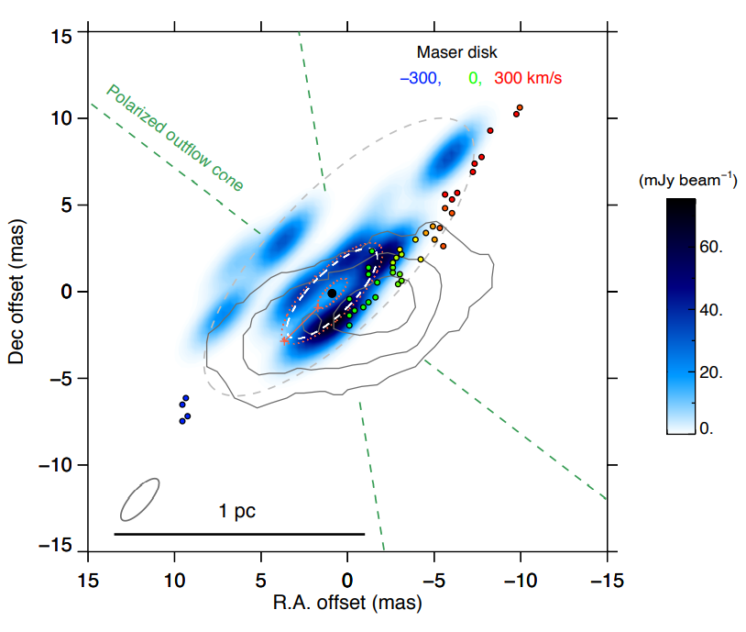
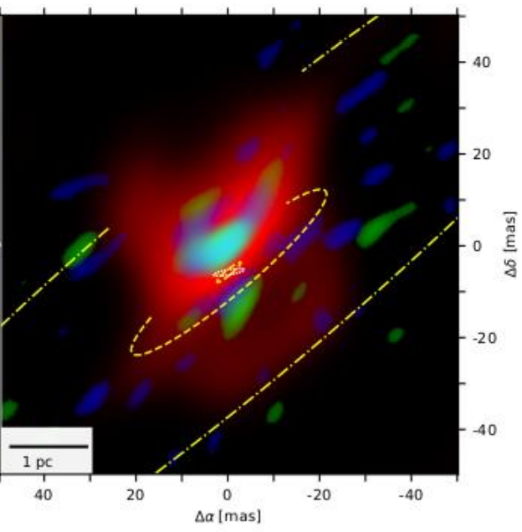
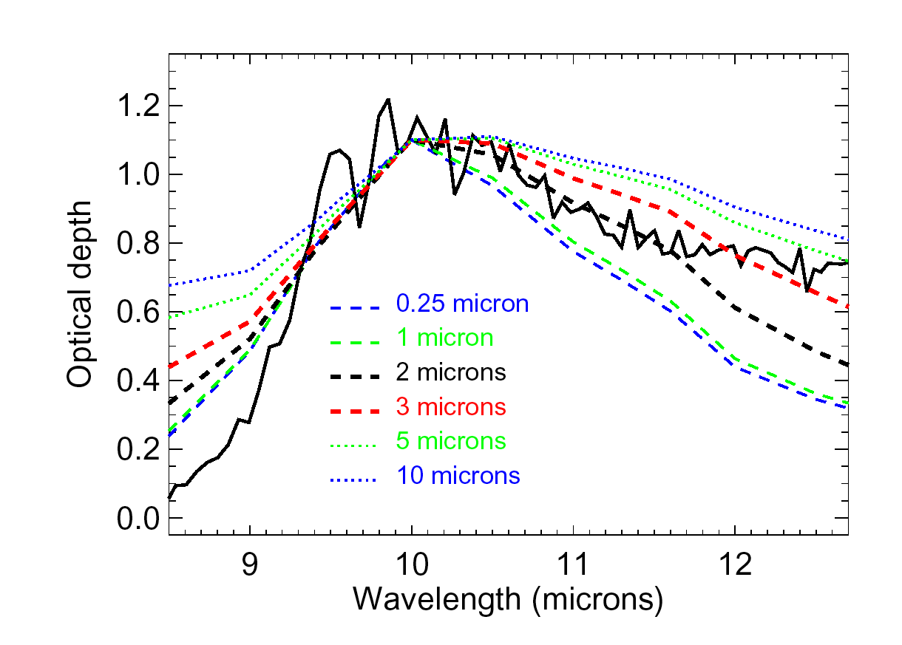
Improving sensitivity and data richness – NGC1068
2004
(2 telescopes)
2020
(4 telescopes)
2022
(4 telescopes)
MACAO-VINCI
GRAVITY
MATISSE
[Wittkowski+2004]
MIDI
[GRAVITY Collaboration 2020, Vermot 2022]
[Gamez Rosas+2022]
[Jaffe+2004]

Slide 15
The french high-angular resolution community
A large and recognized community
~200 people for 90 ETP (2015-2021)
Strong recognition
[Prizes: Academy of Science, Michelson and Fizeau, La Recherche, SF2A, EAS]
ASHRA coordinates the community
Forum of experts of the different fields
Support for R&D, summer schools, workshops,…
http://ashra-insu.fr/
69 in total
Instruments offer a motivating and gratifying training ground

Slide 16
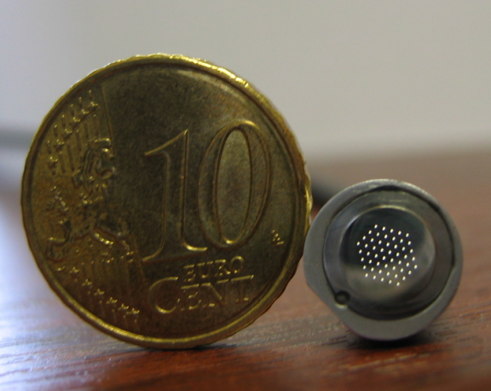
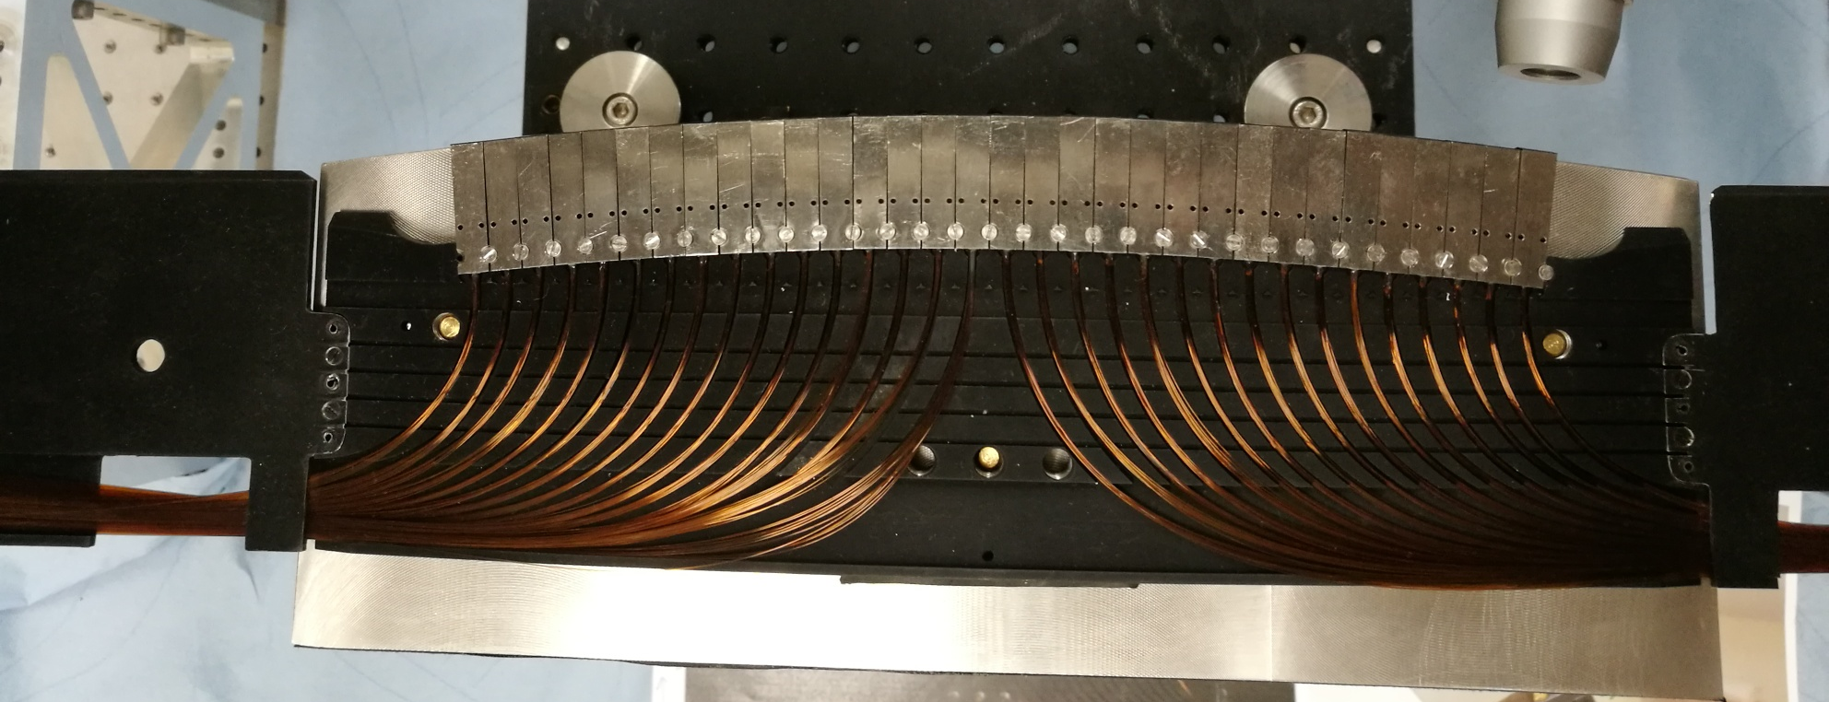
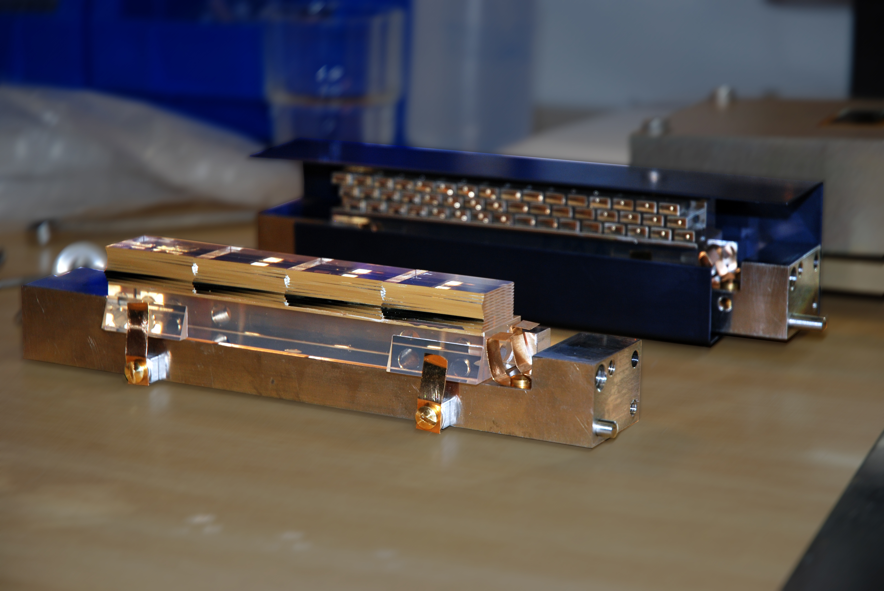
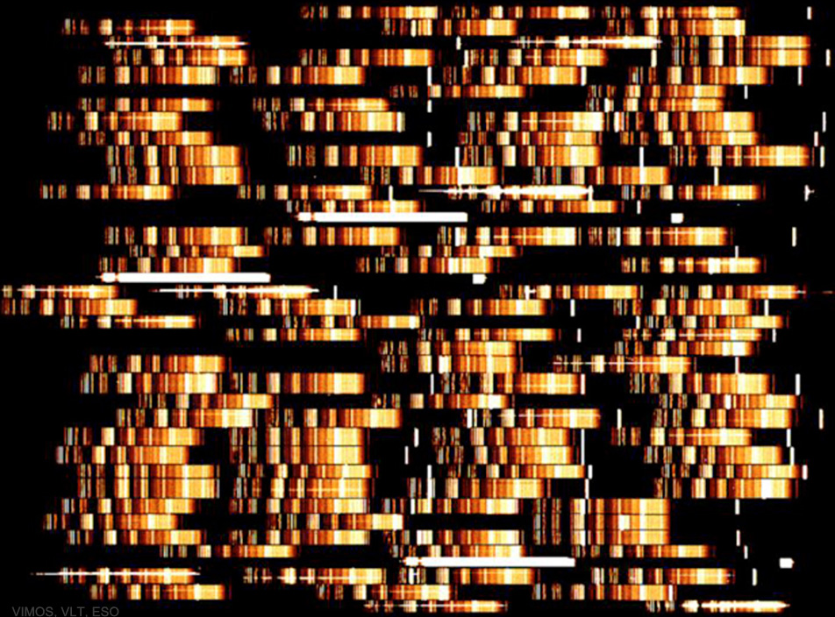
Spectroscopy
64 bundles integrated in one slit of MOONS
Instrument concept, manufacturing, tests, and commissioning
VIMOS (PI), FLAMES-GIRAFFE (PI), X-shooter, MUSE (PI), 4MOST, MOONS (co-PI), HARMONI (co-PI), MOSAIC (PI)
Components: fibers, slicers
➔ SEDI, Winlight
Data reduction, sky subtraction
Galaxies, stellar populations, star formation, surveys (VVDS/VUDS,Gaia, Euclid), Solar system
Concept
On-sky
R&D
MUSE slicers
Data
Science
VIMOS featured images

Slide 17
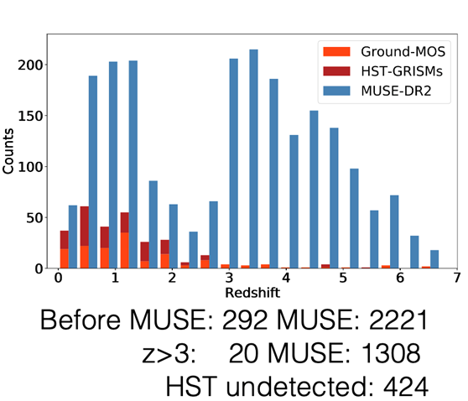
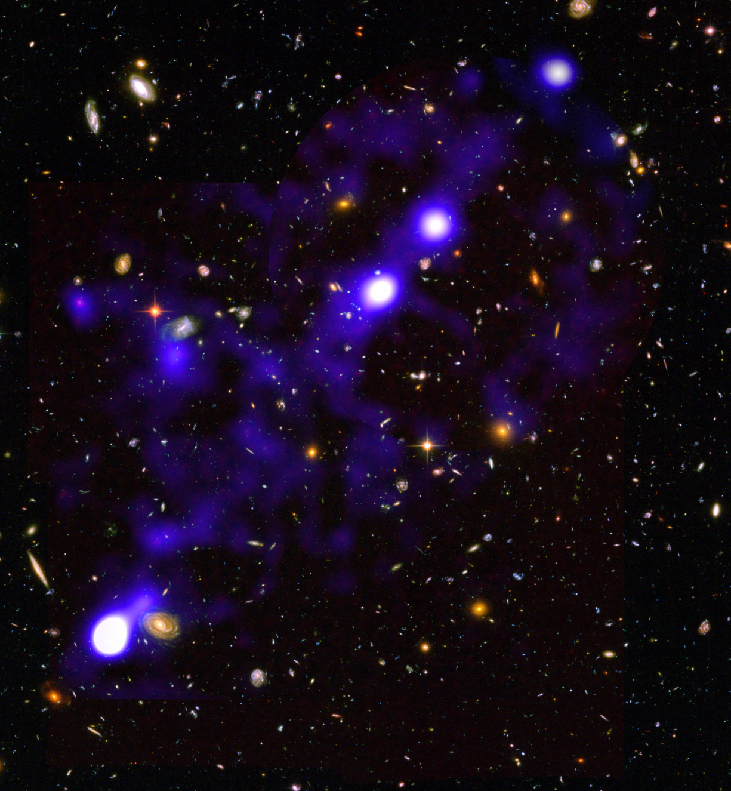
MUSE DEEP FIELDS – beyond hubble
Detection of galaxies at AB>30 and study of the extended ultra faint emission
4.6 Mpc
Circum-galactic medium
Ubiquitous Ly⍺ haloes (z=3-7) surrounding galaxies
[Wisotzki+2018]
Inter-galactic medium
z=3 filament of ionised Ly⍺
[Bacon+2021])
The deepest spectroscopic survey ever: up to 140 hours depth
[Bacon+2022]

Slide 18
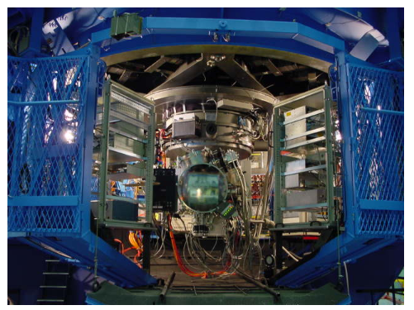
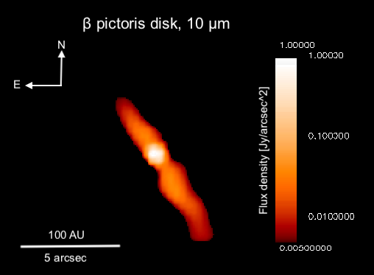
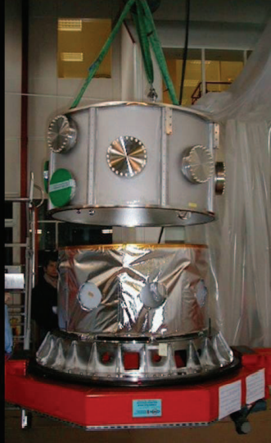
DetectORS
Long-term expertise:
Development/characterization of mid-infrared detectors
Cryogeny (chips, cryomechanisms)
➔ CEA/Irfu, Institut Néel
Heterodyne receivers, correlators, local oscillators, high frequency electronics in the (sub-)millimeter
➔ IRAM, Institut Néel
National coordination for detector developments from near-infrared to sub-millimeter
TIMMI2 on 3.6-m telescope at La Silla
βPic at 10 µm
[Lagage & Pantin, 1994]
VISIR cryostat

Slide 19
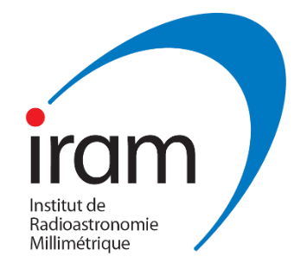
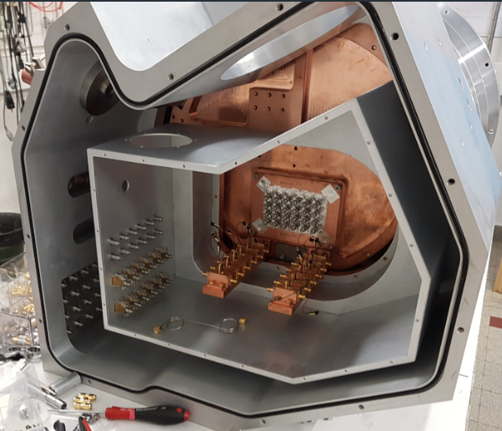
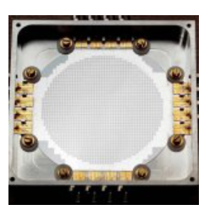
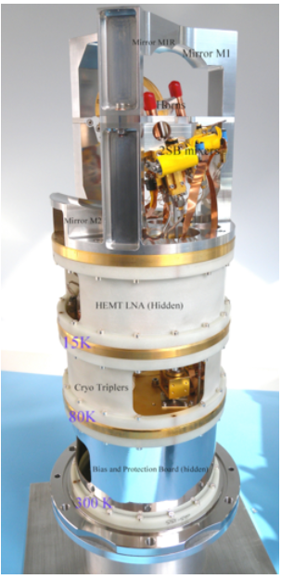
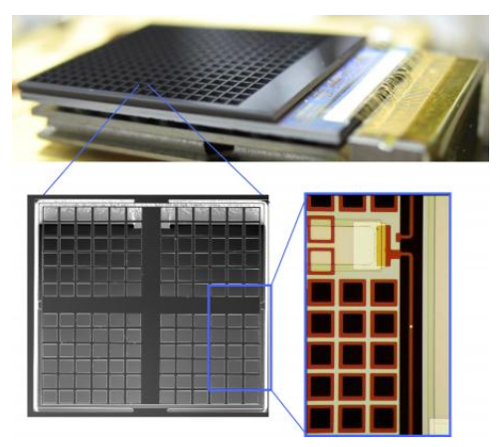
developments in the (sub)-millimeter
Concept
On-sky
Instrument manufacturing
NOEMA and NIKA2 on 30-m IRAM
CONCERTO and ArTéMiS camera on APEX
Band-7 cartridge of ALMA
Components: heterodyne correlators, KIDS array, high-frequency electronics
Data model, online calibration
Artemix database
User support (European ARC, IRAM schools)
CONCERTO on APEX
2000-pixel KIDS array
R&D
Data
https://artemix.obspm.fr/
ALMA band-7 cartridge
Bolometers of ArTéMiS on APEX

Slide 20
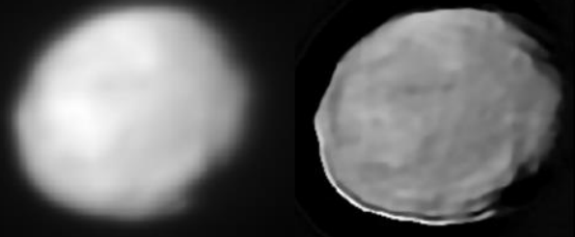
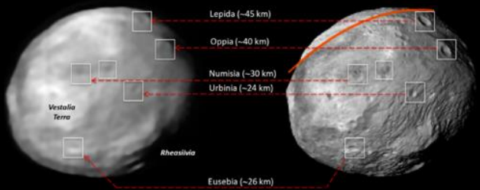
Signal PROCESSING
Challenge: Extract the most out of extremely rich and heterogeneous data sets
Co-conception
Advanced data (post-)processing
Sky subtraction, automatic spectral analysis, Point Spread Function
(PSF) deconvolution/reconstruction, inverse problem approach
Artificial Intelligence breakthrough
Joint analysis of multivariate data, noisy data
Massive data flows, extraction from huge archives
Real-time control
Data accessibility
Data centers (SPHERE-DC, Artemix, …) in close collaboration with ESO
Standard, interoperability, virtual observatory (CDS)
Instrumental Research
SPHERE
[Fétick+2019; LP: Vernazza+]
DAWN
Service to the community
VESTA

Slide 21
On-sky
Data
Science
Partner-ships
R&D
Instruments
Roadmap

