Slide 1
FEET ON THE GROUND EYES ON THE SKY
The ESO Instruments

Slide 2
Why are instruments so important?

Slide 3
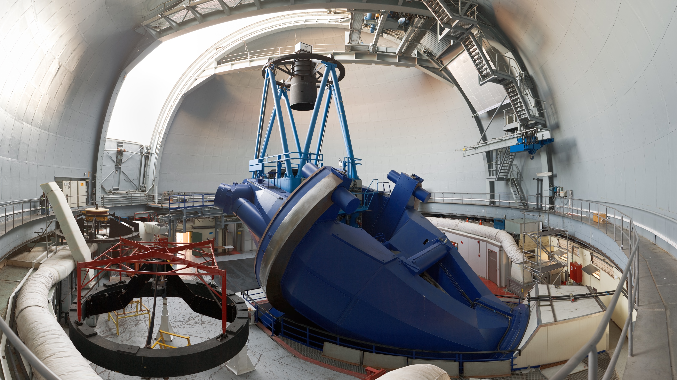
The 3.6-m telescope
Inaugurated in 1976
Massive
Ancient
Still relevant in the VLT era

Slide 4
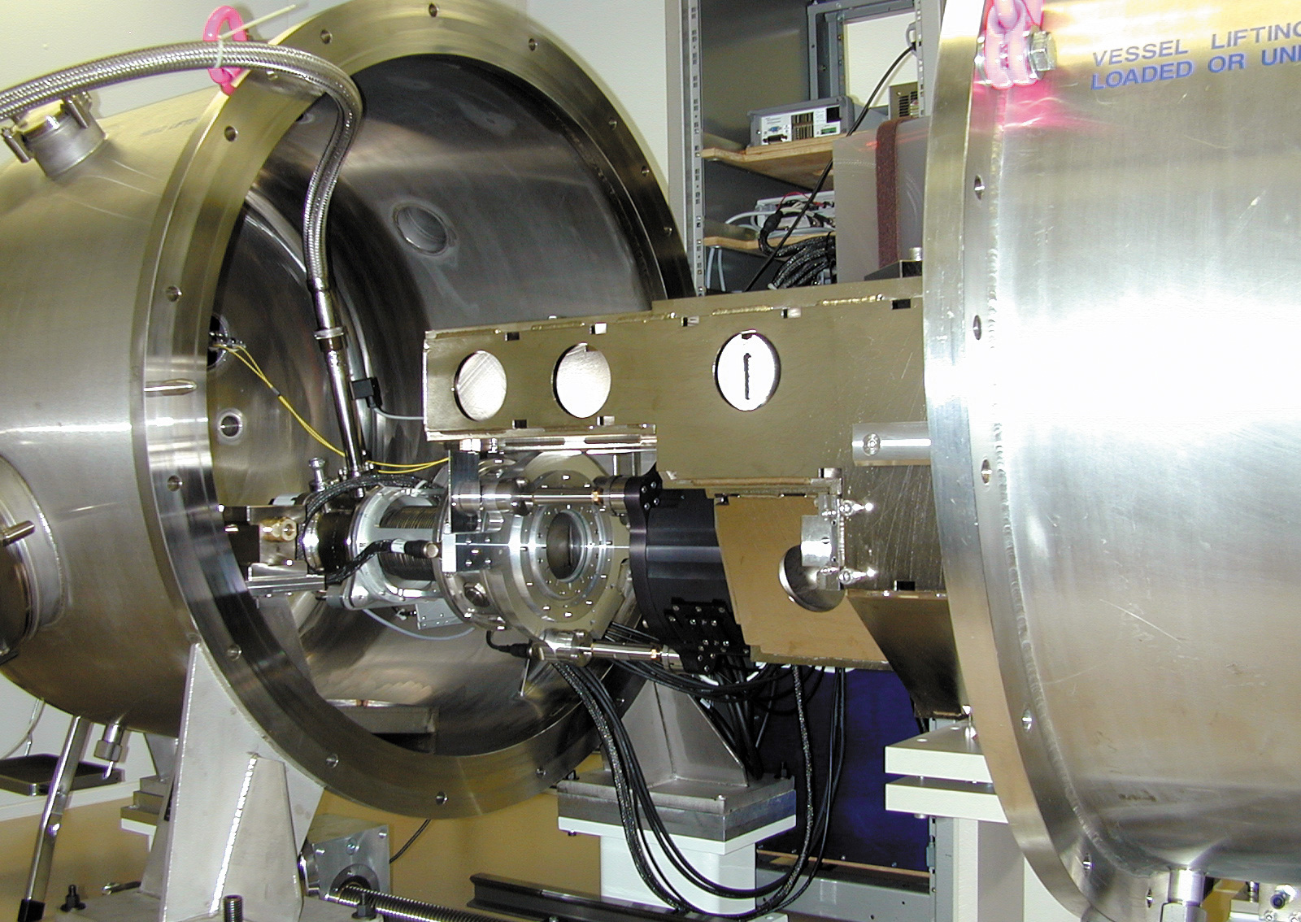
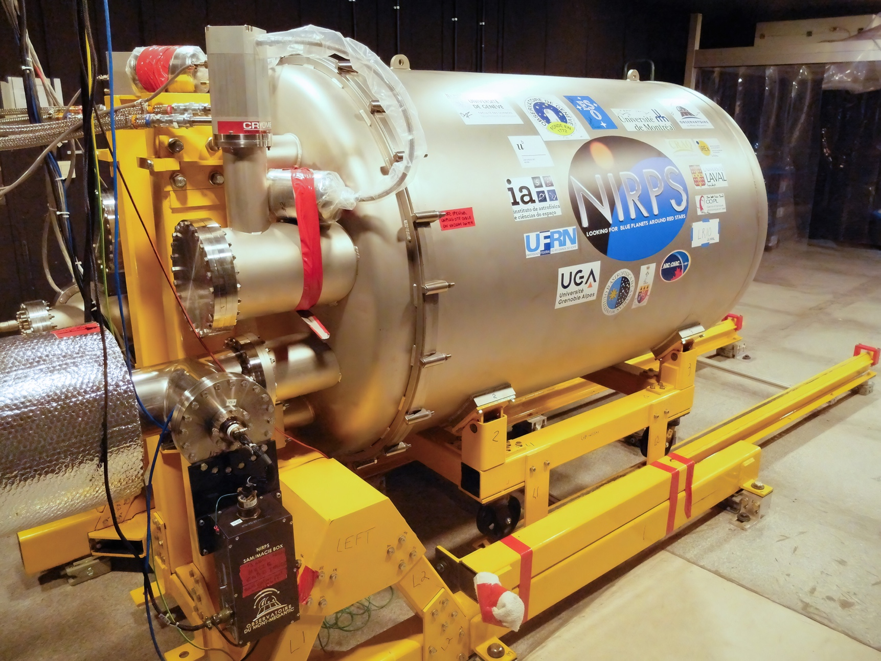
HARPS
NIRPS

Slide 5
Instruments in the VLT era

Slide 6
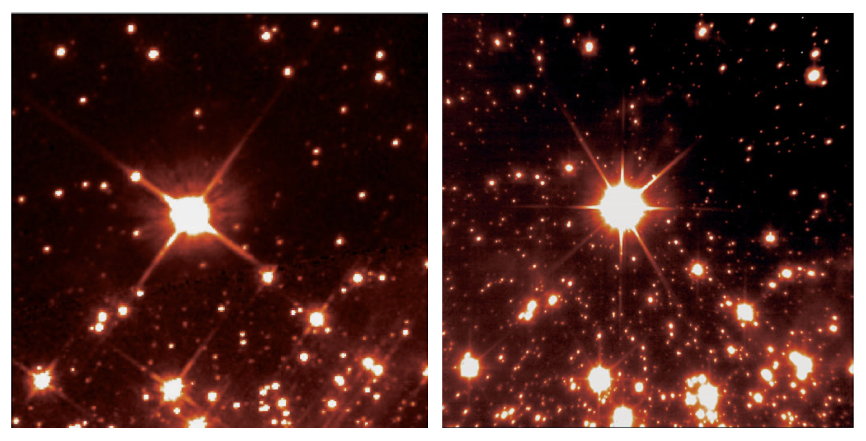
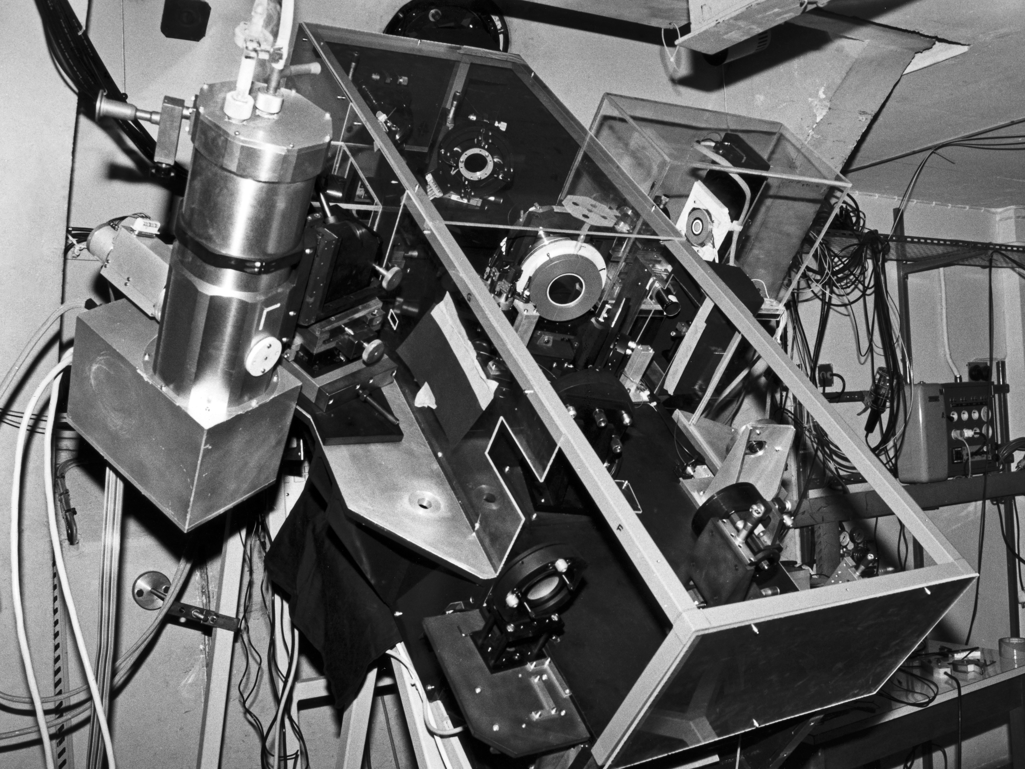
The emergence of AO
HST NACO
ESO Messenger 107 March 2002
Already before the VLT was completed the importance of AO had been established
France led the way on the 3.6m with COME-ON, COME-O+ and ADONIS
This followed through to the first generation of VLT instruments with NAOS/CONICA and MACAO feeding CRIRES and SINFONI

Slide 7
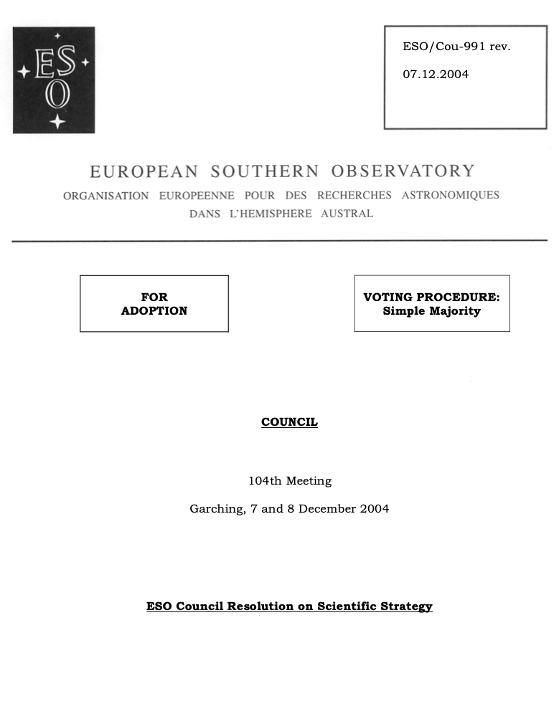
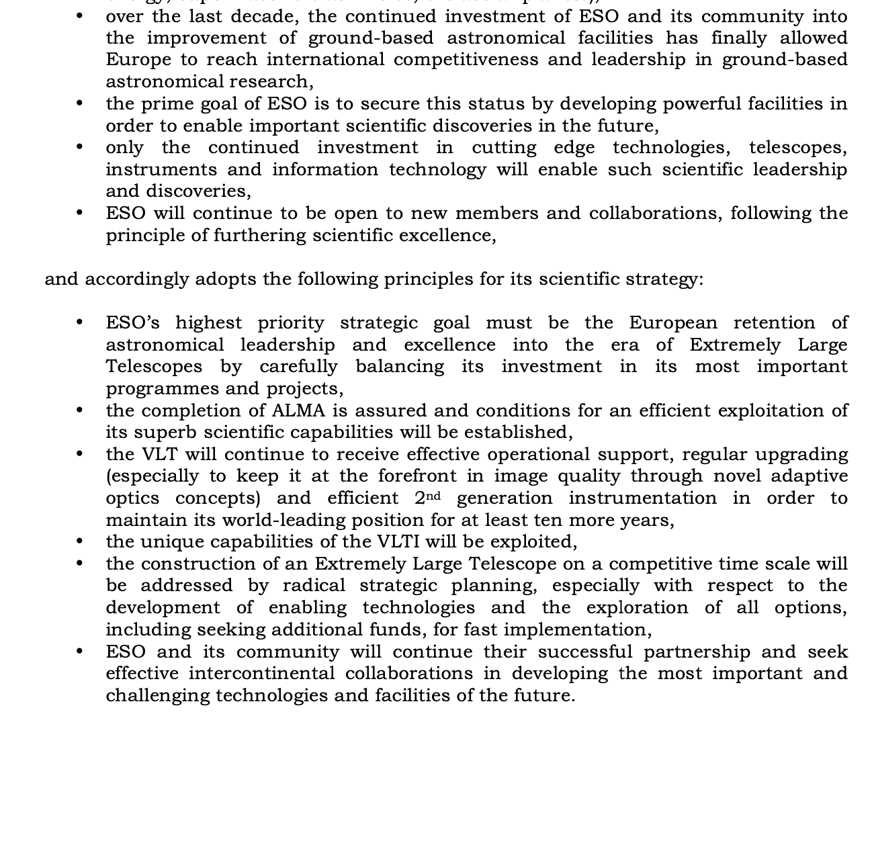
Council’s strategic direction 2004
The VLT will continue to receive effective operational support, regular upgrading (especially to keep it at the forefront in image quality through novel adaptive optics concepts) and efficient 2nd generation instrumentation in order to maintain its world-leading position for at least ten more years,
The unique capabilities of the VLTI will be exploited

Slide 8
Guaranteed Time Observations
ESO’s secret sauce!
Introduced for the VLT in the time of Harry van der Laan
ESO pays (most of) the cost of the hardware and the institutes pay the costs the FTEs
The concept of rewarding the instrument teams with guaranteed time was common for space instruments but not for ground based instruments
Its application at ESO has had a profound impact on ESO’s instrumentation and success on the global stage
200-300 nights of UT time is a huge driver
Hardware costs quite stable, FTE costs scale with delay (typical delay ~1.5)
Compare with US where there is a lot private money going into developing telescopes

Slide 9
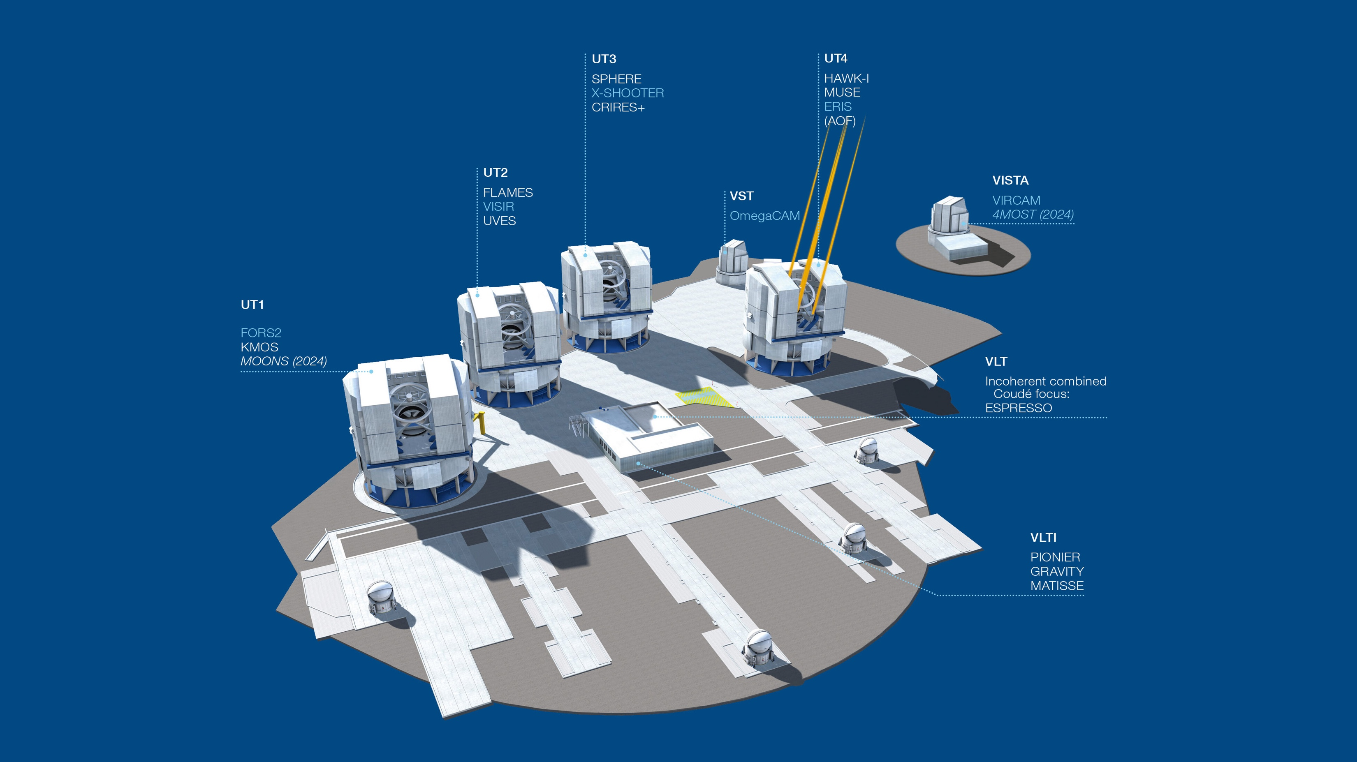
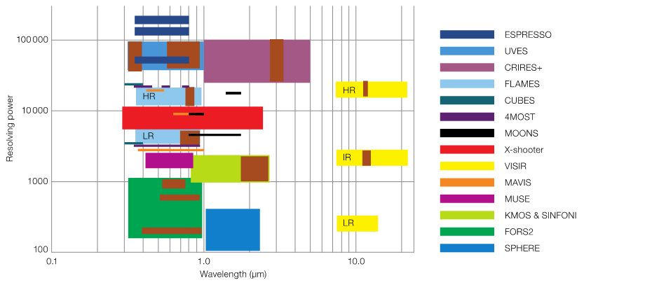
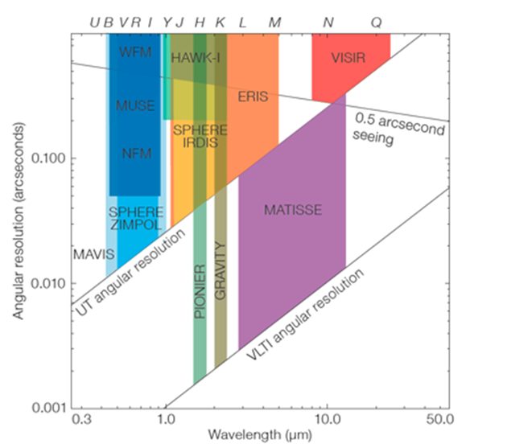
The Current Suite

Slide 10
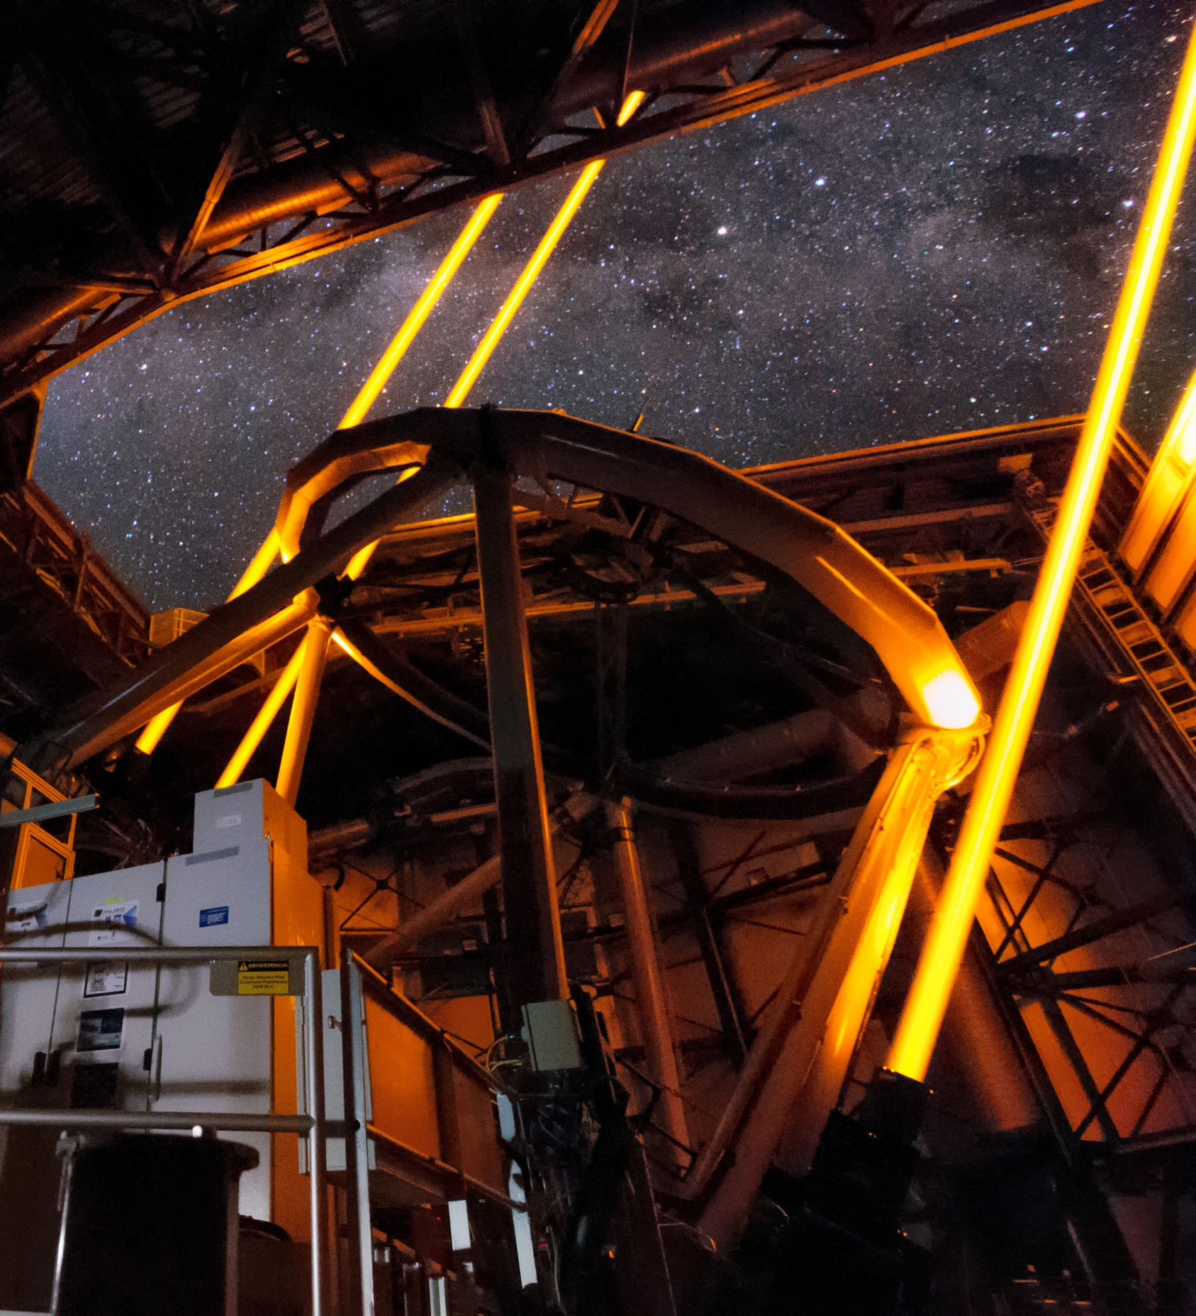
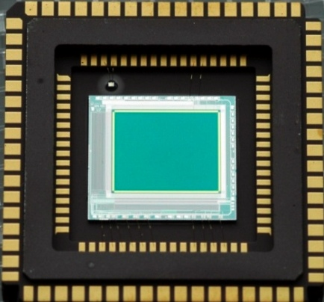
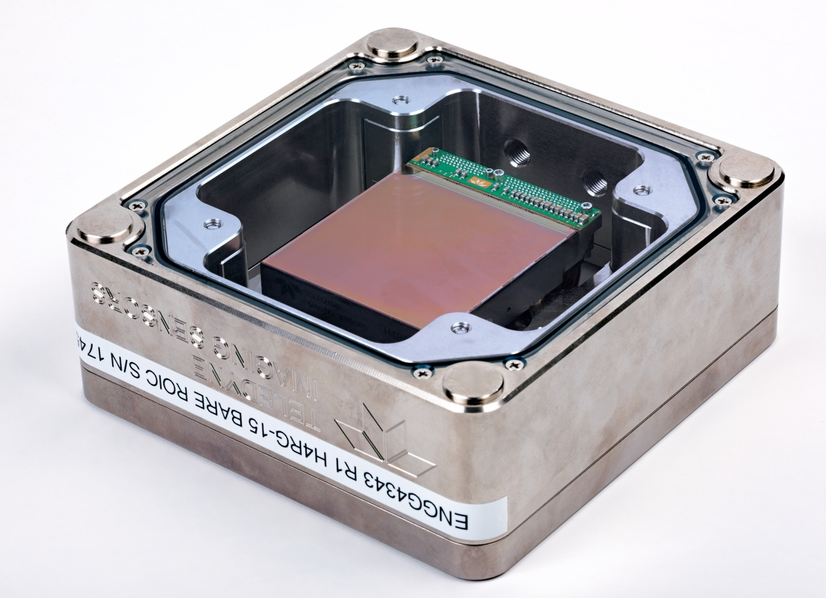
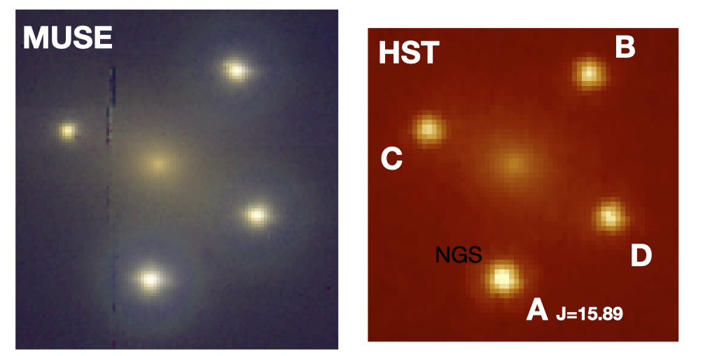
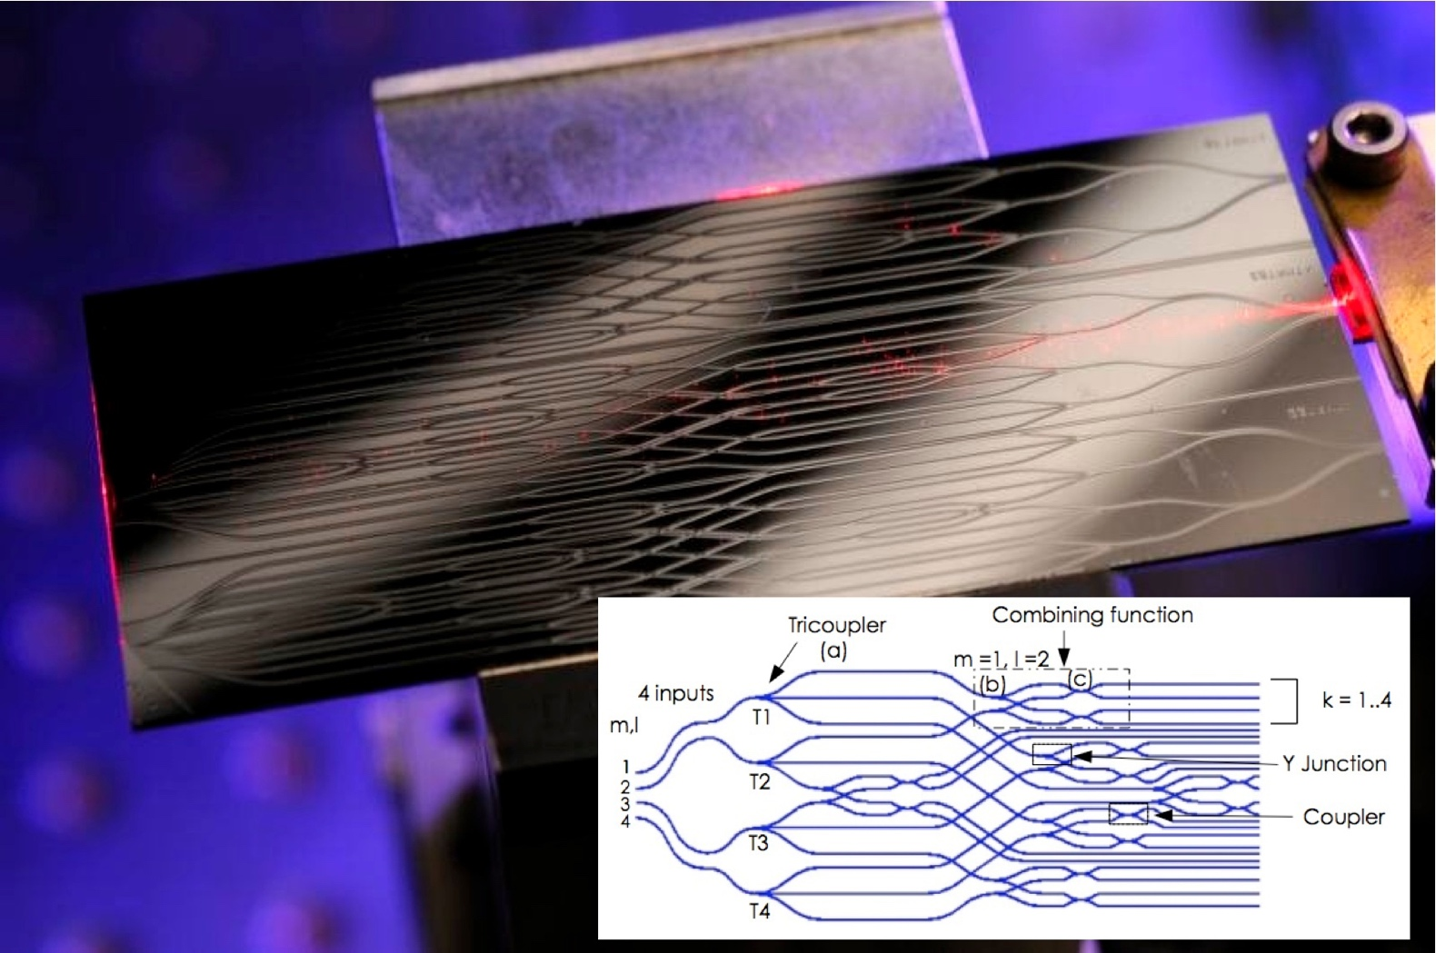
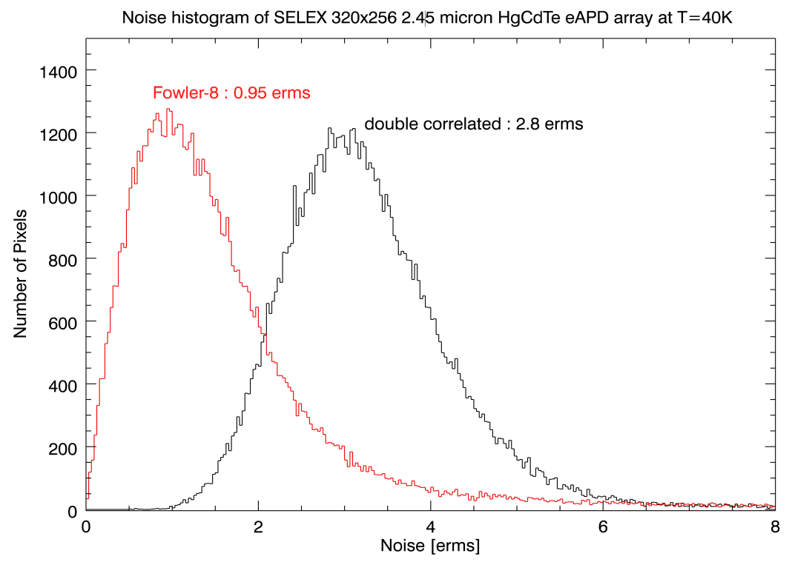
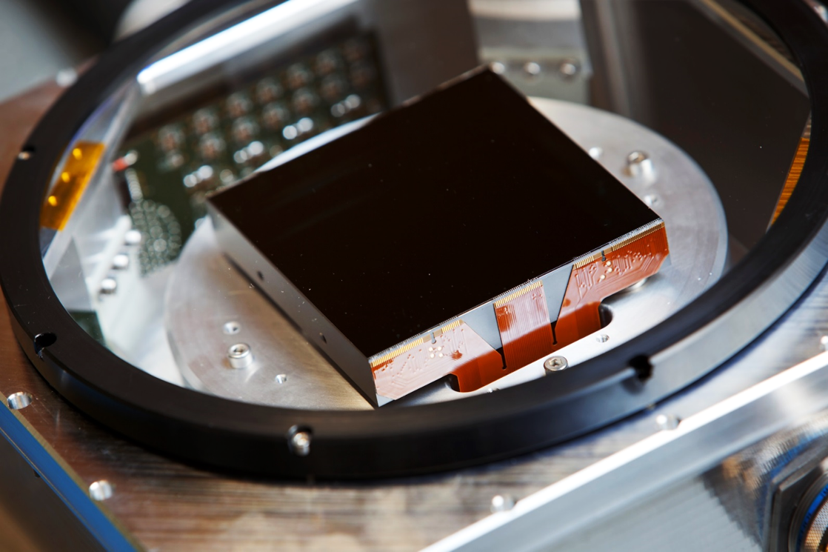
Disruptive Technologies
20W fibre Raman lasers
Opening up new opportunities
320x256 pixels
<1e read noise
300Hz - 1kHz frame rate
The first revolution was CCDs and IR arrays
High speed, low noise IR arrays SAPHIRA detectors (LEONARDO)
AO and interferometry
GRAVITY, IRLOS
Integrated optics
PIONIER and GRAVITY
Solid State Na Laser Guide stars
AOF, MUSE, ERIS, MAVIS, GRAVITY+, ELT, (Keck, TMT…)
MOONS Hawaii 4RG
IRLOS for MUSE:
tip/tilt using SAPHIRA eAPDS
From 7<Jmag<15 to the upgrade 0.5<Jmag<19
ESPRESSO E2V 9kx9k CCD

Slide 11
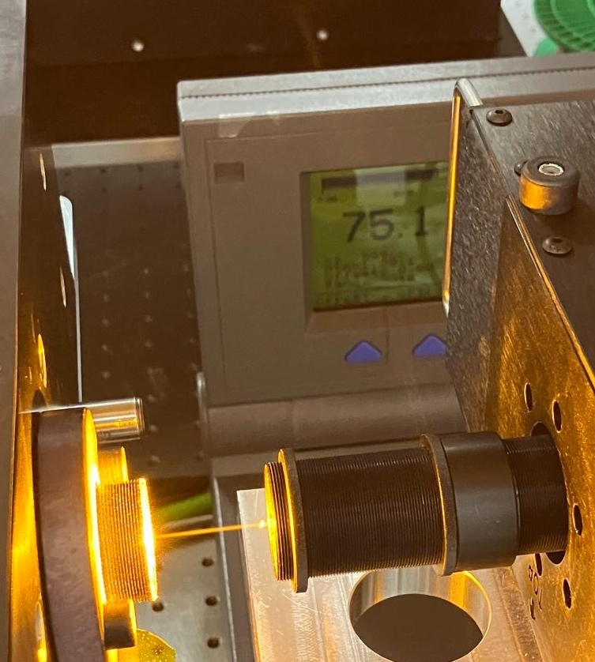
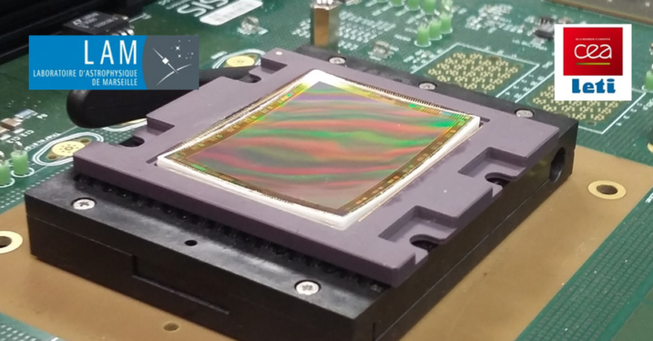
Disruptive Technologies
Future opportunities
75W in the lab
Solid State Na Laser Guide stars
More power
All sky LGS
Laser frequency combs
Longer life, larger coverage
Curved detectors

Slide 12
Science driven
Innovation for the sake of the Science not the Engineering
Another fundamental feature of the GTO policy
Innovation and risk taking is done under the leadership of the PI with the science return being the primary driver
Massive impact on 2nd Generation instrumentation and beyond
SPHERE
GRAVITY
MATTISE
ESPRESSO
MUSE

Slide 13
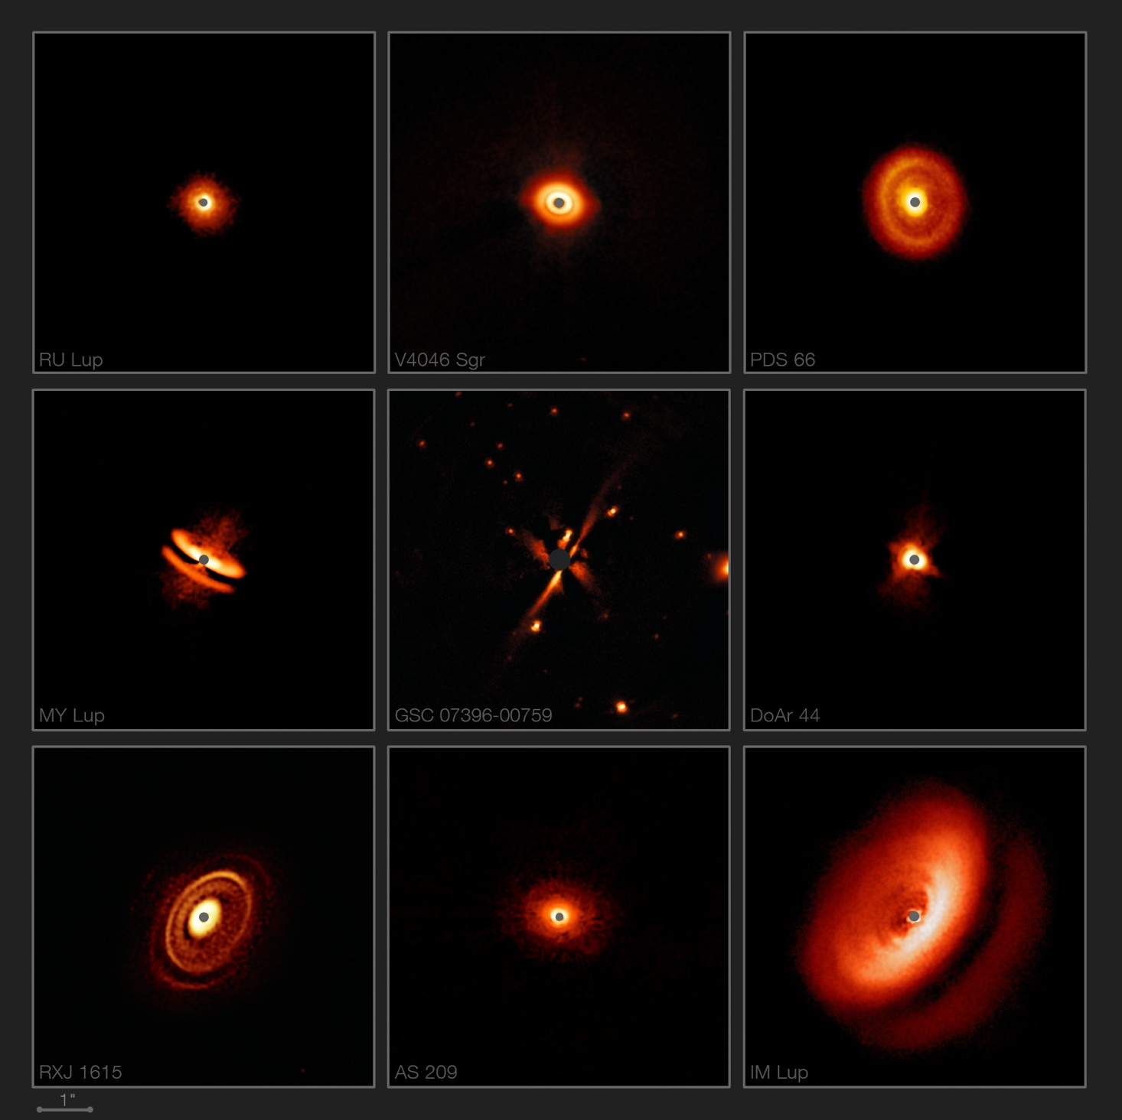
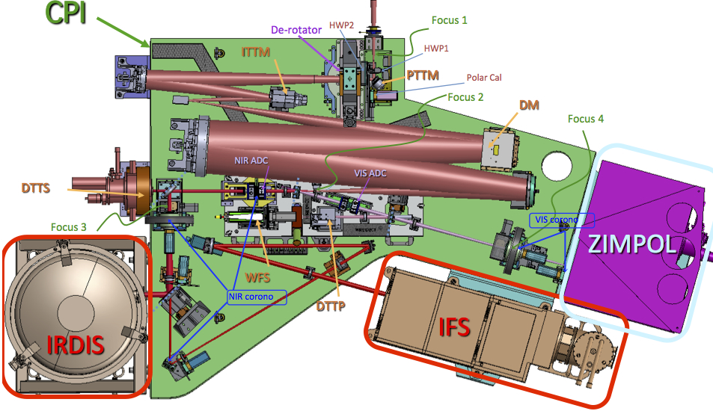
SPHERE
PI: Jean-Luc Bezuit
IRDIS, IFS, and ZIMPOL
Builds on the heritage of all the past AO instruments to to provide the highest image quality and contrast performance
Contrast Gain up to 5 mag wrt current instrumentation (10⁻⁶-10⁻⁷)
Extreme AO (SR ~ 90% in H-band)
Coronagraphy at small inner working angles: 0.1″ – 3″

Slide 14
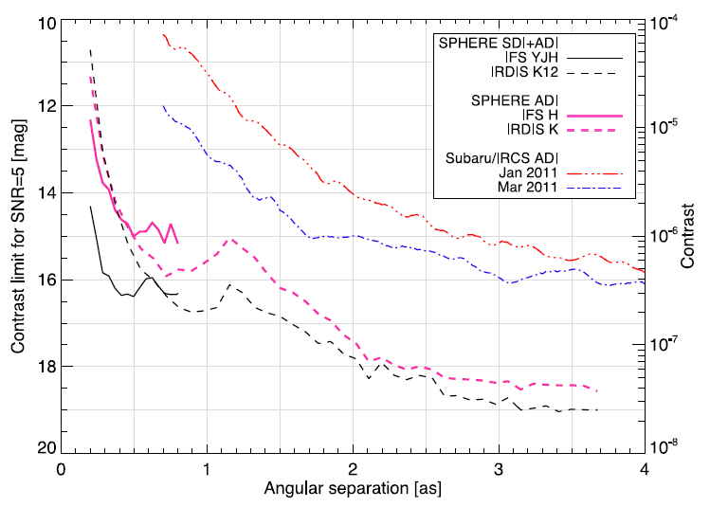
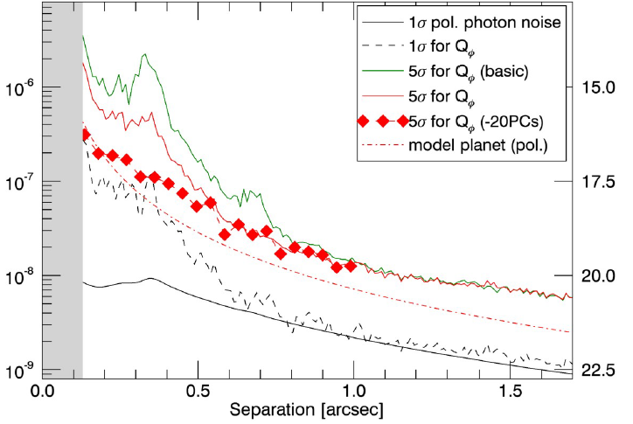
SPHERE
IRDIS and IFS in the NIR
Sirius, Vigan et al. 2015
ZIMPOL in the optical (R-band)
Alpha Cen A, Hunziker et al. 2020
Polarized Intensity! Contrast for fully polarized planet

Slide 15
SPHERE
PI: Jean-Luc Bezuit
IRDIS, IFS, and ZIMPOL
Builds on the heritage of all the past AO instruments to to provide the highest image quality and contrast performance
Contrast Gain up to 5 mag wrt current instrumentation (10⁻⁶-10⁻⁷)
Extreme AO (SR ~ 90% in H-band)
Coronagraphy at small inner working angles: 0.1″ – 3″
Establishes a foundation for future ELT PCS

Slide 16
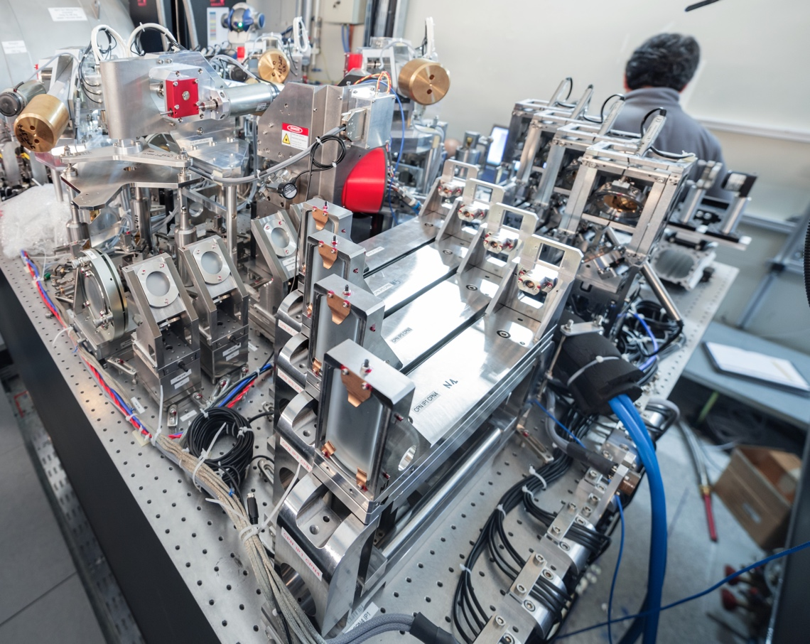
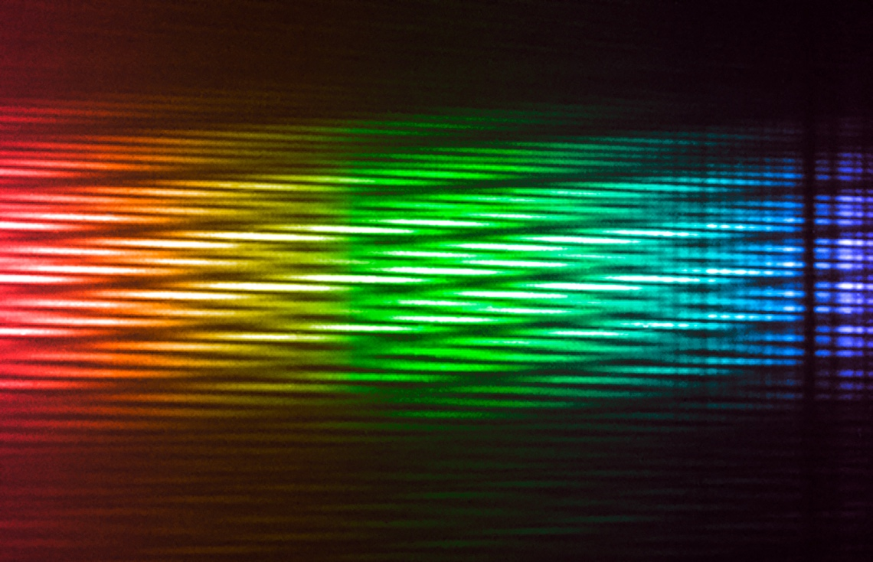
MATISSE
PI: Bruno Lopez
VLTI mid-infrared imaging spectro-interferometer
Operating with all 4 UTs or ATs
Multi-axial beam combination, closure phase imaging
R~30, 500, 1000, and 3500 (L/M) and R~30, 220 (N)
GRAVITY as a fringe tracker

Slide 17
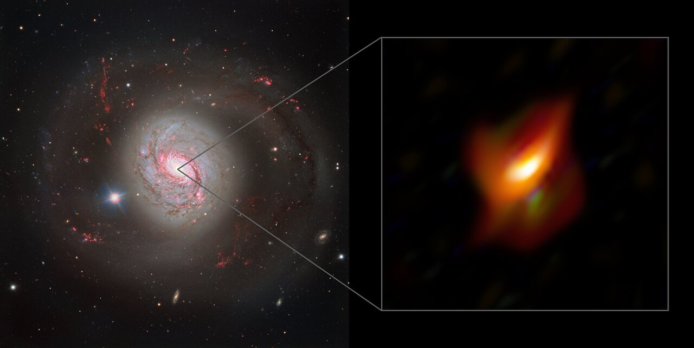
MATISSE
NGC 1068

Slide 18
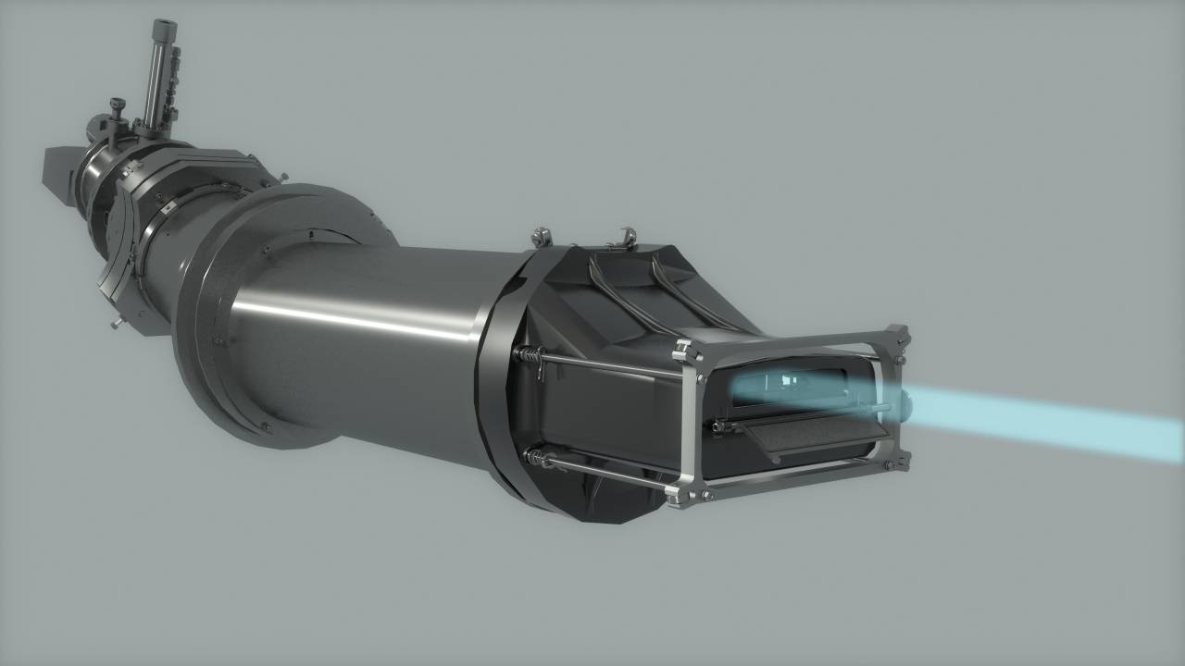
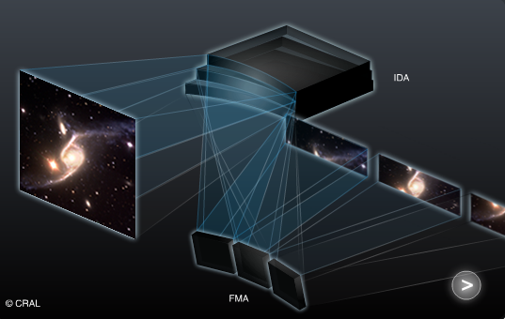
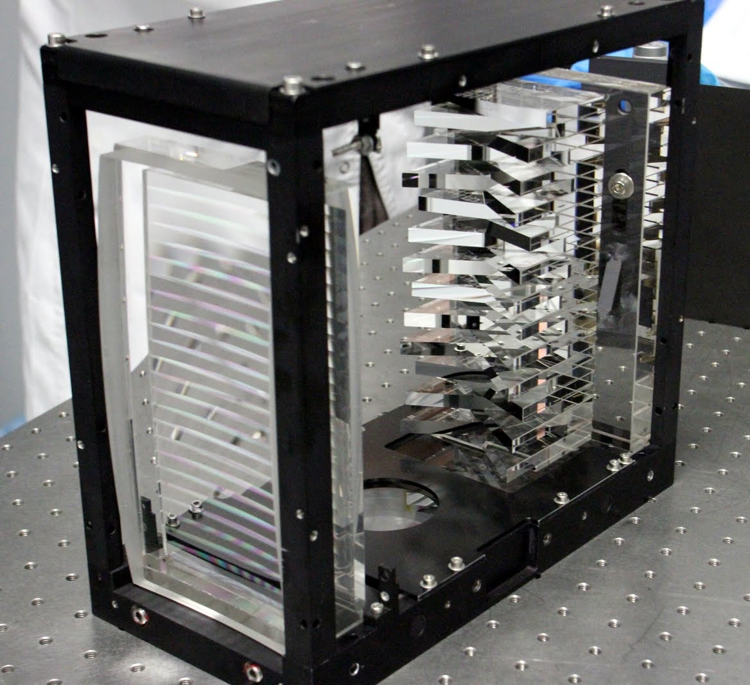
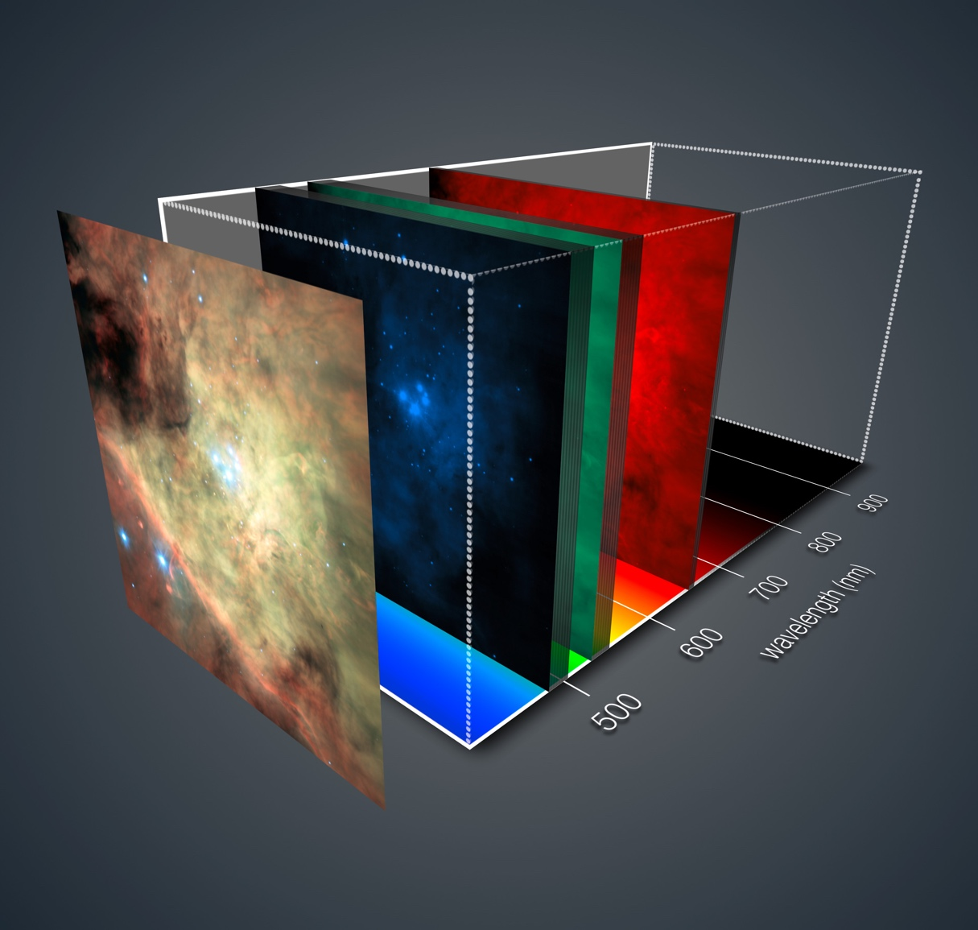
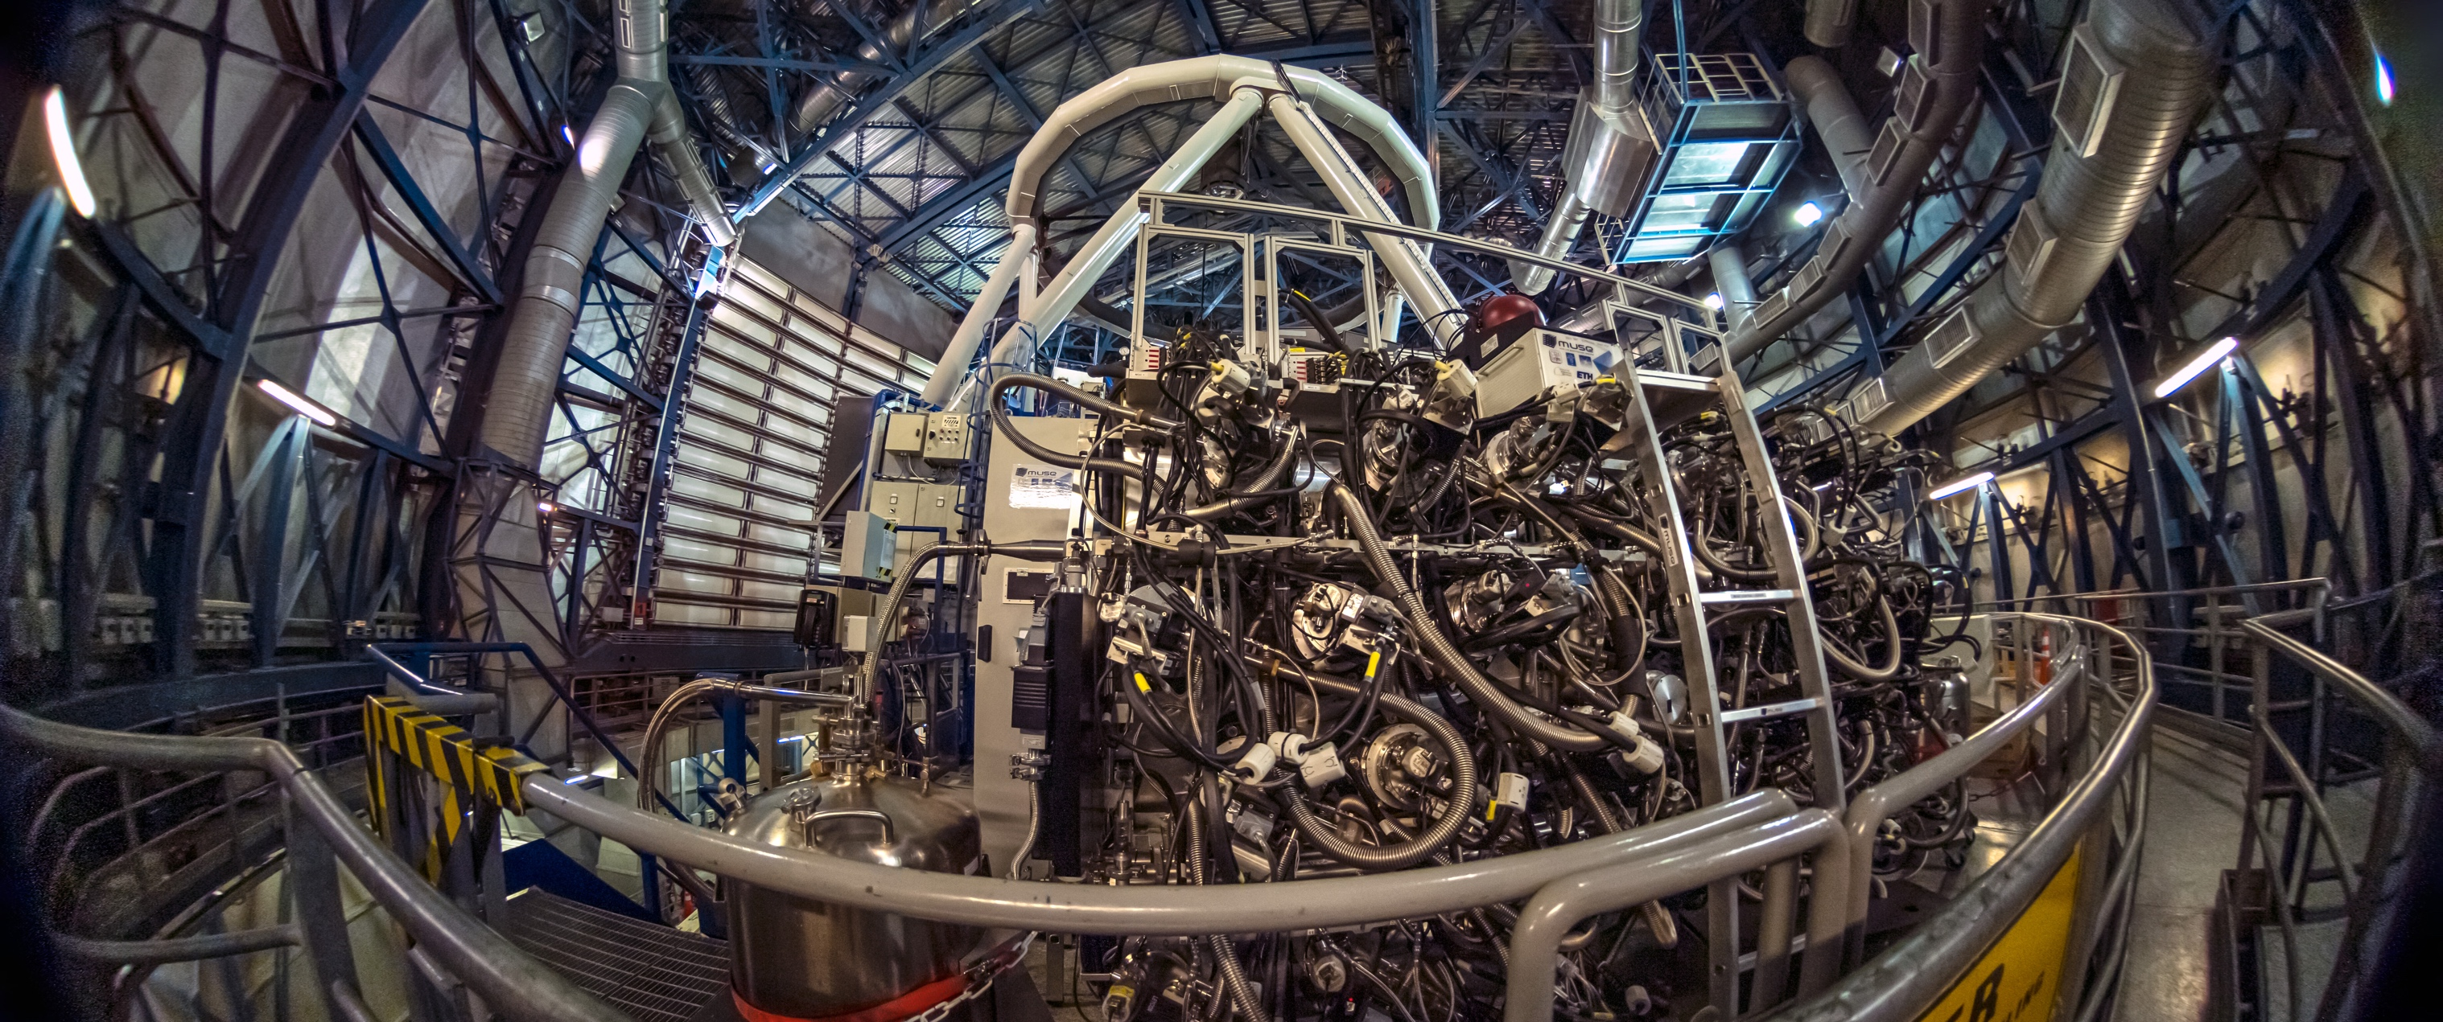
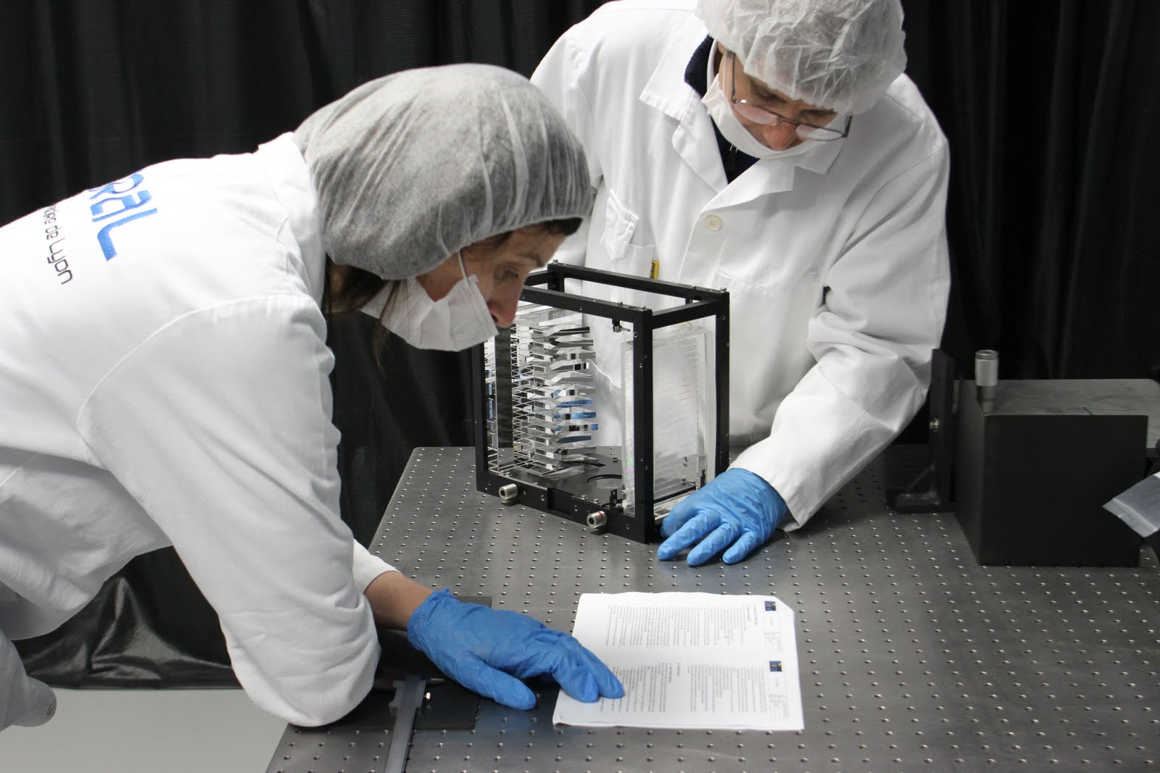
MUSE
PI Roland Bacon
Panoramic integral-field spectrograph in the visible
Redefines MOS
Take a 1 arcmin field and simply chop it up into 24 pieces and feed each into an independent IFU spectrograph
465–930 nm
1x1 arcmin field (WFM – GLAO)
7.5" x 7.5" (NFM – LTAO)
Developed in parallel with the AOF
Provided science direction for the AOF
Winlight Optics
CCD 4k²
VPHG
Slicer
Camera f/2
Collimator

Slide 19
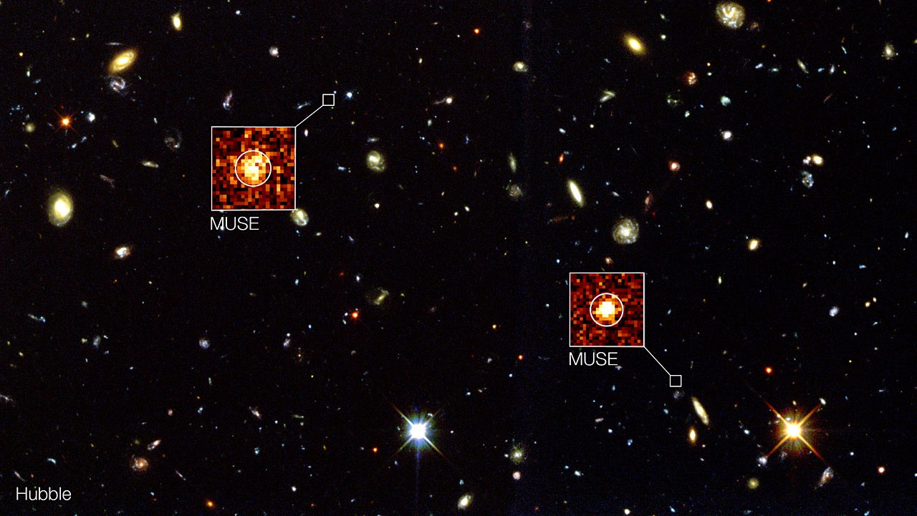
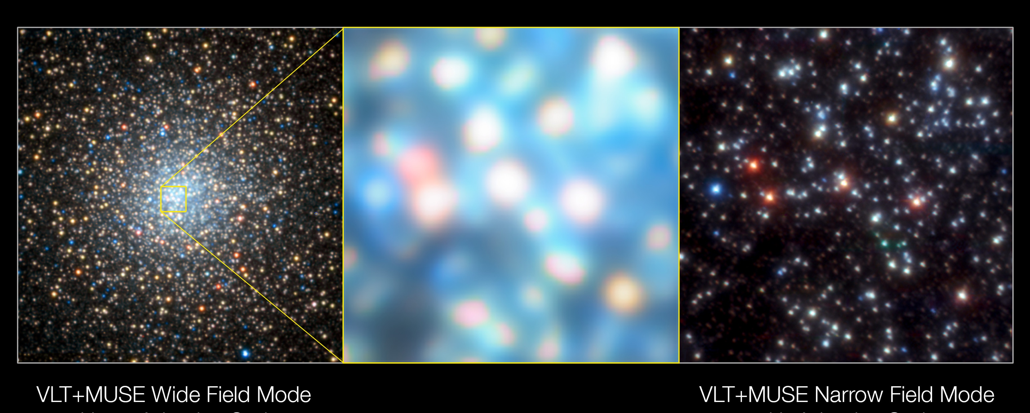
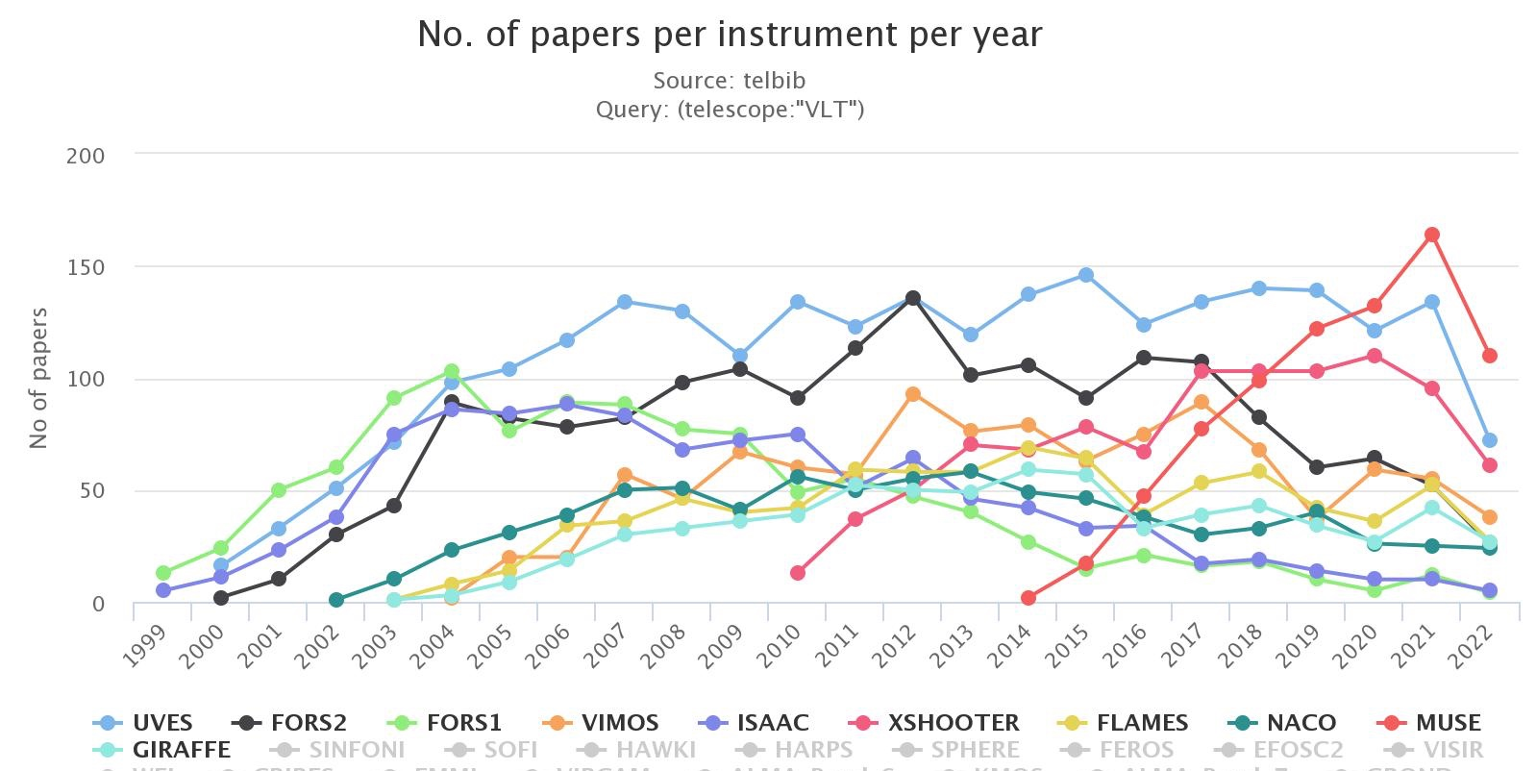
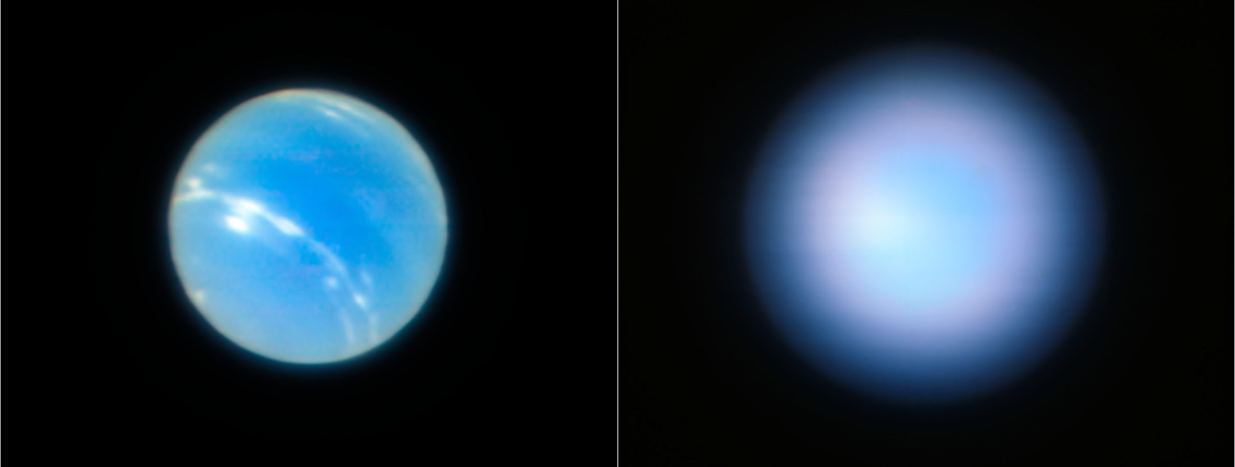
MUSE
PI Roland Bacon
Neptune NFM

Slide 20
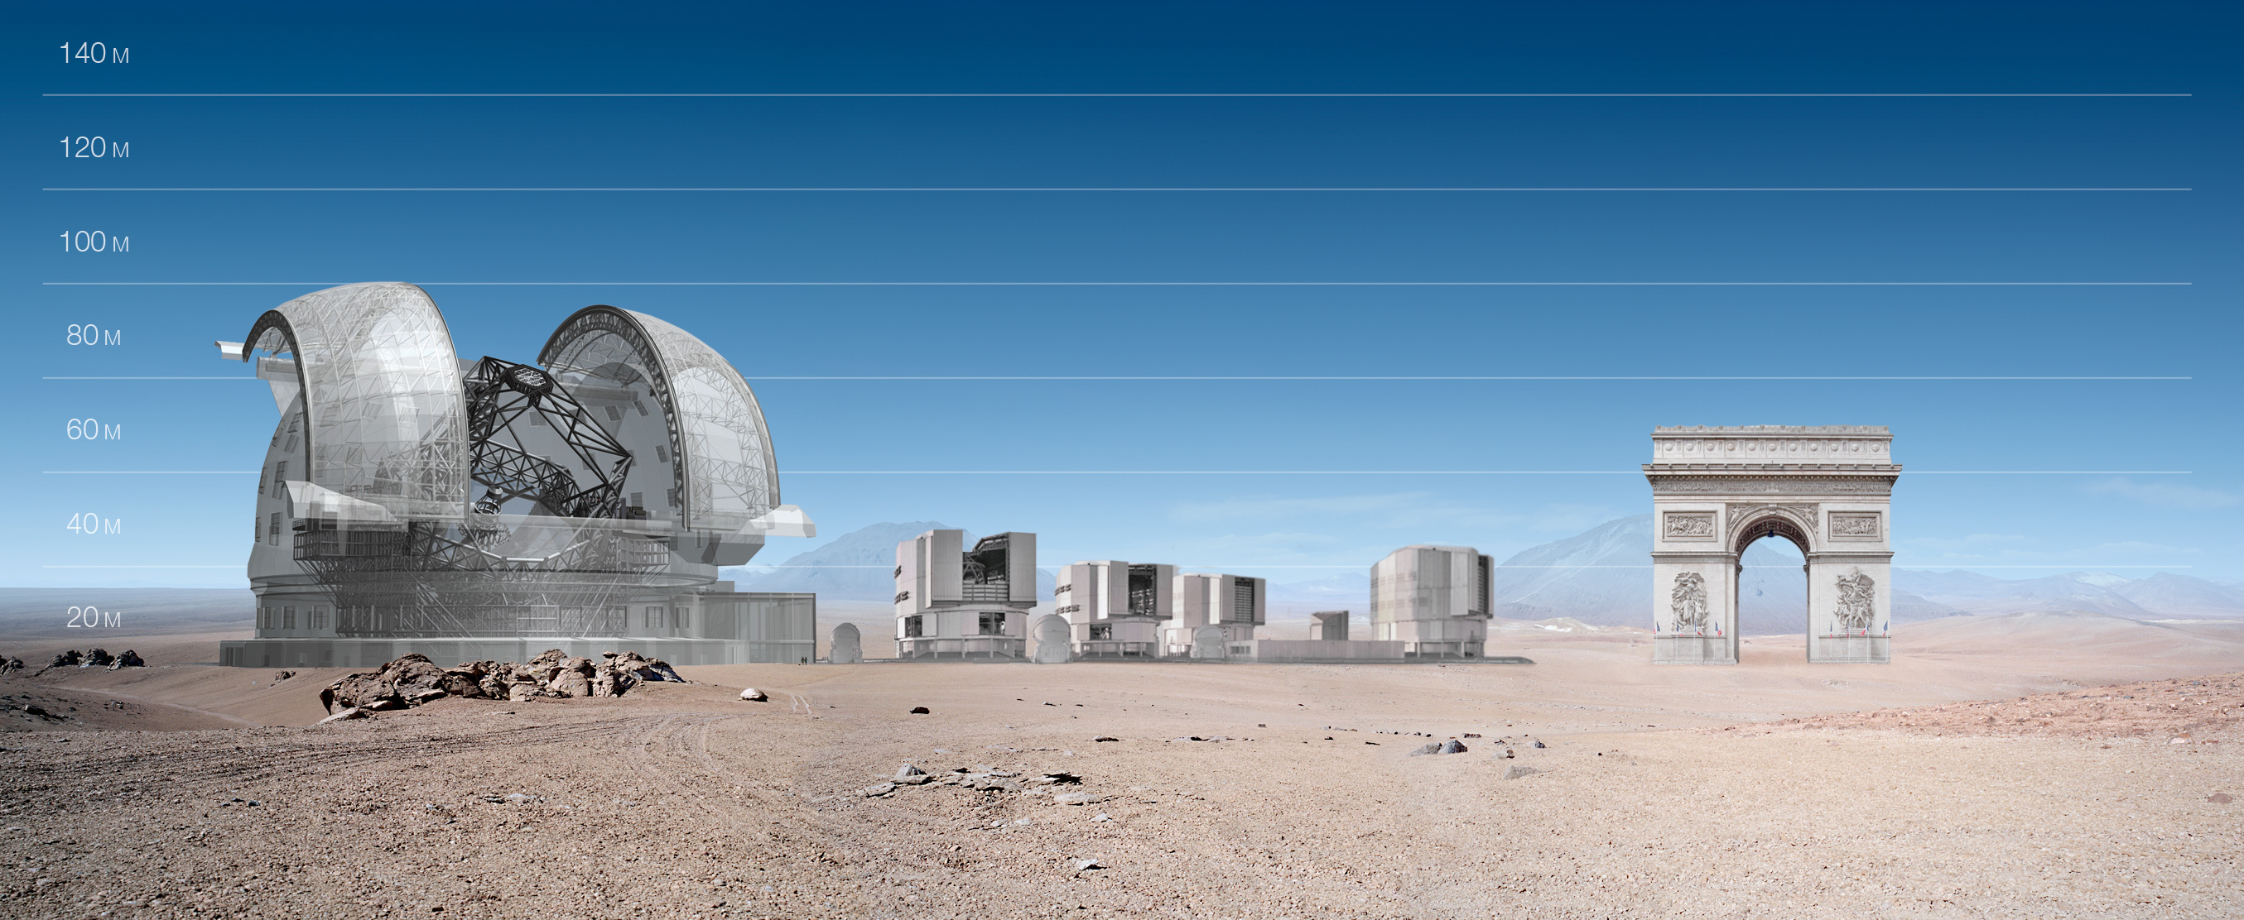
The ELT – challenges of a new scale size
What scales, what doesn’t?

Slide 21
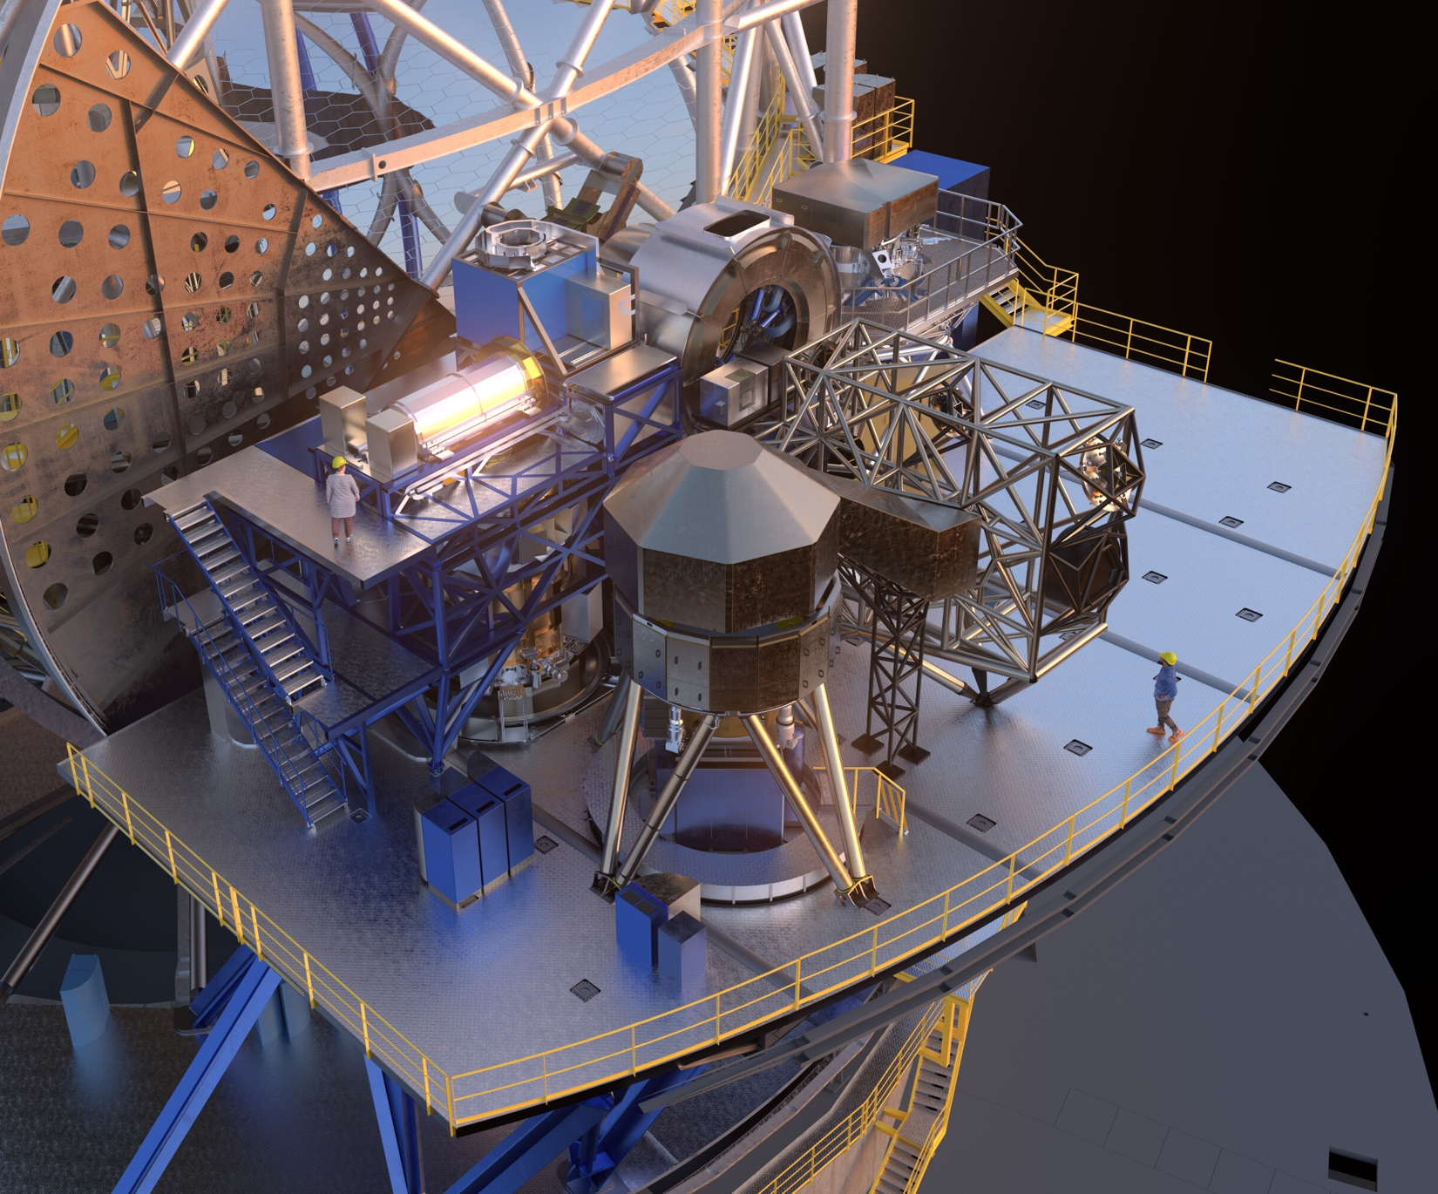
ELT Instruments
A few thoughts on the challenges ahead…
The complexity of the ELT instruments is high
Scales with the number of members of the consortia
The maturity of the interfaces
The size of the instruments
The consortia are large
Many hundreds of FTEs as opposed to a couple of hundred
Estimates made at the end of Phase A (conceptual design level) are too uncertain
30% error of 700 FTEs is dangerous
MOSAIC will be re-evaluated at the end of Phase B

Slide 22
ELT Instruments
A few thoughts on the challenges ahead…
ESO has to be more involved than originally planned
Simultaneously more formal (Systems Engineering) and collaborative
The VLT model is a good one
Together we can face the challenges to come

Slide 23
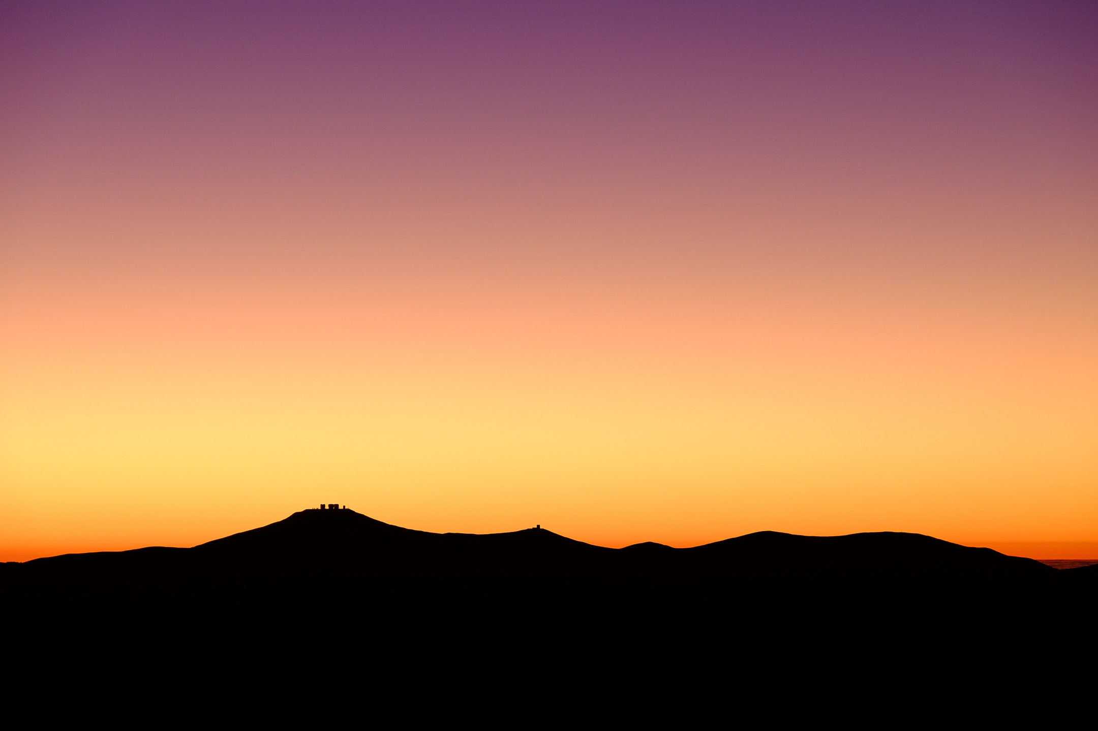
Thank you!
Adrian Russell
ESO Director of Programmes

Slide 25
French Contribution
Across La Silla, Paranal and ELT, France has contributed to 57% of all ESO instruments and played a leading role or PI role in 35%
La Silla 3.6m
TIMMI, COME-ON, COME-ON-PLUS, ADONIS
HARPS, NIRPS
VLT
NAOS, VIMOS, FLAMES/GIRAFFE, VISIR, X-shooter, SPHERE, MUSE, (BlueMUSE to follow)
MOONS, MAVIS, 4MOST
VLTI
AMBER, VINCI, MIDI, PIONIER, MATISSE
GRAVITY, GRAVITY+
ELT
HARMONI, (MOSIAC to follow)
MICADO, METIS, MORFEO, (ANDES to follow)
Notes:
Leading/PI roles shown in Blue on all the slides
ANDES is the new name for HIRES, MORFEO the new name for MAORY

Slide 26
Thematic Sequences
Multi Object Spectrographs and surveys
VIMOS
GIRAFFE
MUSE
MOONS
4MOST
AO
COME-ON
COME-ON-PLUS
ADONIS
NAOS
SPHERE
MUSE
MAVIS
MICADO
HARMONI
MORFEO
VLTI
AMBER
VINCI
MIDI
PIONIER
MATISSE
GRAVITY
GRAVITY+
MID-IR
TIMMI
VISIR
METIS
High Stability planet hunters
HARPS
NIRPS
X-shooter

Slide 27
French Contribution
Across La Silla, Paranal and ELT France has contributed to 57% of all ESO instruments and played a leading role/PI role in 35%
Notes:
Leading/PI roles shown in Blue.
ANDES is the new name for HIRES, MORFEO the new name for MAORY

Slide 28
La Silla 3.6m
TIMMI
PI: Pierre-Olivier Lagage
COME-ON, COME-ON-PLUS
Prototypes Piérre Lena lead
ADONIS
Jean-Luc Beuzit lead
HARPS
Jean-Pierre Sivan, Jean-Loup Bertaux
NIRPS
Xavier Delfosse

Slide 29
VLT
NAOS
Gerard Rousset / Anne Marie La Grange
VIMOS
PI: Olivier Le Fèvre
FLAMES/GIRAFFE
Co-PI: Francois Hammer
VISIR
PI: Pierre-Oliver Lagage
X-shooter
Co-PI: Francois Hammer
SPHERE
PI: Jean-Luc Beuzit
MUSE
PI: Roland Bacon
(BlueMUSE to follow)
PI: Johan Richard
MOONS
Co-PI: Hector Flores
MAVIS
Co-I: Benoît Neichel
4MOST (VISTA)
Co-I: Johan Richard

Slide 30
VLTI
AMBER
PI: Romain Petrov
VINCI
PI: Vincent Coudé du Foresto
MIDI
Co-PI: Guy Perrin
PIONIER
PI: Jean-Philippe Berger then Jean-Baptiste Lebouquin
MATISSE
PI: Bruno Lopez
GRAVITY
Co-Is: Guy and Karine Perraut
GRAVITY+
Co-I: Thibaut Paumard, Jean-Baptiste Lebouquin and Florentin Millour

Slide 31
ELT
HARMONI
Deputy PI: Benoît Neichel
(MOSIAC to follow)
PI: Roser Pello
MICADO
CoI: Yann Clenet
METIS
Co-I: Eric Pantin
MORFEO
Co-I: Philipe Feautrier
(ANDES to follow)
Co-I: Isabelle Boisse

