Slide 1
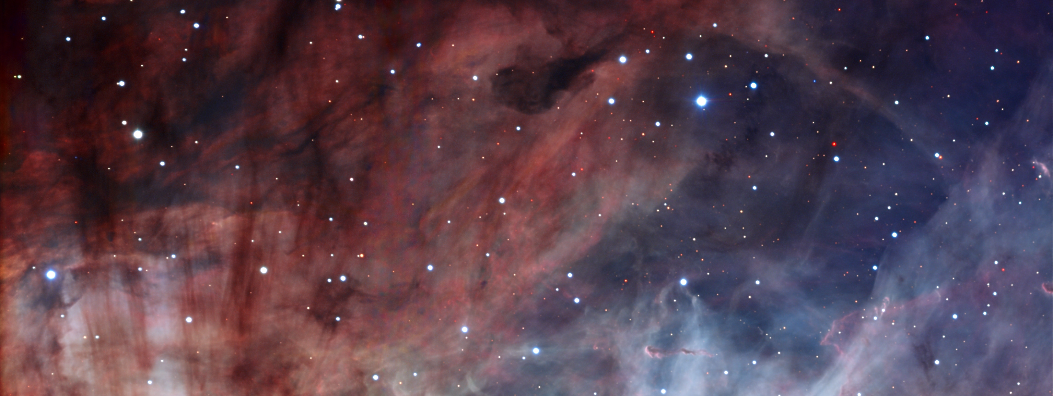
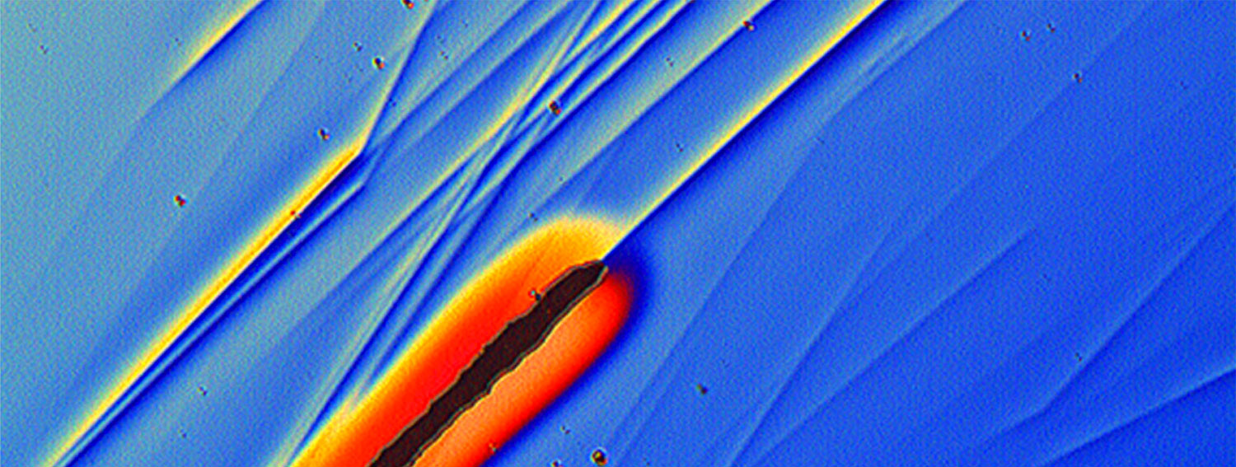
ESO in french astronomy
  Martin Giard (CNRS/INSU)
  ESO 60-years
  2022, November 3rd

Slide 2
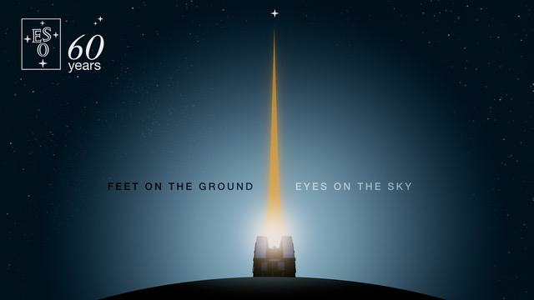
ESO in french astronomy
Martin Giard,
Deputy director Head of Astronomy and Astrophysics Division at CNRS
Karine Perraut,
CNRS Scientific Delegate for ESO affairs

Slide 3
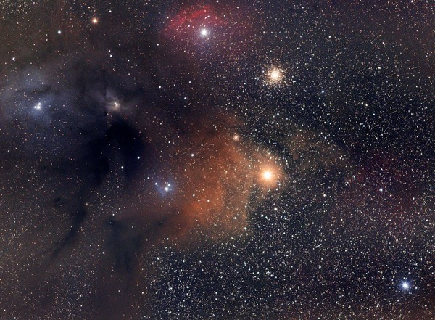
Contribution to ESO observatories and their instruments:
=> 2/3 rd of french yearly spendings for astronomical tools
about 35 M€/year consolidated contribution
Today, following a long tradition of developping instruments for ESO telescopes (SPHERE & MUSE for VLTs, MATISSE & GRAVITY for VLTI), and ALMA (samplers and ARCs), France is again heavily committed to build instruments for ESO telescopes:
  VISTA: 4MOST, APEX: CONCERTO
  ELT 1st generation: HARMONI (Deputy PI), MICADO, MORFEO, METIS
  VLT & VLTI: MOONS, BLUEMUSE, GRAVITY+, SPHERE+
  ELT 2nd generation: MOSAIC (PI), ANDES

Slide 4
Our contributions to ESO instruments rely on cutting-edge astronomical systems developped in our laboratories with industrial partners:
  Instrumentation for millimeter radio-astronomy
  Bordeaux-Paris-Grenoble
  Adaptive Optics and High-Contrast Imaging
  Paris-Grenoble-Marseille-Lyon
  Optical long baseline interferometry
  Paris-Nice-Grenoble-Lyon
  Optical & NIR spectroscopy
  Lyon-Paris-Marseille-Toulouse
=> See the presentation by Karine Perraut and colleagues

Slide 5
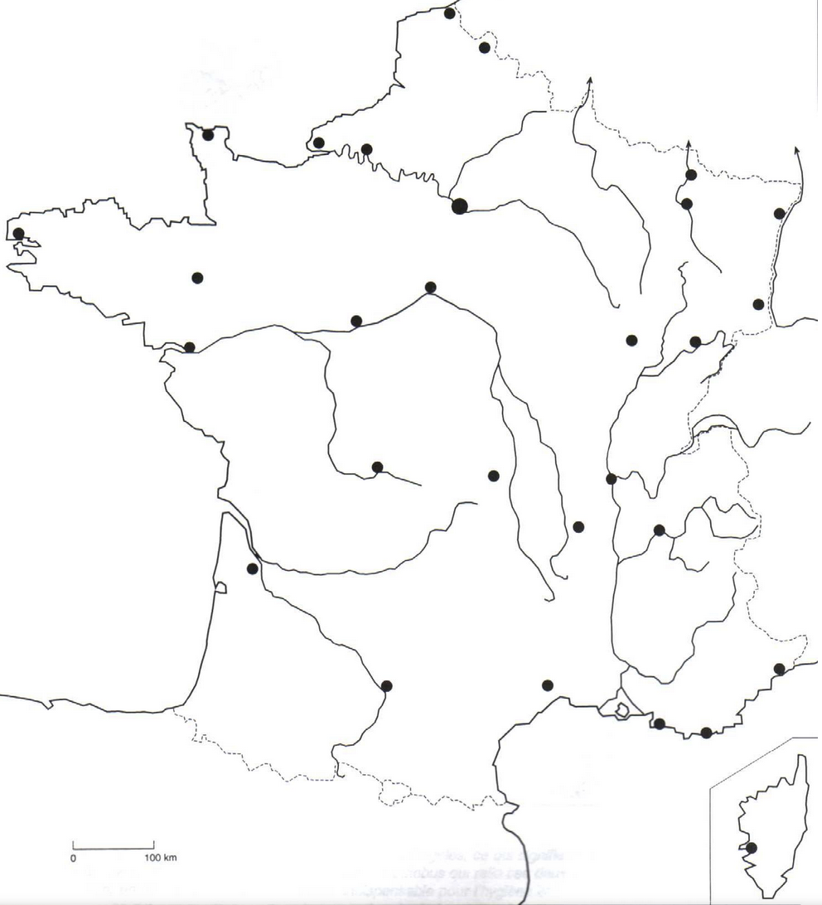
French Institutes involved in developments for ESO
ALMA instrumentation and ARCs:
LAB, Obs. de Paris, IPAG-IRAM
APEX, VISTA, VLT, VLTI, ELT:
CEA-AIM, CRAL, GEPI, IPAG, IRAP, LAGRANGE, LAM, LESIA, LUPM, ONERA, UTINAM
Tools for data portal (Aladin):
CDS Obs. de Strasbourg
Using, archiving and publishing:
ALL INSTITUTES
CNRS-INSU
Obs. de Paris
GEPI, LESIA
Obs. de Strasbourg
CDS
CEA-AIM
LERMA
UTINAM
French academic partners:
CNRS, CEA, ONERA,
Obs. de Paris – PSL,
Sorbonne Univ.,
Univ. Paris Cité,
Obs. de la Cote d’Azur,
Univ. de la Cote d’Azur,
Univ. Grenoble Alpes,
Aix Marseille Univ.,
Univ. de Lyon,
Univ. De Strasbourg,
Univ. de Bordeaux, Univ. de Montpellier,
Univ. Fed. de Toulouse,
Univ. de Besançon
CRAL
IPAG
LAB
IRAM
IRAP
LUPM
O.C.A.
LAGRANGE
LAM,
ONERA

Slide 6
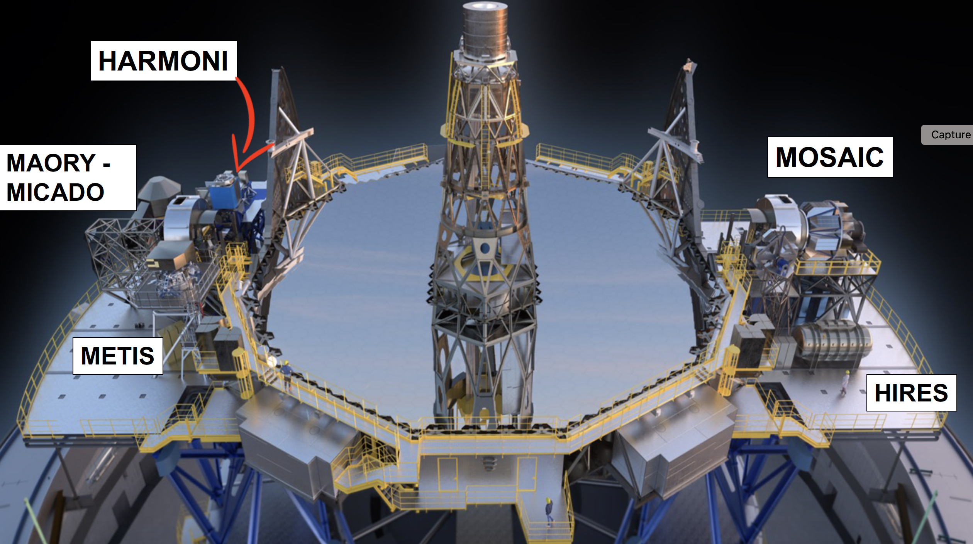
Fall 2009:
Building the E-ELT and its instruments has been decided to be one of the top priorities of the french astronomy community.
MORFEO -
ANDES

Slide 7
HARMONI : Integral Field Spectrograph
Fr Deputy PI at LAM
Responsible for:
- SCAO, LTAO, AIT, High Contrast
- IFU, Science Software, Instrument
Software
CRAL
IPAG
O.C.A.
LAGRANGE
IRAP
LAM,
ONERA

Slide 8
MICADO (first light imager and spectrometer)
Responsible for SCAO sub-system, RTC and command software, High Contrast module
Obs. de Paris
LESIA, GEPI
UTINAM Besançon
IPAG

Slide 9
MORFEO : 60’’ MCAO for MICADO
Responsible for the LGS WFS module
IPAG
O.C.A.
LAGRANGE

Slide 10
METIS : Infrared imager & spectrometer
Responsible for cryogenic mechanism and derotator, AGPM masks, Band N test bench,
CEA-AIM

Slide 11
MOSAIC : Multi IFU spectrometer
Fr PI at LAM
Responsible for Project managment, NIR-Spectrograph, AITV, IFU fiber link, instrument software
Obs. de Paris
GEPI
IRAP
LAM,
ONERA

Slide 12
ANDES : high resolution spectrograph
Contributions to : Calibration units, fiber design, K band
IPAG
O.C.A.
LAGRANGE
IRAP
LUPM
LAM,
ONERA

Slide 13
French Institutes involved in developments for ESO
ALMA instrumentation and ARCs:
LAB, Obs. de Paris, IPAG-IRAM
APEX, VISTA, VLT, VLTI, ELT:
CEA-AIM, CRAL, GEPI, IPAG, IRAP, LAGRANGE, LAM, LESIA, LUPM, ONERA, UTINAM
Tools for data portal (Aladin):
CDS Obs. de Strasbourg
Using and publishing:
ALL INSTITUTES
CNRS-INSU
Obs. de Paris
GEPI, LESIA
Obs. de Strasbourg
CDS
CEA-AIM
LERMA
UTINAM
French academic partners:
CNRS, CEA, ONERA,
Obs. de Paris – PSL,
Sorbonne Univ.,
Univ. Paris Cité,
Obs. de la Cote d’Azur,
Univ. de la Cote d’Azur,
Univ. Grenoble Alpes,
Aix Marseille Univ.,
Univ. de Lyon,
Univ. De Strasbourg,
Univ. de Bordeaux, Univ. de Montpellier,
Univ. Fed. de Toulouse,
Univ. de Besançon
CRAL
IPAG
LAB
IRAM
IRAP
LUPM
O.C.A.
LAGRANGE
LAM,
ONERA

Slide 14
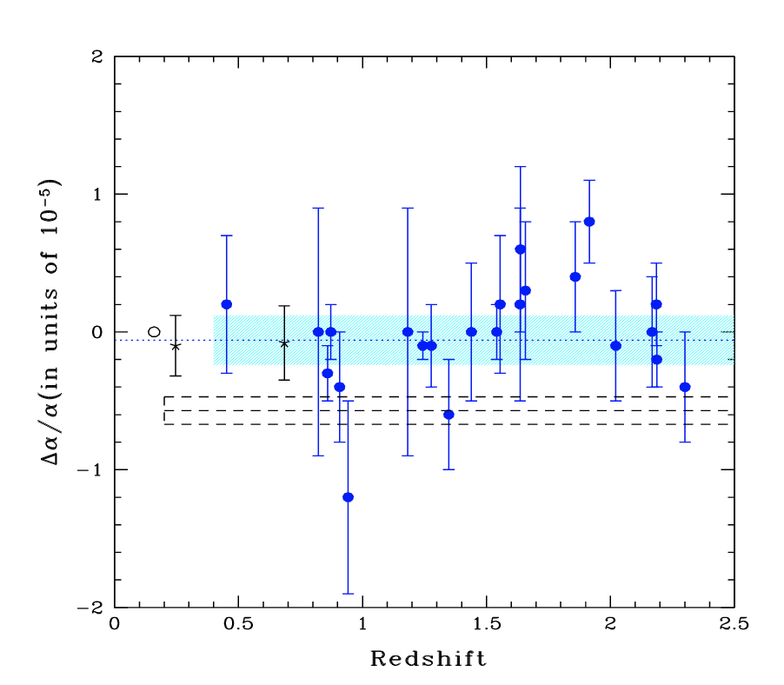
Quality, reproducibility and seriousness are the ESO signature …
… and sometimes no-detection is much better than anything else !
=> see Srianand, Chand, Petitjean, and Aracil 2004, PRL 92, 12
« Limits on the Time Variation of the Electromagnetic Fine-Structure Constant … »
Pune – Paris collaboration:
- 30 nights of UVES during 2 years
- 32 quasar absorption systems
0.4 ≤ z ≤ 2.3
∆α/α = (−0.06 ± 0.06) × 10⁻⁵

Slide 15
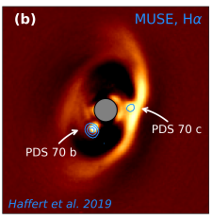
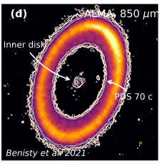
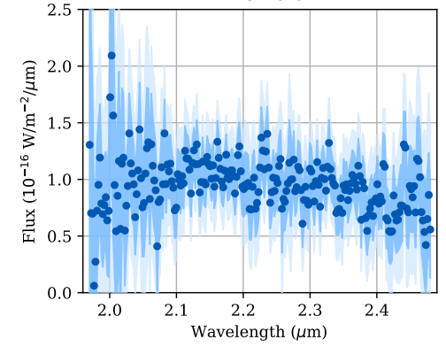
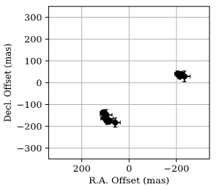

SPHERE + MUSE + GRAVITY + alma => planets formation in PDS 70
(when french astronomy meets ESO)
SPHERE K-band
ALMA 850 µm
[Keppler+2018]
[Mueller+2018]
[Benisty+2021]
MUSE Hα
[Haffert+2010]
GRAVITY K-band Spectrum (R~500) Astrometry
[GRAVITY collaboration: Wang+2021]
Wavelength (µm)
Notes:
100 µas precision, R ~ 500
∼22 and 34 au

Slide 16
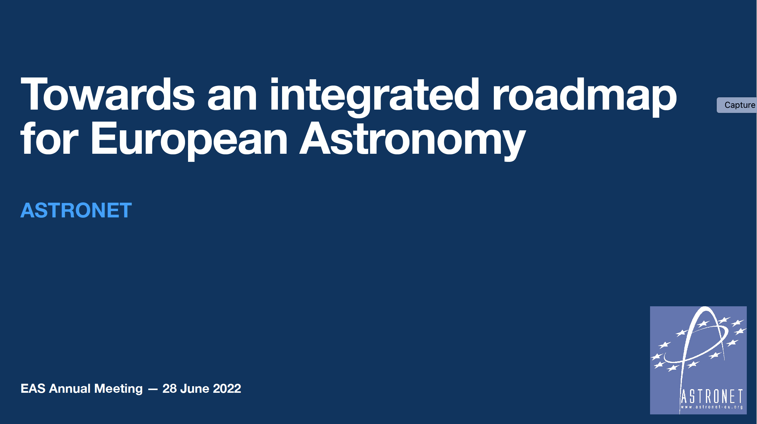
when the astronet roadmap meets ESO perspectives
Editorial board
Saintonge (UCL, chair)
R. Stark (Leiden)
C. Catala (Obs. Paris)
A. Andersen (Niels Bohr Inst.)

Slide 17
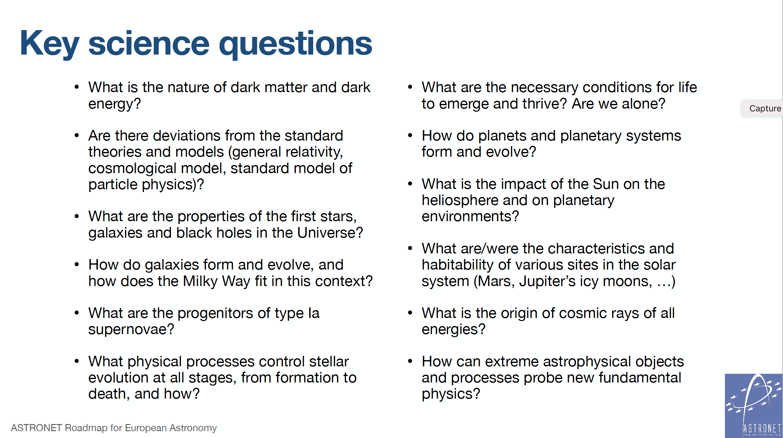
• What is the nature of dark matter and dark energy?
• Are there deviations from the standard theories and models (general relativity, cosmological model, standard model of particle physics)?
• What are the properties of the first stars, galaxies and black holes in the Universe?
• How do galaxies form and evolve, and how does the Milky Way fit in this context?
• What are the progenitors of type Ia supernovae?
• What physical processes control stellar evolution at all stages, from formation to death, and how?
• What are the necessary conditions for life to emerge and thrive? Are we alone?
• How do planets and planetary systems form and evolve?
• What is the impact of the Sun on the heliosphere and on planetary environments?
• What are/were the characteristics and habitability of various sites in the solar system (Mars, Jupiter’s icy moons, …)
• What is the origin of cosmic rays of all energies?
• How can extreme astrophysical objects and processes probe new fundamental physics?

Slide 18
Eso perspectives (in red) within the astronet roadmap
Short term:
ESO unity and resilience is the safer way through the ongoing crisis for European astronomy plans
Most of mid term Astronet objectives go through ESO :
Upgrade ALMA
Develop VLT with BlueMUSE and high-contrast, high angular resolution instrumentation
Make E-ELT first light first priority, and 2nd generation instruments second priority
Build CTA
Longer term objectives will be very challenging to materialize, likely impossible without ESO, will probably need a world-wide cooperation :
A European Solar Telescope,
A wide-field, high multiplex spectroscopic facility behind a 8-10m class telescope

Slide 19
For another 60 years of succesfull European astronomy …
Again, following the Astronet roadmap 2022:
We have to take our part of the carbon and ecology transition
Assess the environmental footprint of our instruments
Invest in the de-carbonation of our observatories
Reduce our environmental footprint
We have to work for and with the people
Diversity and inclusion are required in all our organisations
Include and listen the local populations for any development on their land
Educate all people

Slide 20
HAPPY BIRTHDAY ESO !
MAKE EUROPEAN ASTRONOMY SHINE FOR 60 MORE YEARS

