Slide 1

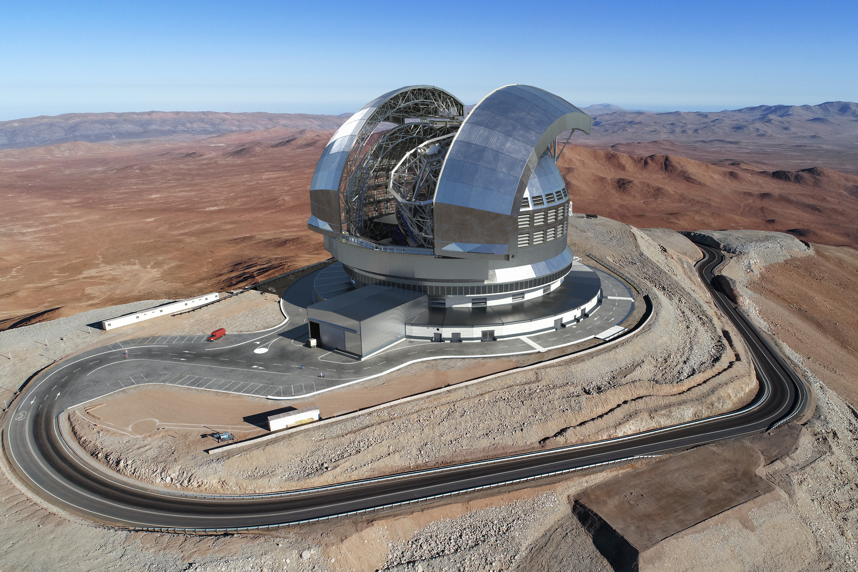
60th ESO anniversary
Enabling tomorrow’s world with sensing solutions
Sensors for ESO
November 4th 2022
Didier Roziere, CTO
Bruno Luong, Physicist & Mathematician
Christian Néel, CSO

Slide 2


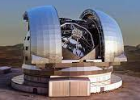




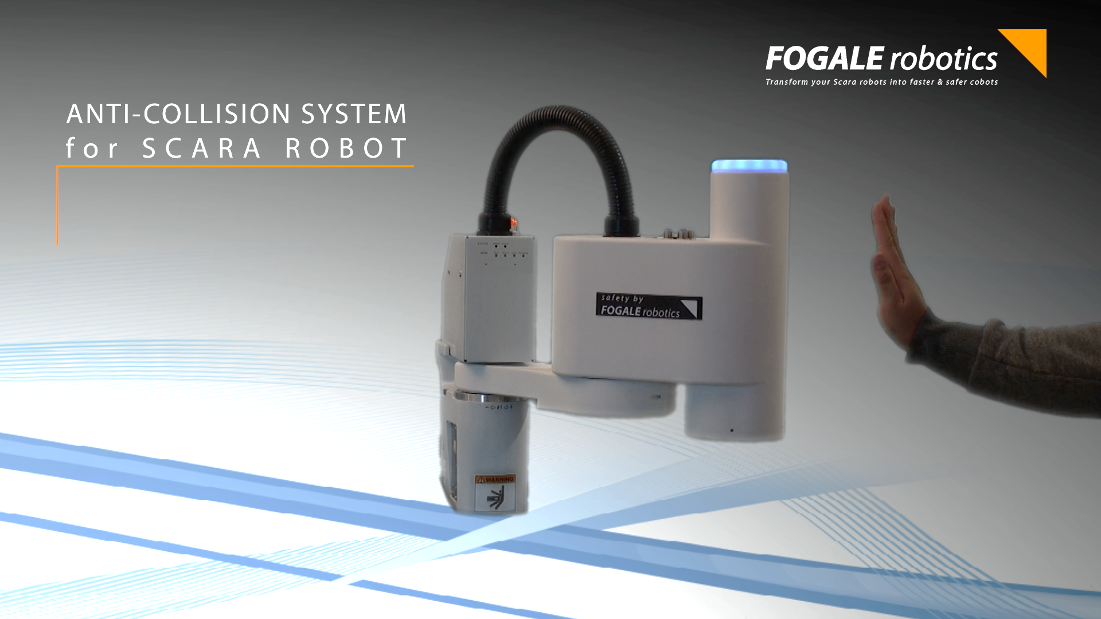
Fogale Sensors at a glance
Key Figures
A recurring business based on diversified markets …
Since
1983
80%
International sales
Medical
Turbomachinery
Metrology
An actual portfolio of
140 patents
A team of
20 people
mainly engineers
Mission
… and a spirit of innovation to enable new markets
  Keep extending a world recognized expertise in capacitive & inductive metrology to continue inventing and developing cutting-edge products and systems.
  Build a high-level team by bringing together experts in their own field who will:
    Execute our business strategies focused on large markets where technological breakthroughs are necessary
    Aggregate world class sensor technology expertise and build up on our Innovation & Patent management methods
Hydrogen
Robotics
3D HMI

Slide 3

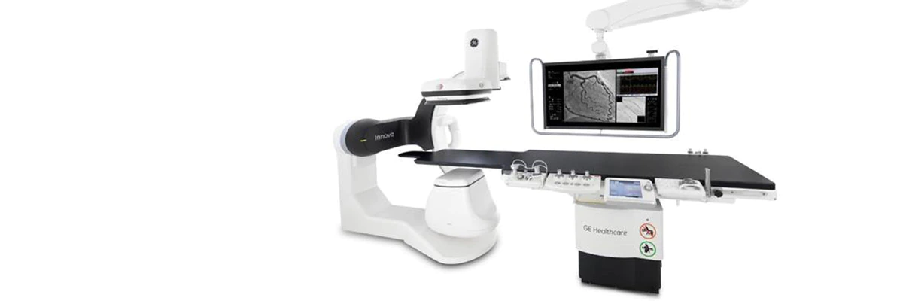
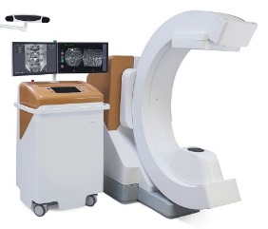
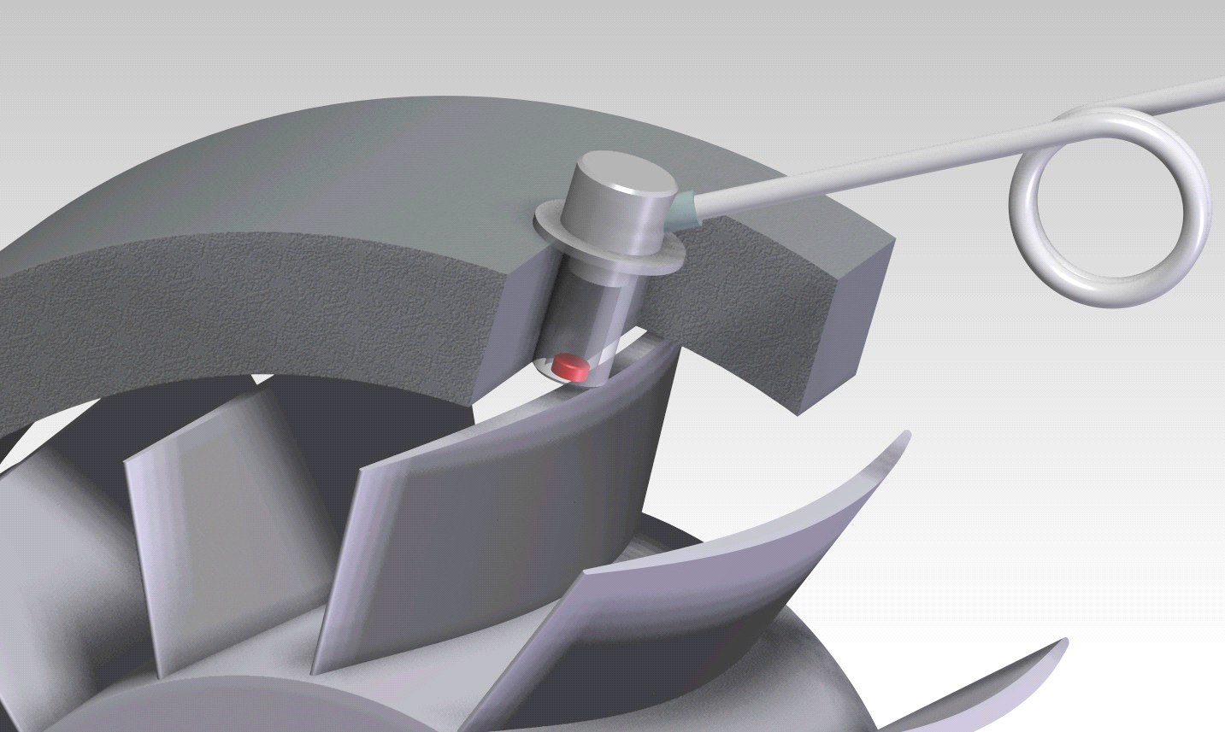
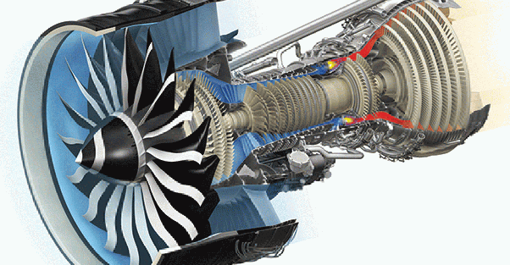
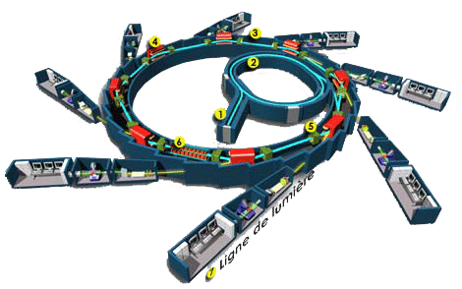
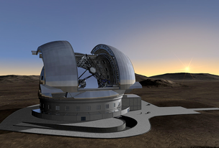















Fogale Sensors businesses in a nutshell
A world leader in the development and supply of capacitive dimensional metrology solutions
Medical business
Turbomachinery business
Engineering department
High turnover recurrence
High growth potential
High turnover recurrence
High growth potential
Industrial solutions & technological showcase
Start-up factory
Test bench measurements
Energy and aeronautic turbines
Health monitoring
High resistance sensors
Unique electronics
Smart data treatment
Start-up incubator
Innovation methodology
Market and IP analysis
Medical imaging
X radiation dose optimization
Image quality optimization
Patient & staff protection
Anticollision systems
Industrial Metrology
Particle accelerators alignments
Control of gun barrels
Areas of application:
Areas of application:
Some areas of applications:
Health
Energy
Aeronautic
Scientific facilities
Nuclear
Industries
Defense
Customers:
Customers:
Customers:

Slide 4
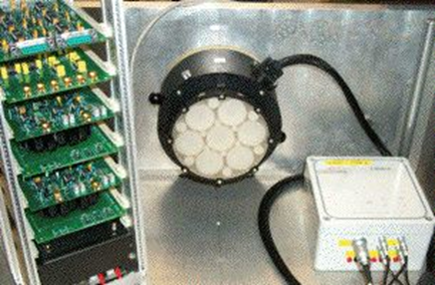
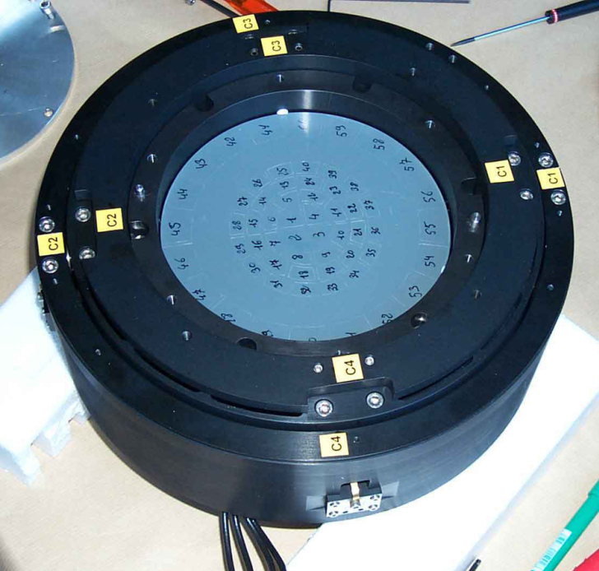
Sensors for ESO
Tip Tilt control of Adaptive Optic
VLT is equipped with Adaptive Optic to correct the distortions of the light beams (induced by the atmospheric turbulence)
LESIA of Observatoire de Meudon has developed high performance Tip Tilt mounts for ESO
Adaptive optic are based on mechanical flexure manipulator and non contact voice coil actuator
Tip Tilt measurement and control by capacitive sensors from FOGALE
VLT NAOS
VLTI MACAO
Tip-Tilt range: +/-2 mrad
Resolution: < 0.2 µrad
Fogale’s capacitive sensor noise: < 0.2 nm/Hz^{1/2}

Slide 5

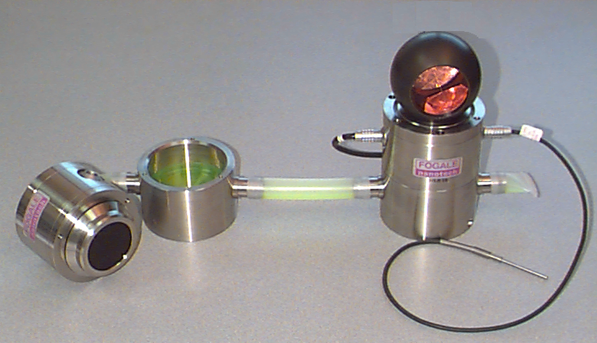
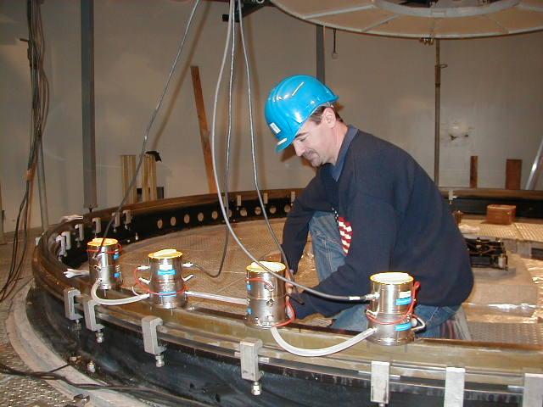
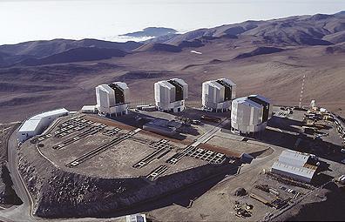
Sensors for ESO
Alignment system of the Coudé rotating platform
Each of the four VLT telescopes is equipped with one Coudé Rotating Platform which allows optical equipment to be rotated
Each Coudé Rotating Platform was aligned with Fogale’s Hydrostatic Levelling System (HLS)
HLS principle
  Based on the communicating vessels principle
  Metrology referential: liquid free surface
  Level of liquid measured by non contact capacitive sensor
1
h
2
Accuracy: +/-5 µm
Diameter of Coudé: 5.1 m

Slide 6
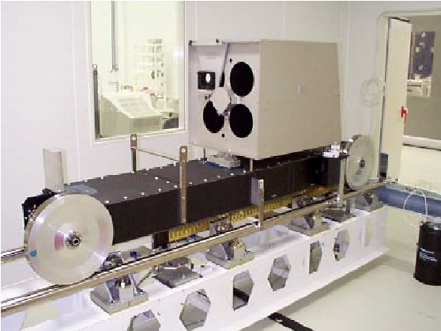
Sensors for ESO
The VLT delay line rails alignment system
Solution to align VLT delay line rails based on the use of:
  Capacitive Hydrostatic Levelling System (HLS): materialize vertical reference
  Capacitive Wire Positioning System (WPS):
    Materialize vertical shift with distance sensor => sag compensation
    Materialize also horizontal reference
  Laser Telemeter: measure displacement of Trolley
  Inductive Inclinometer: measure Tip-Tilt of Trolley
WPS
Trolley
Telemeter
Tensor
Inclinometer
Distance
sensor
Hydrostatic level
To HLS0 (external reference)
Weight
Basement of pre-alignment
Rails length 66 m
Accuracy: 5 µm/m

Slide 7
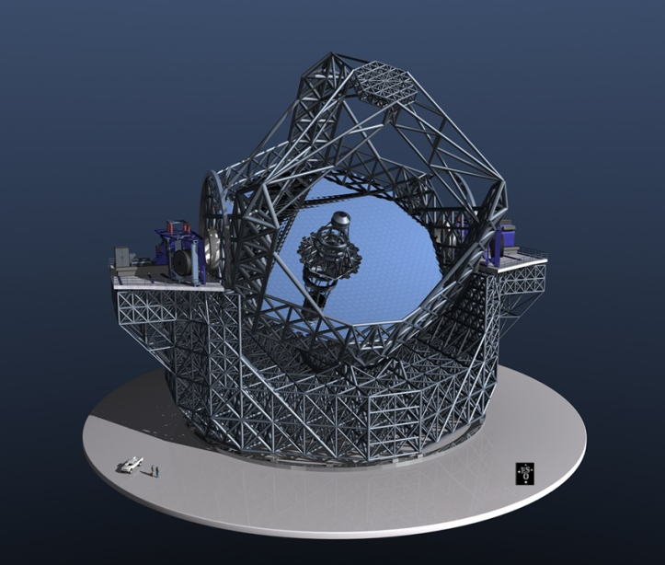
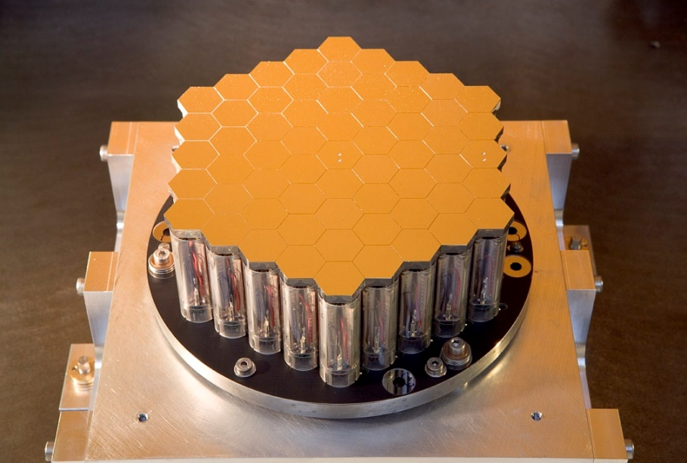
Sensors for ESO
APE = Active Phasing Experiment
Optical phasing of segmented mirror with sub-nanometer precision
Experimental Project involved IAC-INAF-LAM, Fogale and ESO
Evaluation of new technologies (4) for wavefront sensors for ELT study (FP6)
  Successfully tested on sky at VLT, Chile 2008-2009
  Extended use still in Germany (ESO) 2010
“Internal Metrology” (IM) developed by FOGALE
  Reference metrology for closed & open loop Control / measure the shape of
the Active Segmented Mirror (ASM): Piston/Tip/Tilt
154 mm
61 segments
±7.5µm range piezo actuators

Slide 8
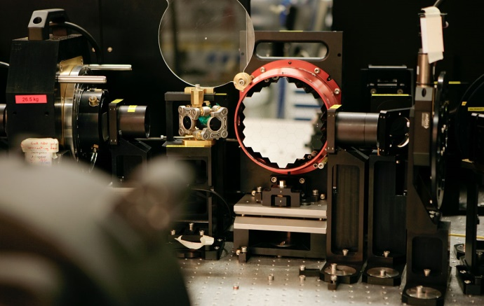
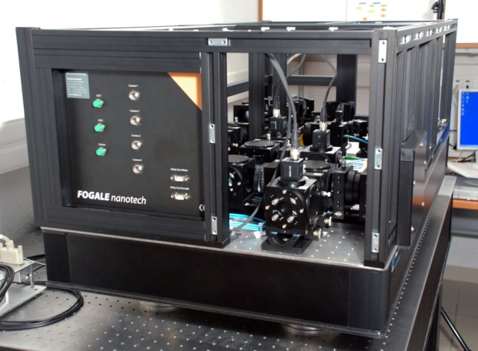
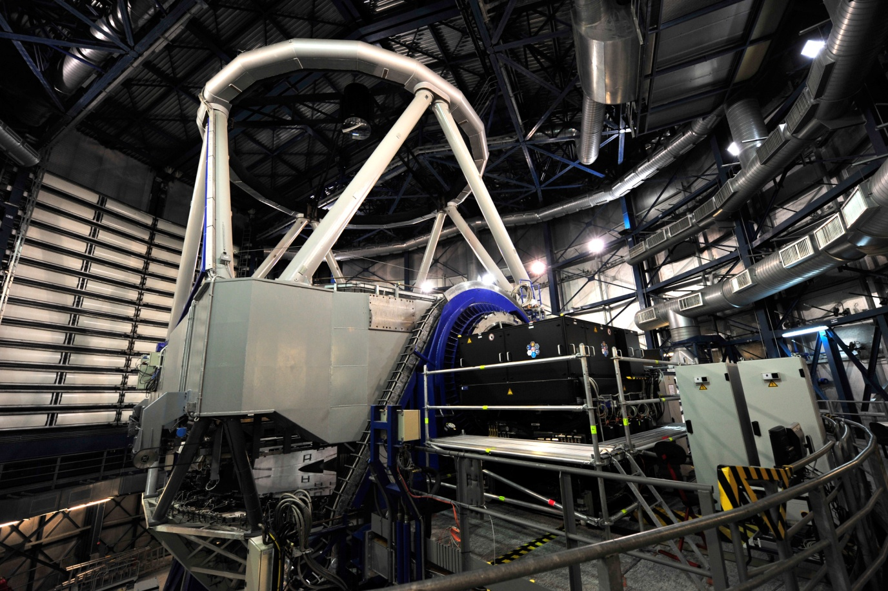
Sensors for ESO
APE: IM measurement principle
Combination of three concepts
  Instantaneous phase shifting interferometry with 4 cameras
  Low coherence interferometry
  Dual wavelength interferometry(λ = 835 & 860 nm)
Closed loop characteristics
  PI control loop f_{acq} = 8 Hz
  Close loop delay < 200 ms
  Close loop bandwidth 0.4 Hz
INTERNAL Metrology
Optical layout
APE Onsky test at VLT
(Paranal)

Slide 9
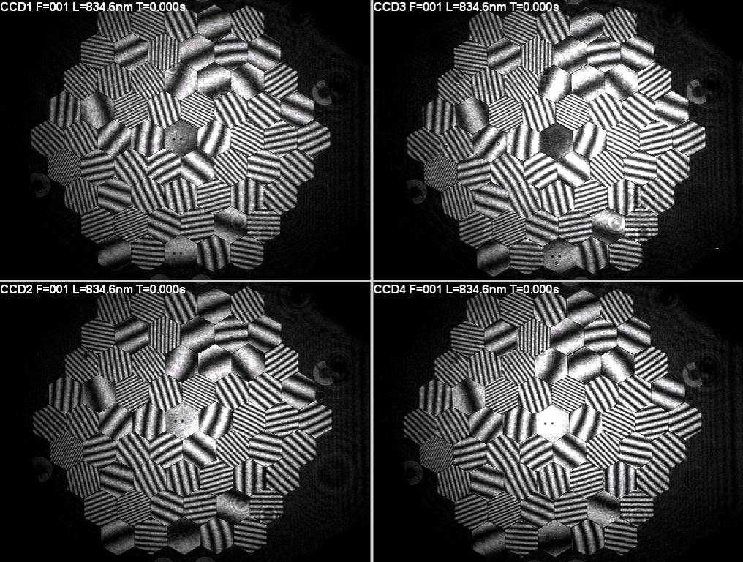
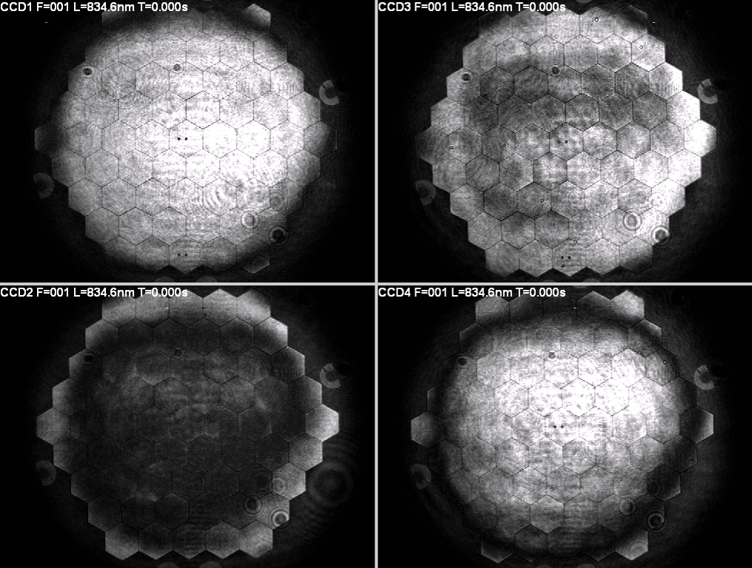
Sensors for ESO
APE
Fringes acquired by 4 cameras of IM
ASM at free positions: 61 segments are out of phase
ASM in closed loop: 61 segments are in phase
A
Accuracy 0.3 nm at 2.2 m of working distance

Slide 10
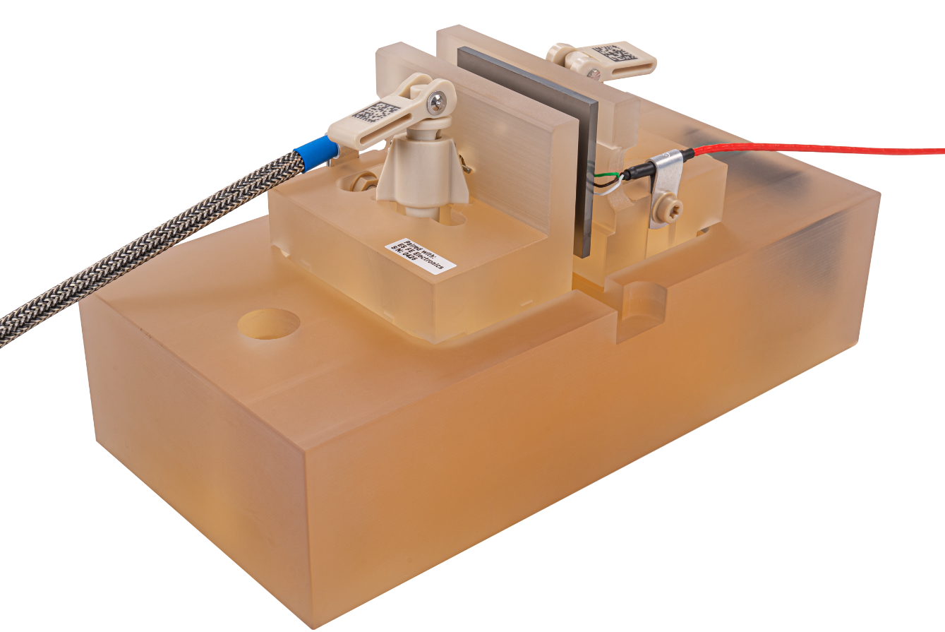
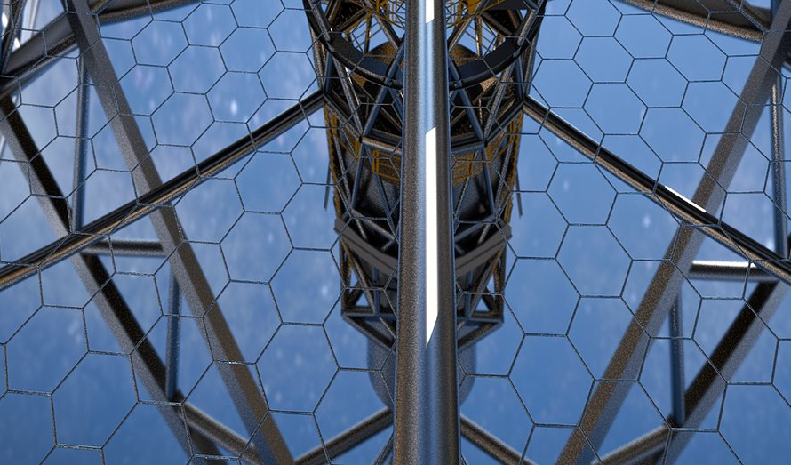

Sensors for ESO
Edge sensor to monitor and align the segmented primary mirror of ELT
Edge sensor based on an innovative inductive technology
First generation of Edge sensors supplied by Fogale to SALT telescope (South Africa)
  11m diameter segmented primary mirror (91 segments)
  Project started on 2012
  Successfully tested on 2015
Edge sensor for ELT designed and manufactured by FAMES consortium
comprising Fogale Sensors (France) and Micro-Epsilon (Germany)
  39m diameter segmented primary mirror (798 segments)
  Project started on 2017
Edge sensor for ELT
798 hexagonal segments - 4500 Edge sensors

Slide 11
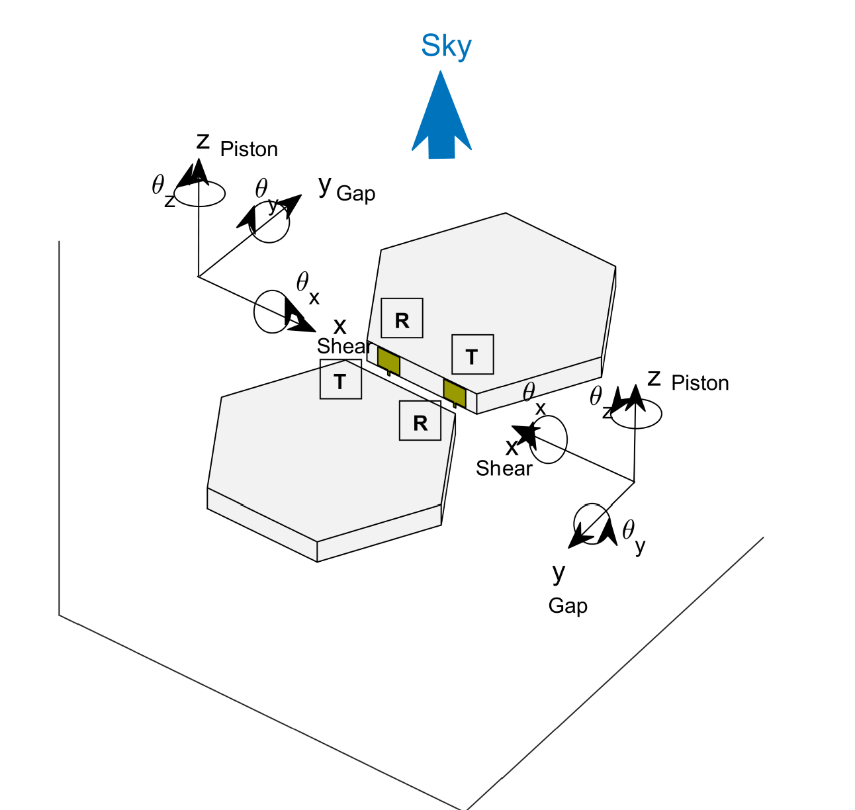
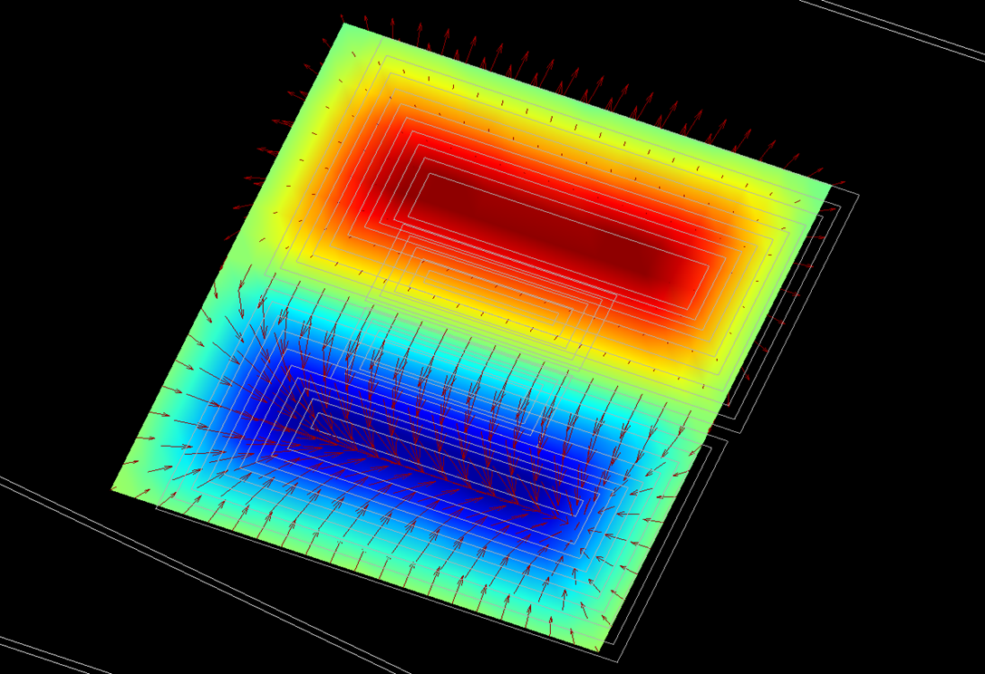
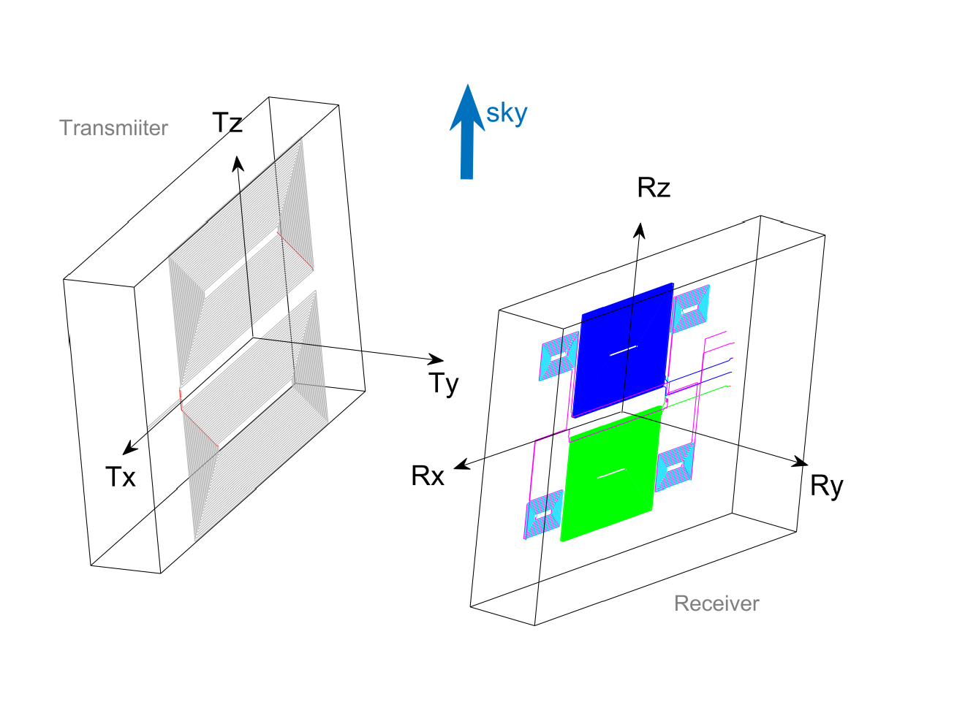
Sensors for ESO
Edge sensor: principle
Based on multicoil mutual inductance
Each sensor is composed of a couple of ultra stable transmitter and receiver
Installed on each side of hexagonal segments
Non contact measurement of
  Piston (mirror surface alignment)
  Gap (distance separation between two adjacent hexagonal segments)
  Shear(lateral offset between two adjacent hexagonal segments)
I
V_{A}
Receiver A
ω
Receiver B
Transmitter
V_{B}
V_{piston} = (V_{A}-V_{B}) / (V_{A+}V_{B})
V_{gap} = K / (V_{A+}V_{B})
EM simulation for performance optimization

Slide 12
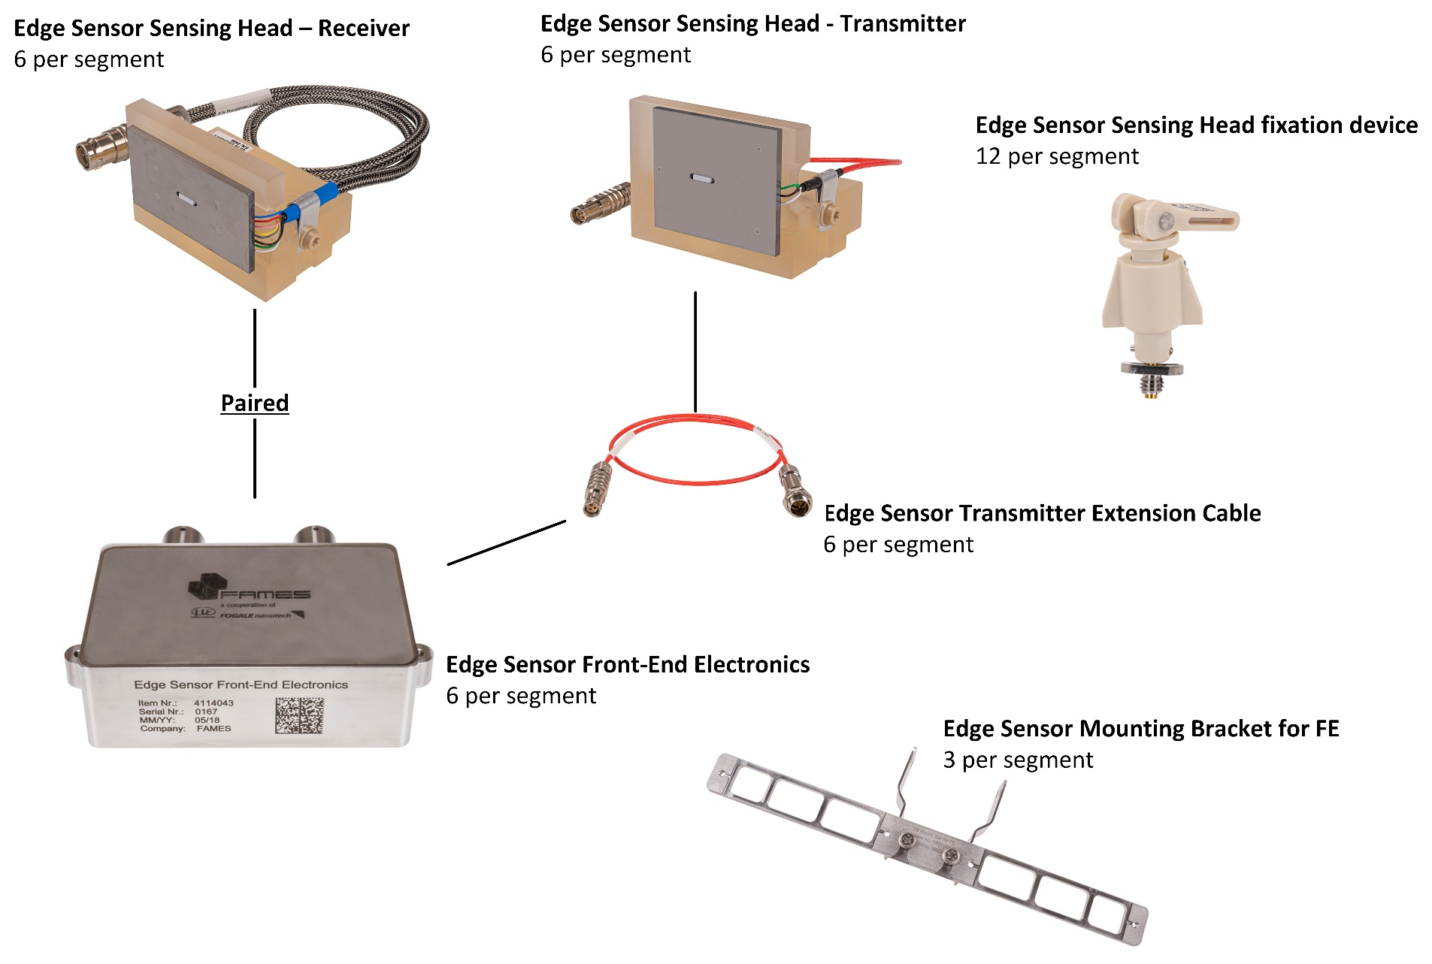
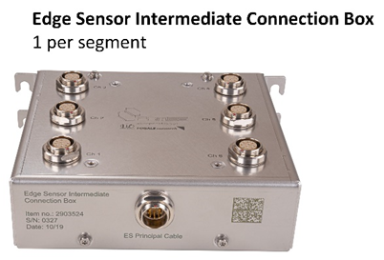
Sensors for ESO
Edge sensor to monitor and align the segmented primary mirror of ELT
Measurement range
  Piston: +/-200 µm
  Gap: 2.5 to 5.5 mm
  Shear: +/-2 mm
Piston performances
  Resolution: < 1nm
  Temperature sensitivity: < 12 nm/°C
  Humidity sensitivity: < 10 nm/50%RH
  Long-term variation: < 10 nm/week
Current status: Series production
Already delivered: 787 Edge sensors
Last batch delivery: 2024
Edge sensors

Slide 13
Sensors for ESO
Thank you

