Slide 1
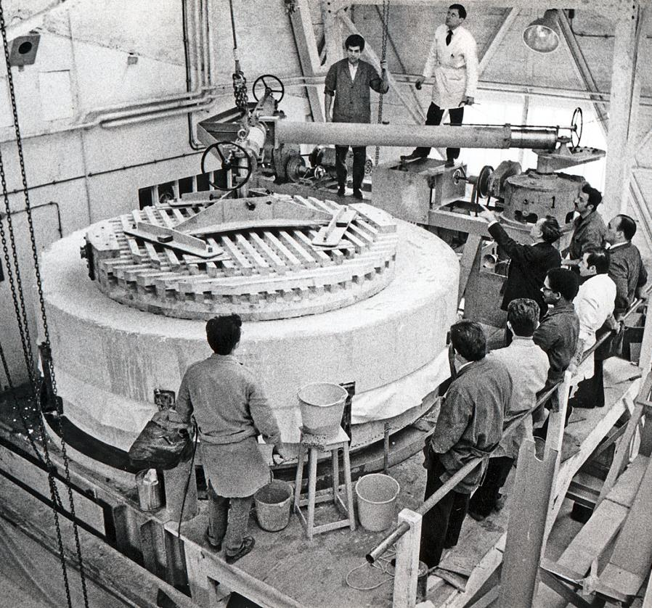
Safran Reosc
The 60th ESO Anniversary
Safran Reosc Mirrors
03/11/2022

Slide 2
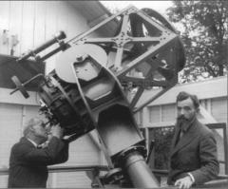
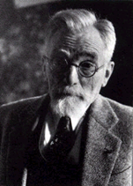
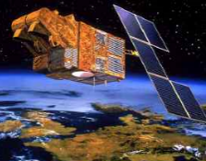
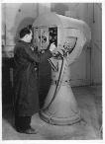
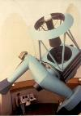
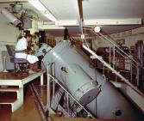
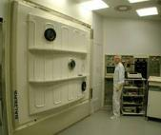
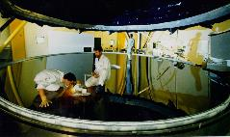
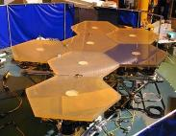
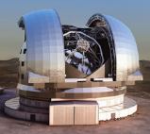
A prestigious scientific foundation
REOSC : Recherche et Etude en Optique et Sciences Connexes
Set up in 1937 by a group of scientists from Paris Institute of Optics including Charles FABRY and Henri CHRETIEN
The first Ritchey Chrétien telescope
Henri Chrétien 1879 - 1956
An 85-year legacy in excellence for Science-Space-Defense-Industry
1 pix IR cam Telescopes & spectrographs coatings Space VLT GTC ELT
1937
2000
2010
2020

Slide 3
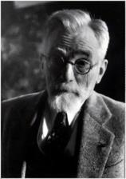

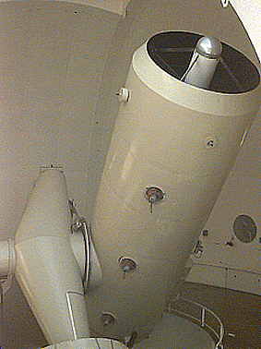
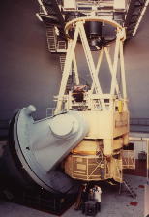
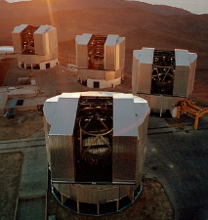
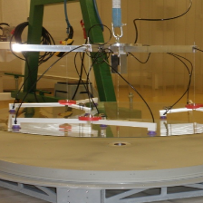
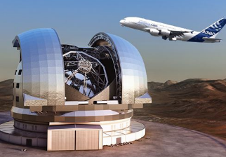
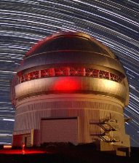
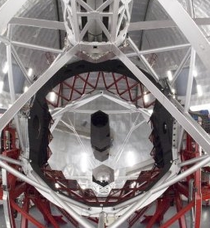

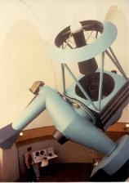
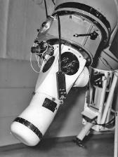
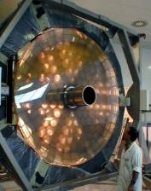
85 years of key astro optics supply
ESO set-up
H. Chretien
152 cm
360 cm
VLT 8-m
Thin Shell
ELT 39-m
1937
2001
2004
1962
1967
1991
2010
1963
1994
2017
Telescopes & Instruments
Gemini 8-m
GTC 11-m
SOFIA

Slide 4
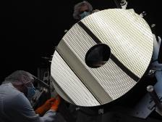
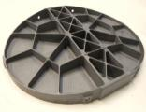
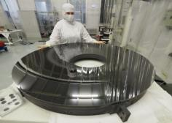
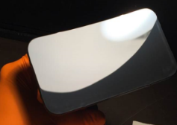
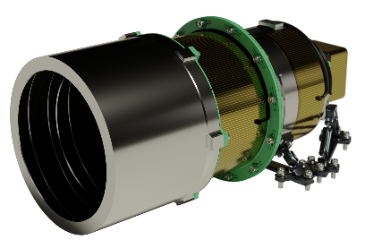
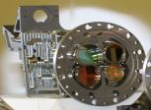
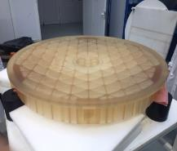
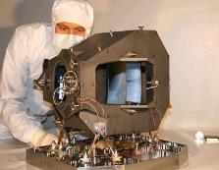
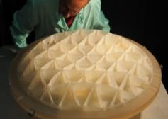
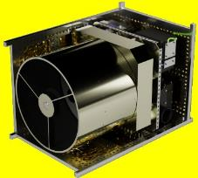
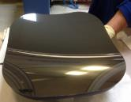
Optics for space : A few examples
Earth Observation
Weather Forecast
Science Mission
Environment Mission
µSat
PLEIADES NEO
METEOSAT SECOND GENERATION
EUCLID
[Dark Univers map]
MICROCARB
[CO2 monitoring]
SEEING Wide Field of view
(Maritime surveillance)
Scan mirrors
SiC Primary Mirror
SiC primary mirror
SiC freeform optics
EXPORT PROGRAM
JWST NIRSpec
[early universe search]
MERLIN
[Methane LIDAR]
SEEING Ident
(Earth Observation)
Spectral Separator
IASI-NG
Ceramic mirror
Free form Mirrors
All SiC mirrors TMA
Ceramic Mirrors

Slide 5
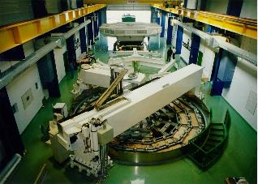
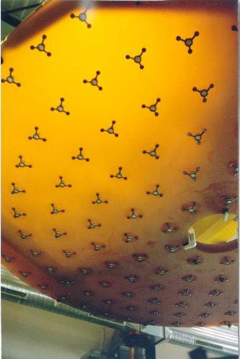
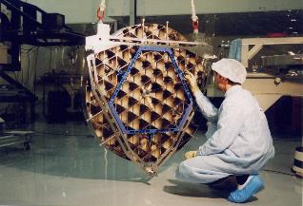
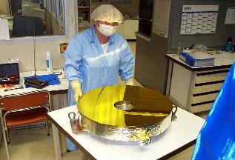
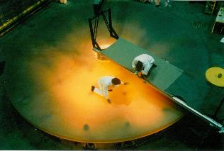
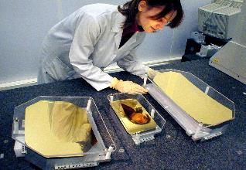
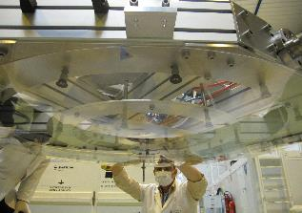
The Very Large Telescope
8m primary mirrors (July 1989)
Other Optics
8m workshop in Saint Pierre Du Perray
1.2m secondary mirrors in nickel-plated berillyum
VLTI Delay line mirrors
Quality inspection
Rear face with pads
Mirrors of the CRIRES instrument
Thin shell for the Deformable Secondary Mirror

Slide 6
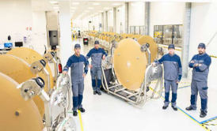
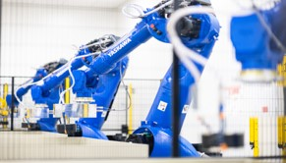

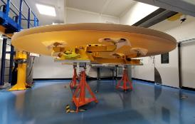
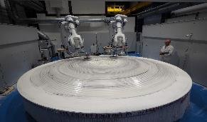
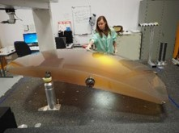
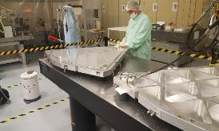
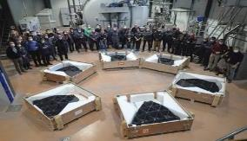
The challenges of the Extremely Large Telescope mirrors
M1 : Serial production
M2&M3 : Glass ceramic monolithic mirrors
Safran Reosc selected for the polishing and integration of all five main optics
  Primary M1 (segmented 39-m aperture)
  M2 and M3 (4-m)
  M4 correcting atmospheric turbulences
  M5 image stabilization
M4 : Glass ceramic thin shell
M5 : A giant SIC mirror

Slide 7
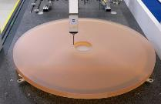
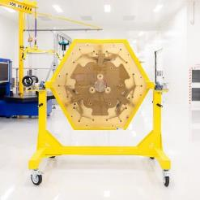
The primary mirror
Main Activities
Pad gluing
Completely new dedicated plant in Poitiers.
  5000m2 of workshops,
Development and industrialization of new processes :
  798 Segment Assemblies +133 Spare
  1 segment per day / 133 different types of segments
  76 production steps,
  50,000 glued pads,
  18,000 L of polishing slurry…
  10 optical measurements per segment with high resolution and full aperture interferometric test
Polishing
Zerodur blank (SCHOTT, DE)
Metrology
Cutting
Integration
Segment support (TNO/VDL, NL)
Finishing
Metrology
ESO Deliverables
Safran Deliverables

Slide 8
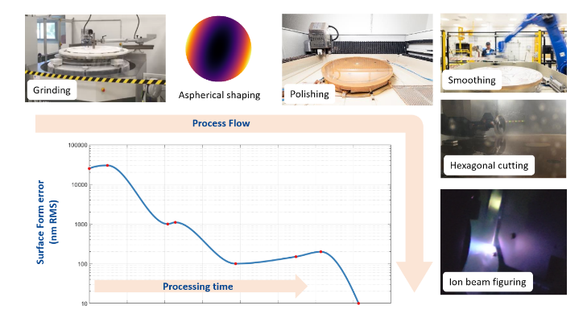

A 4.0 factory for unequaled accuracy
Factory 4.0 dataflow
Unequaled accuracy

Slide 9




Beyond the state of the art automated processes
Interface pad gluing
Hexagonal cutting
51 Invar interface pads per segment
50 000 glued pads in total
30 Years lifetime in challenging envt.
Closed-Loop glue injection
Specific ultrasonic control
Circular segments (Ø1520 mm) cut to hexagons 1440 mm corner to corner
133 different hexagonal shapes
12 Edge Sensor pockets
More than 100 points to be controlled for each segment up to 10 µm accuracy

Slide 10


Telescope-sized metrology
A multi cross checked process
Pad gluing
Polishing
Metrology
Cutting
Talissman : A world first in interferometry
Integration
Finishing
Metrology

Slide 11

To conclude
Thanks to ESO for the trust placed in Safran Reosc over the years.
These technological and industrial firsts push us to provide technologies beyond the state of the art.
In this regard, with ELT we face a complexity never reached and largely underestimated for all the optics.
The challenges we are facing are different from those we had in mind at the start of the contract and put the company in a difficult technical and economic situation.
We have a unique expertise in high-performance optics : Help us to maintain it.

