Slide 1
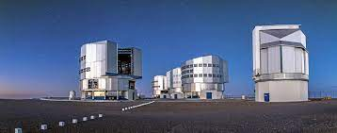
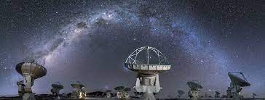
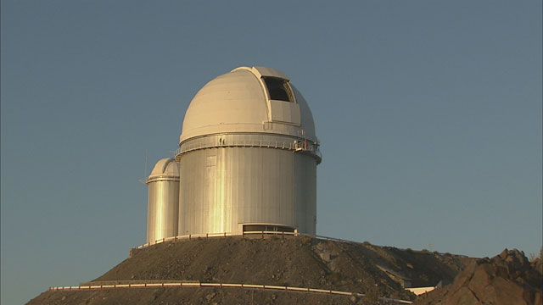
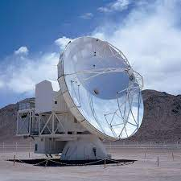
Interstellar Medium & molecule
Personal selection of topics & results
Thanks to Rosine Lallement , Anaelle Maury,, Jérôme Pety, Evelyne Roueff

Slide 2
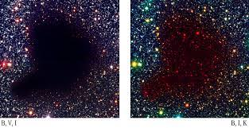
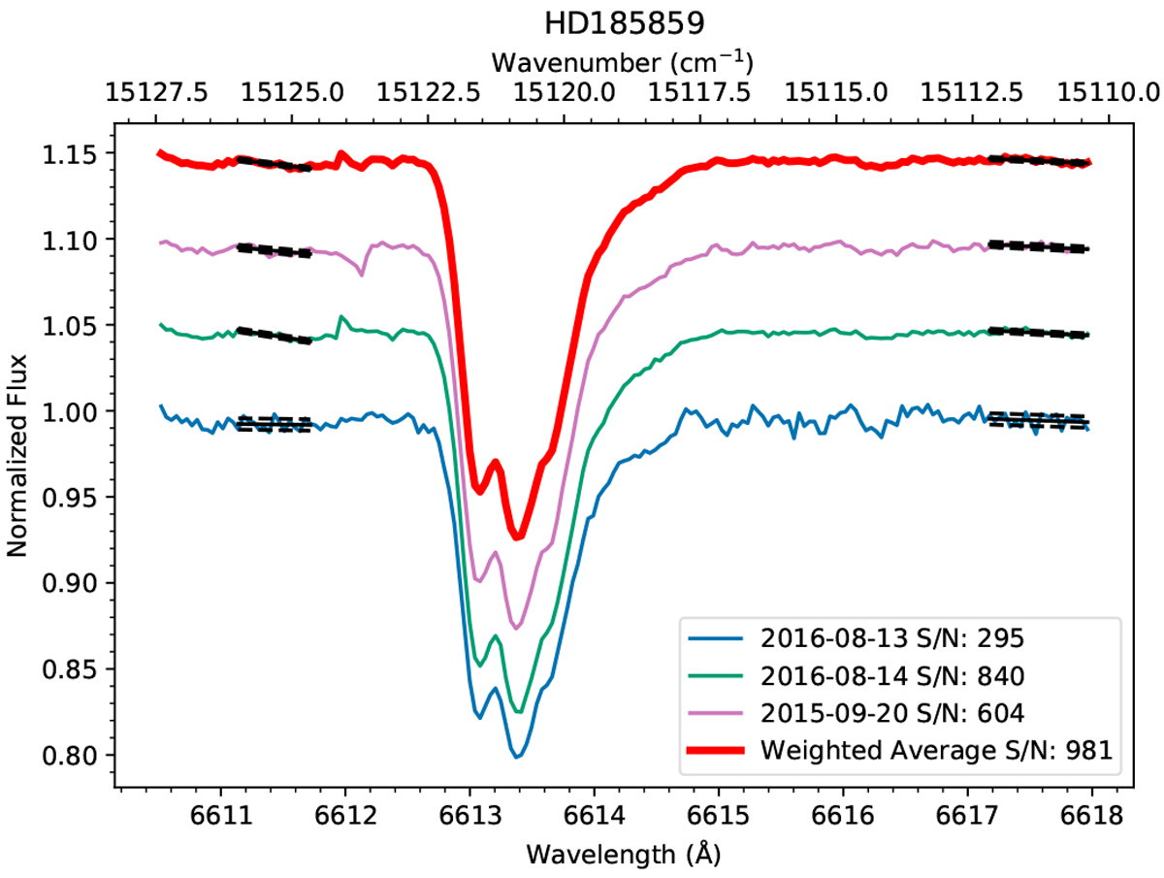
Some historical background
Messier’s catalog of Bright nebulae (include galaxies)
Detection of CN in cometary comae, e.g. Halley 1910
Barnard’s catalogs of dark clouds (1919)
Detection of interstellar molecules CH, CN, CH⁺ (late 1930s)
Detection of Diffuse Interstellar bands (DIBs) (late 1930s
)Polar molecules with radio-telescopes (> 1960s)
Exploration of the far UV sky (> 1970s)
High resolution spectroscopy (> 1970s - ESO)
Exploration of the (far)infrared sky (> 1990s - ESO)
Interferometry ESO - ALMA
B68, Alves+
Elyajouri+2017

Slide 3
Main constituent : Hydrogen,
Hydrogen is present in different phases: Ionized , neutral, molecular
Other molecules are built from “heavy elements” O, C, , S, Si …They cannot reach abundances higher than 0.1%
Solid matter = dust grains represent ~1% of the mass of the gas & contribute to the extinction of visible light & the far infrared emission

Slide 4
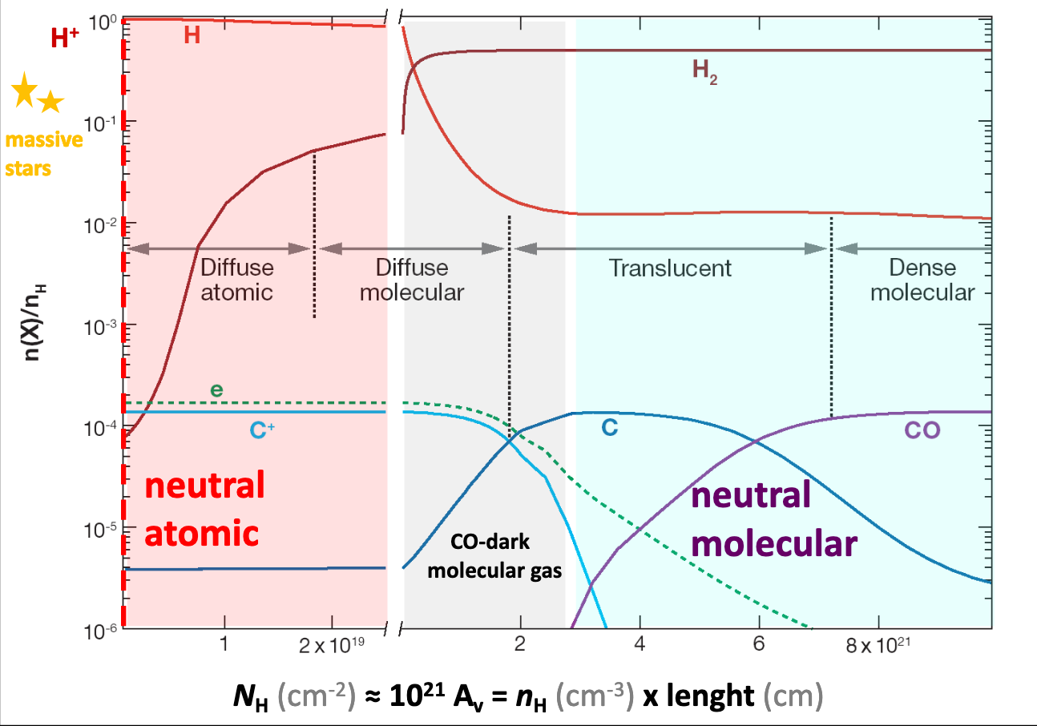
The multi phase ISM : simplified structure
J. Goicoechea

Slide 5
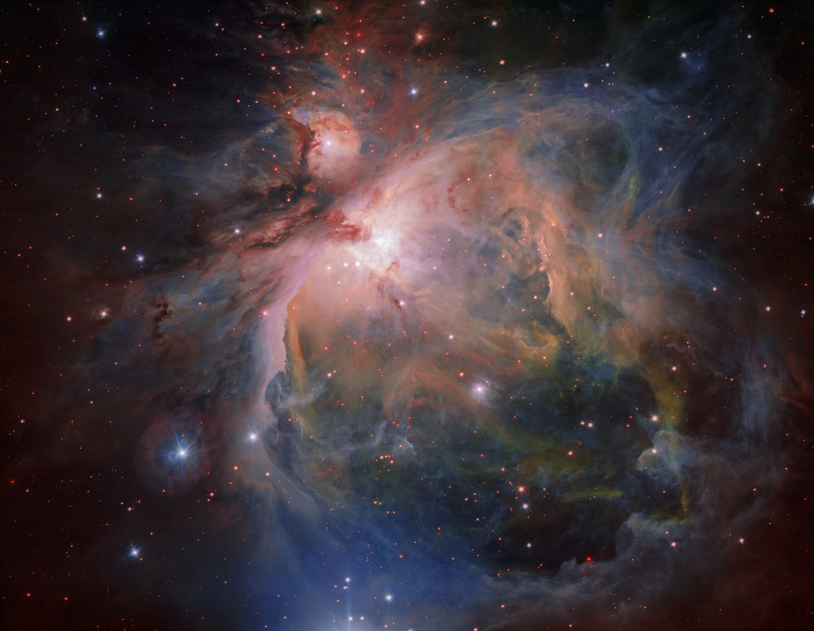
The multi phase ISM : the example of Orion clouds
ESO VISTA Z(0.88µm),J(1.25µm)K(2.2µm)
ESO VST G(0.48µm),r(0.6µm)Hα(0.66µm) & i(0.77µm)

Slide 6
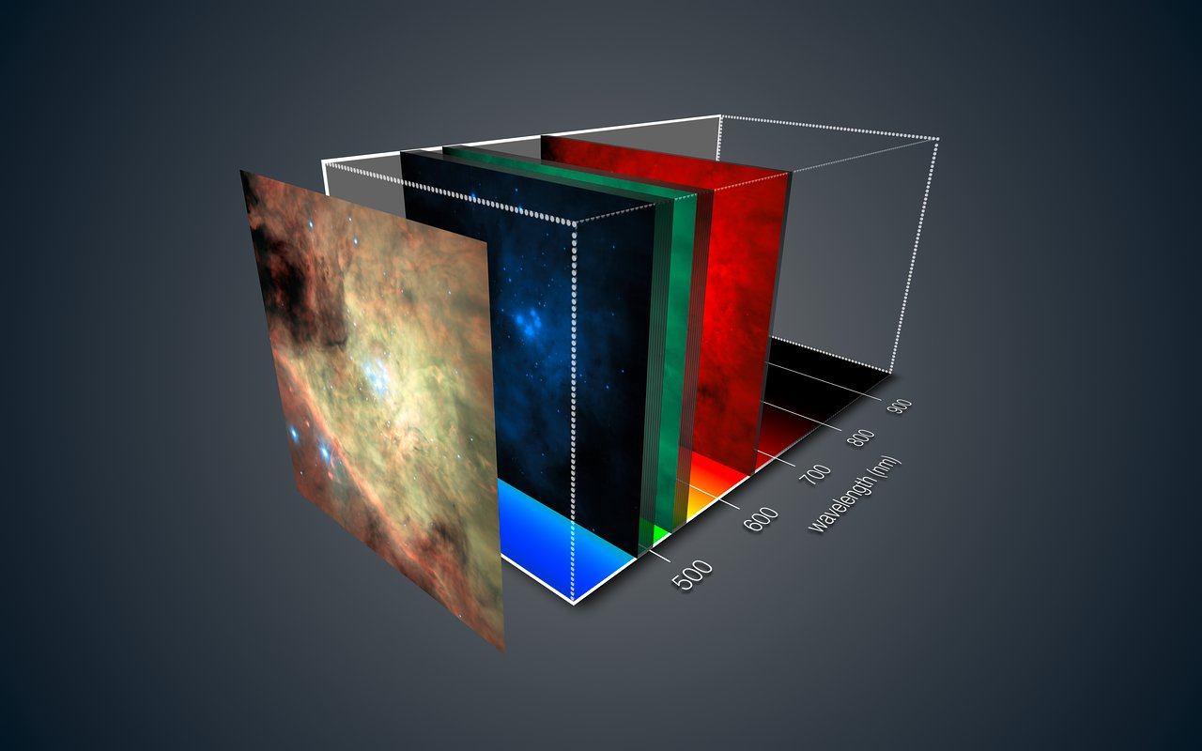
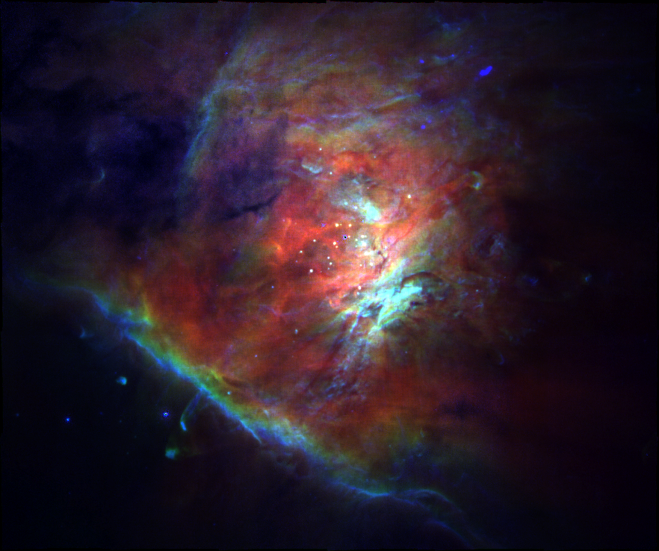
Probing the ionized/neutral gas interfaces MUSE@VLT
Weilbacher+2015
OI(0.6300µm),OII(0.7320µm)OIII(0.5007µm)
Hβ (0.486µm),NII(0.6584µm)SII(0.6731µm)

Slide 7
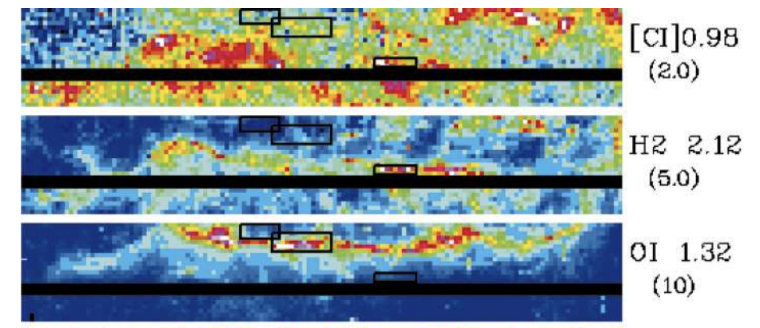
Probing the formation/destruction of molecular hydrogen
Spatial separation of the ionization & dissociation fronts
Intense H₂ emission lines
➔ Key data for PDR models (e.g. Meudon PDR code in France)
ESO NTT
Walmsley+ 2000

Slide 8
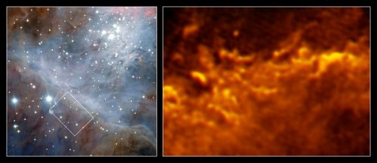
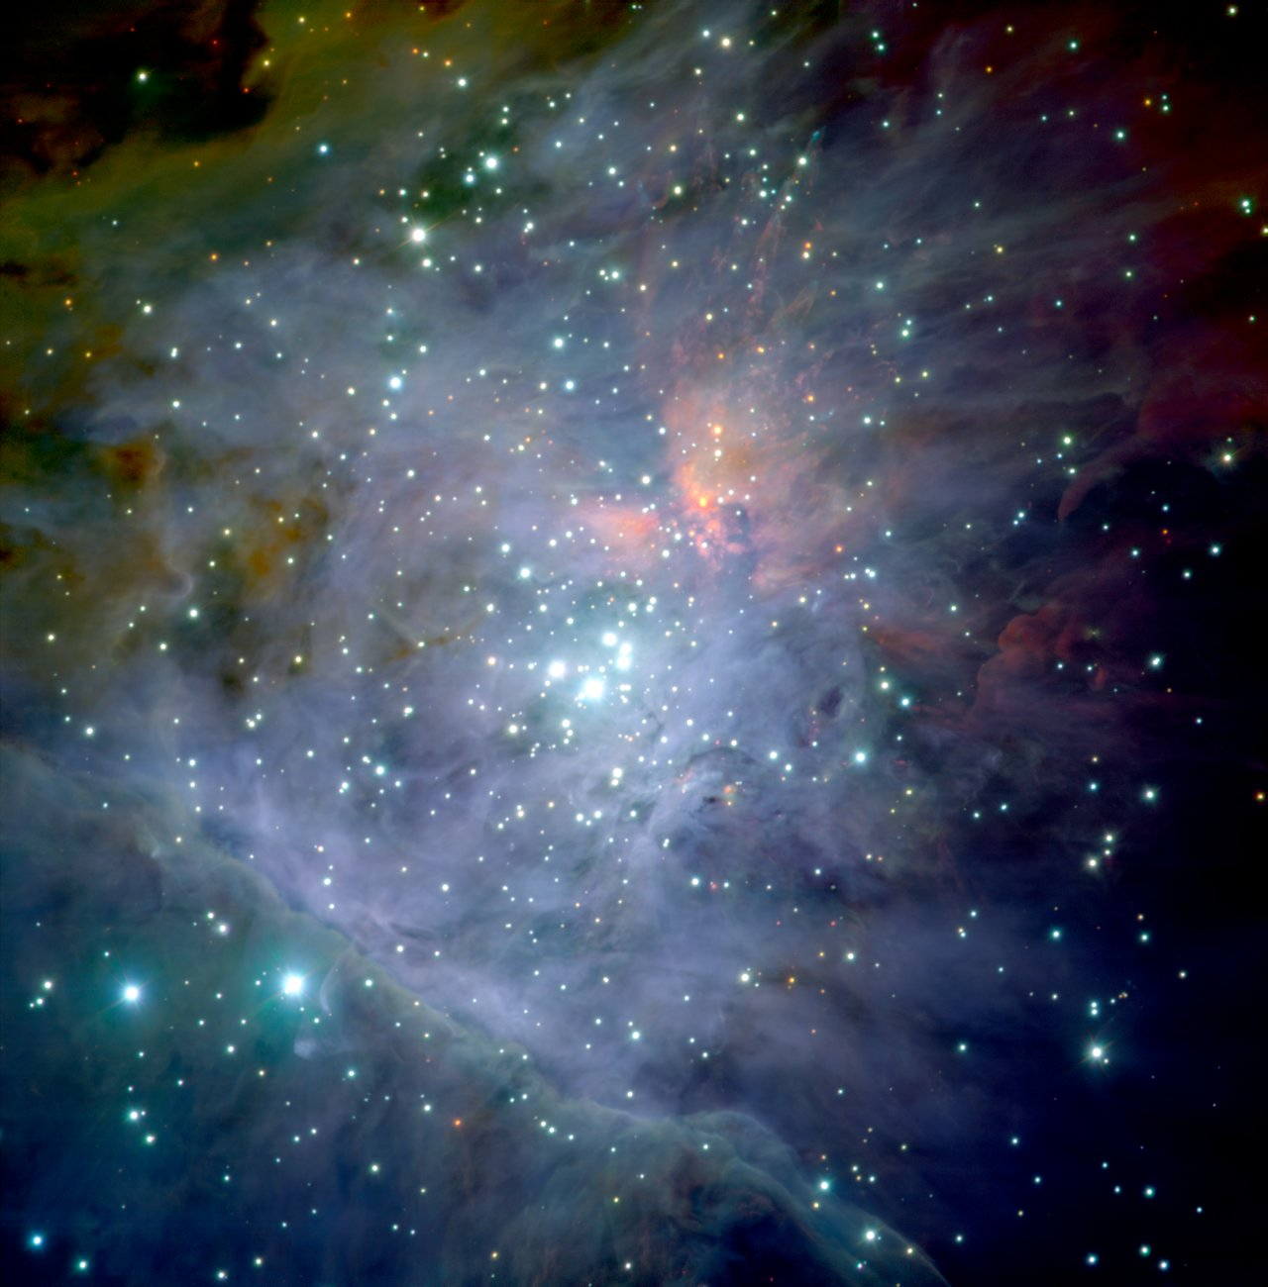
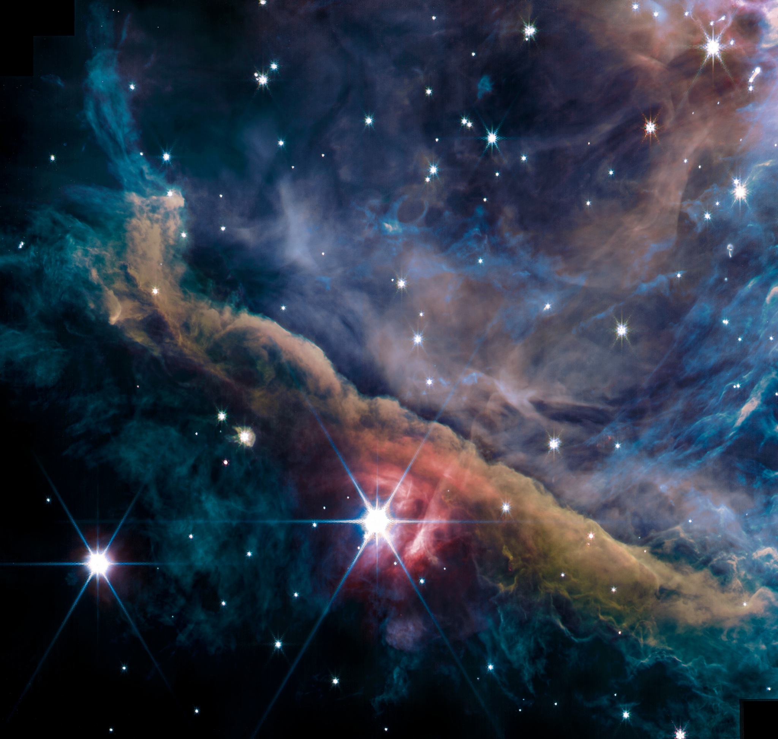
Reaching high angular resolution in the infrared and millimeter domains : ALMA & JWST
ALMA
JWST
1.4&2.1 µm, 2.7 – 3.4 µm,
4 µm, 4.4 – 4.8 µm
ESO ISAAC J(1.2µm),H(1.6µm)K(2.2µm)
Goicoechea+2016

Slide 9
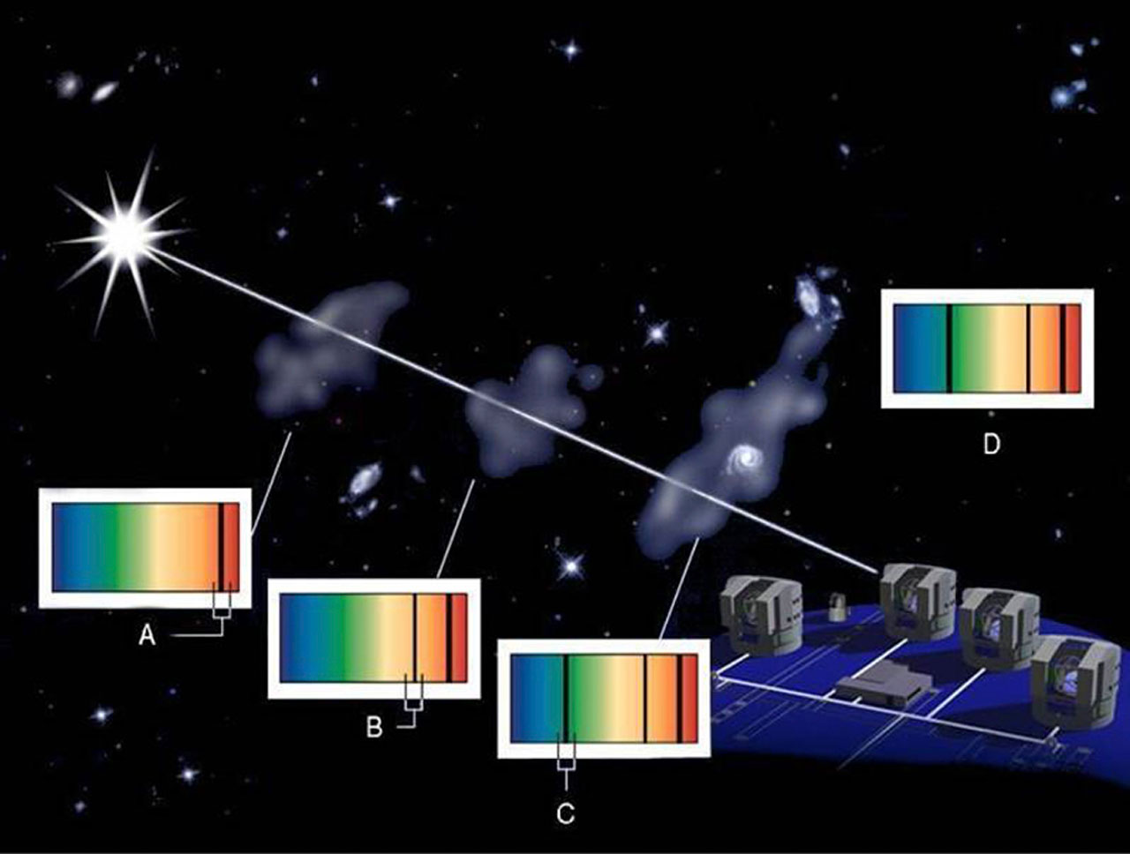
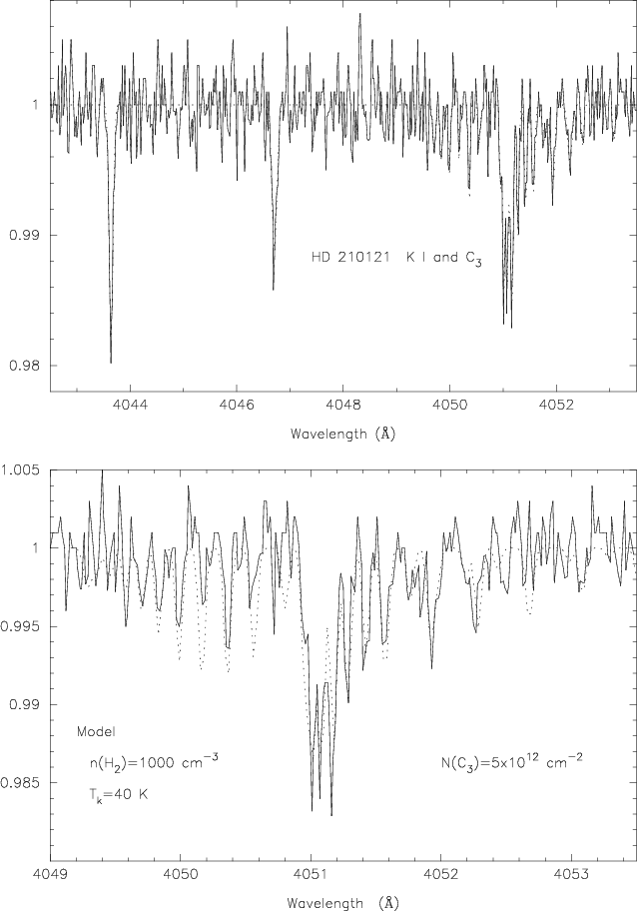
From small to large molecules absorption spectroscopy@ESO
The abundant C₃ carbon cluster : a challenge for chemical models & a building block (fragment ?) of heavier species
C₃ ~1/17 C₂ and the most abundant interstellar molecule with 3 Carbon atoms
ESO-UVES
Roueff+2002

Slide 10
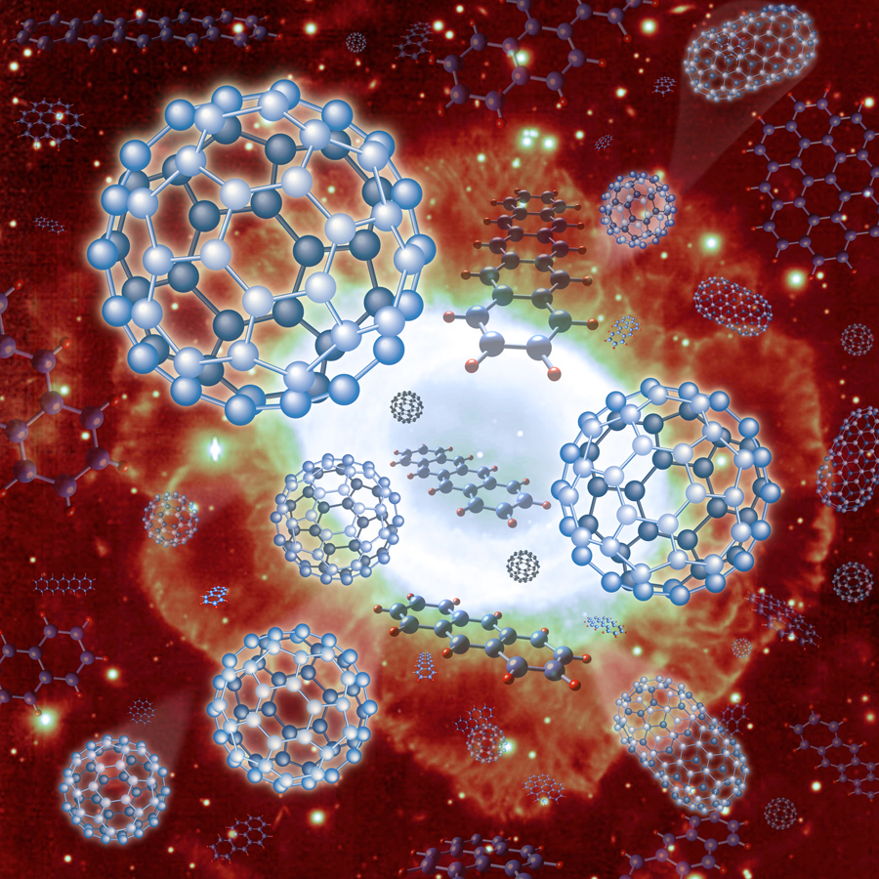
Diffuse Interstellar Bands (DIBs) at ESO
A long story with CES, FEROS, UVES, FLAMES/GIRAFFE, KMOS, MUSE to find their carriers
Rotational contours
Elyajouri+2018 (EDIBLES/UVES)
- DIBs are detected along all sight lines at at all distances : From nearby clouds (FEROS, Puspitarini+2013), spiral arms (GIRAFFE, Puspitarini+2015, Galactic bulge (UVES, GIRAFFE, Chen+2013), LMC (UVES, Ehrenfreund, Cami et al, 2002, GIRAFFE (Van Loon et al, 2013), distant galaxies (AM 1353-272 B, Antennae, Monreal-Ibero+2015,2018, MUSE) ➔ DIBs can be used in 3D kinetic maps of the ISM
-DIBs follow interstellar dust at first order, but disappear in the dense cloud cores (Barnard 68 ; KMOS , Elyajouri+2017)

Slide 11
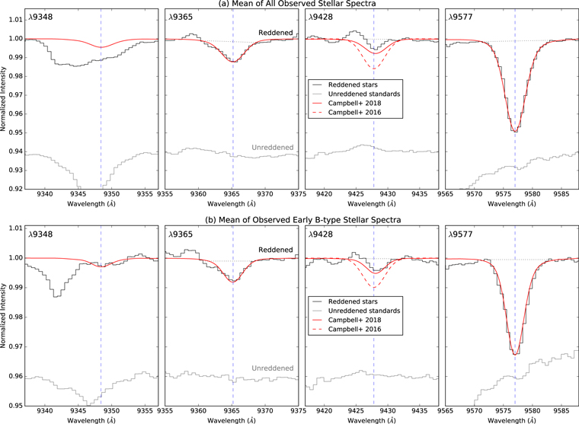
Diffuse Interstellar Bands (DIBs) at ESO
A long story with CES, FEROS, UVES, FLAMES/GIRAFFE, KMOS, MUSE to find their carriers
C₆₀⁺
Lallement+2018 (EDIBLES/UVES)
- Today C₆₀⁺ (buckyball fullerene) remains the unique species identified (CES, Foing+ 1994, UVES , Cox+ 2017; Lallement+ 2018)

Slide 12
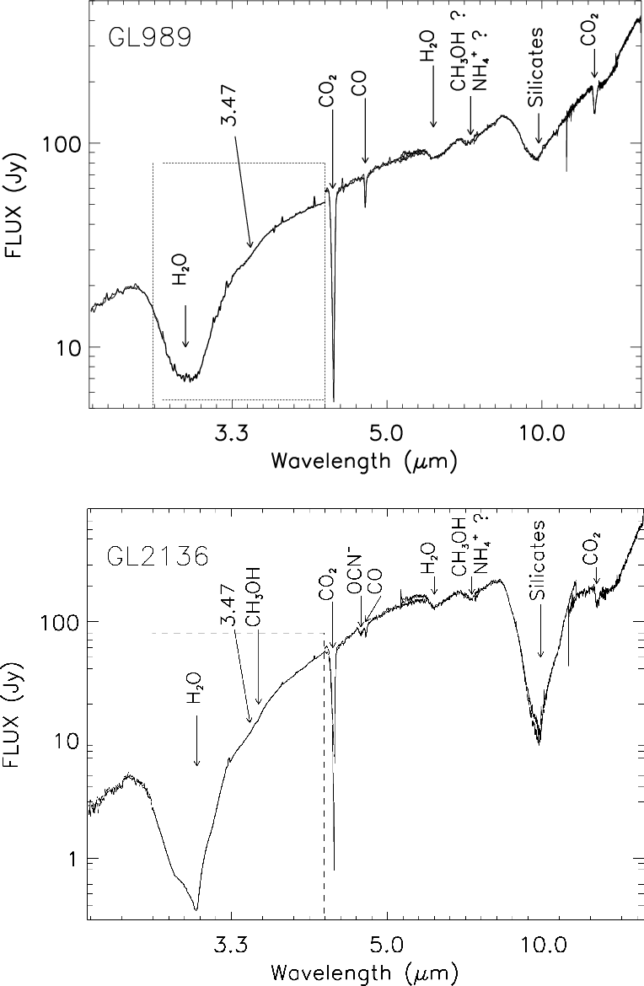
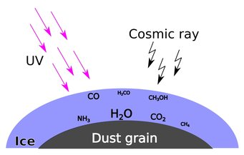
Molecules in solid state : probing the ice composition beyond water ice
Growth of “ice mantles” on dust grain in molecular clouds : what is their composition ?
Is it universal ?
→ Determination of the ice composition towards embedded sources (YSO) in the Milky Way and in the LMC
Main ice component : H₂O
Plus CO₂ CO , NH_{3 ,} CH₃OH …
→ Comparison with laboratory data
Shimonishi+2016
ESO ISAAC + AKARI
Dartois+2002
ESO ISAAC + ISO

Slide 13
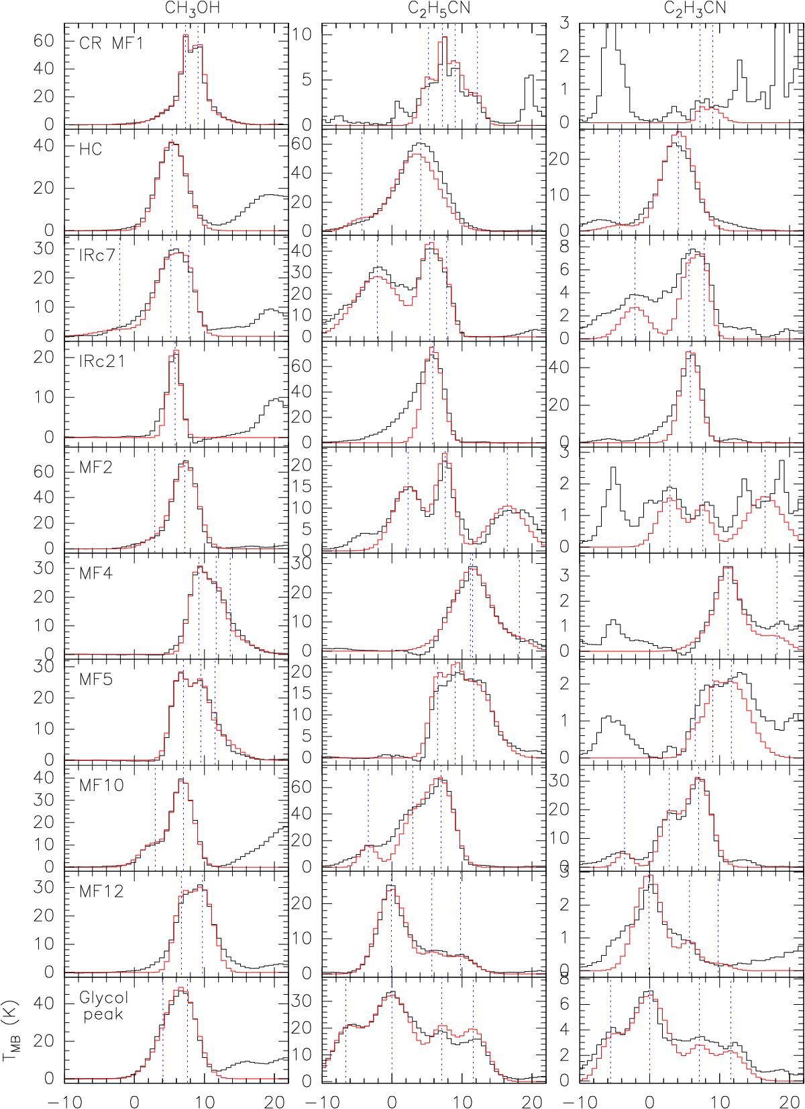
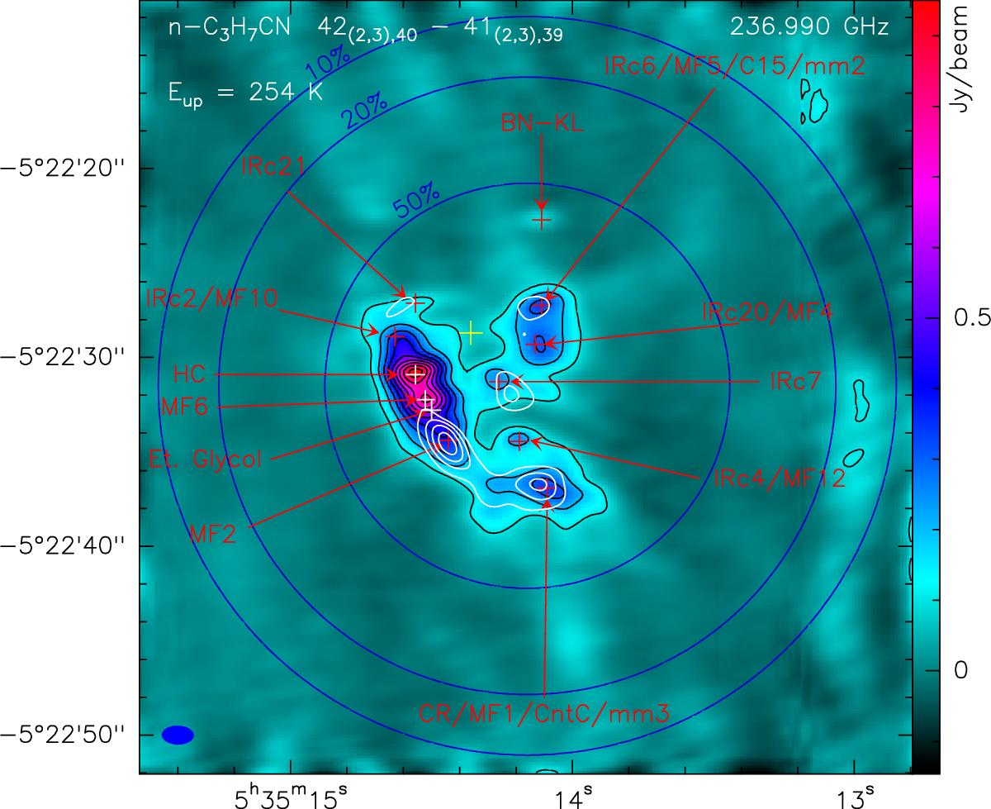
The route to molecular complexity : the Orion hot core region
CH₃OH
C₂H₅CN
C₂H₃CN
n-C₃H₇CN
H₂CO at different velocities
One of the best site for complex species with SgrB2 with a detection of n-C₃H₇CN
Spatial variation of molecular abundances and line profiles : relation with the explosive event 500 yrs ago ; ice mantle disruption and time dependent chemistry
Strong Interdisciplinary collaboration with chemists and physicists thanks to the CNRS-INSU PCMI program
ALMA
Pagani+2017,2019

Slide 14
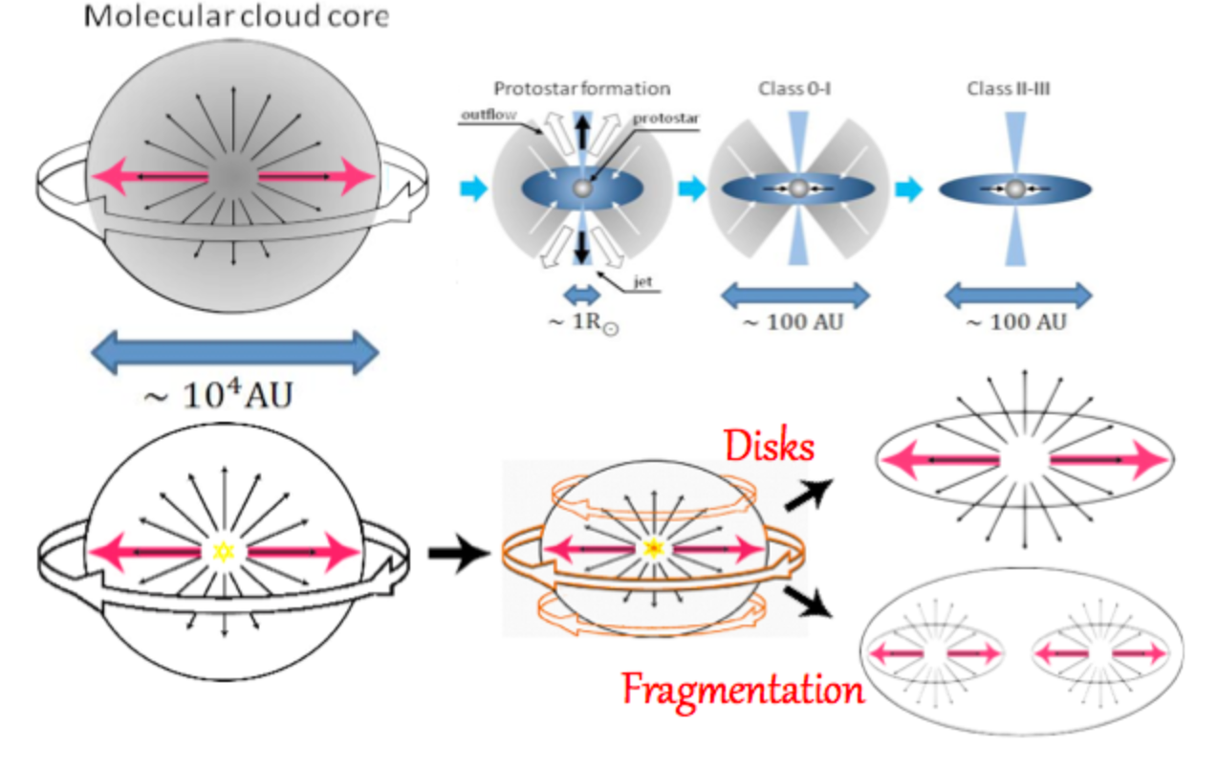
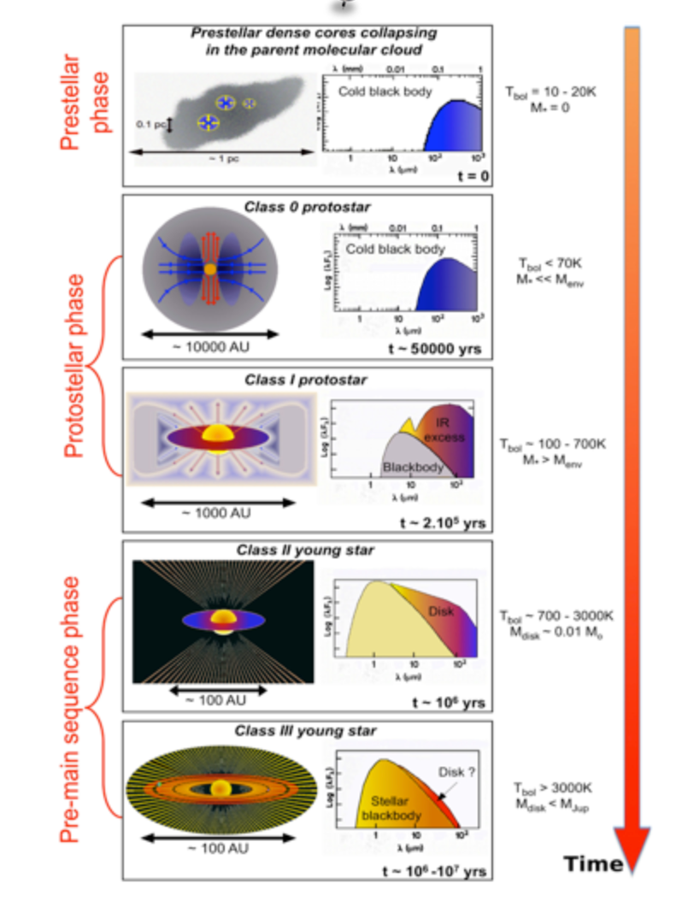
Probing the earliest stages of star formation
Highly embedded objects ➔(far)infrared to radio wavelengths emission spectrum
Is the collapse regulated by the magnetic field ? How ?
What is the Origin of jets & outflows ?
Does the collapse lead to single versus multiple objects ?
When does the disk forms ? What size ? When does the planet formation starts ?
A. Maury

Slide 15
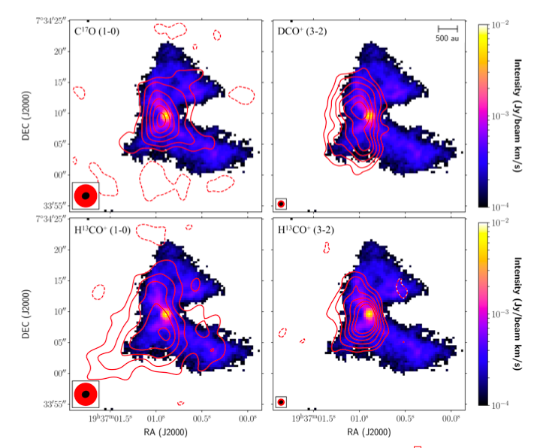
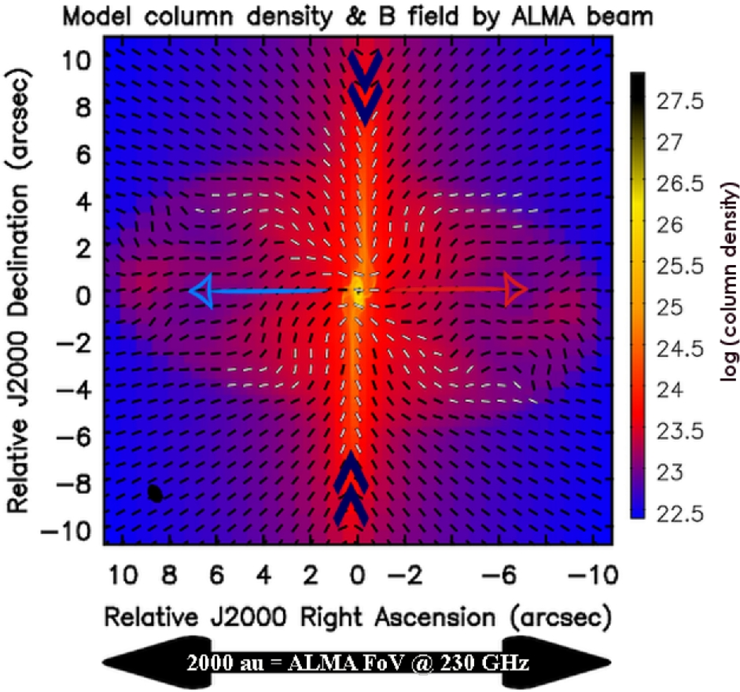
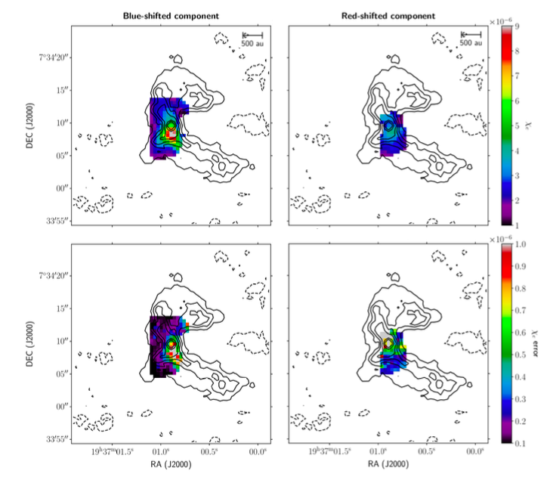
Physical structure of a young protostar : B335
Estimation of the ionization fraction from molecular lines :
high values support the good coupling with the magnetic field : a challenge for collapse models
A case of magnetically regulated collapse with loss of angular momentum
Molecular outflow + Cavity + strong magnetic field + (very) small disk
Maury+ 2018 , Cabedo+2022
ALMA

Slide 16
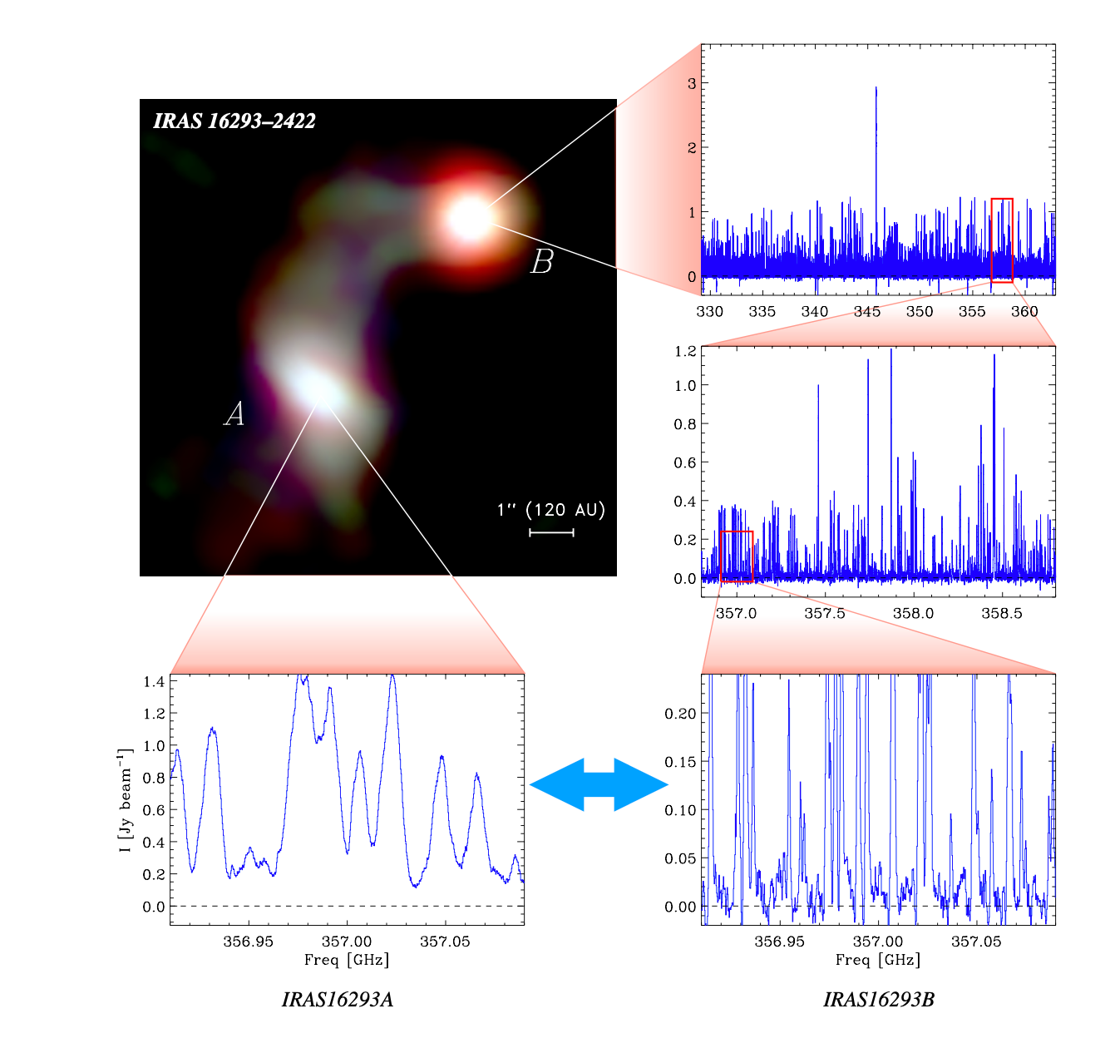
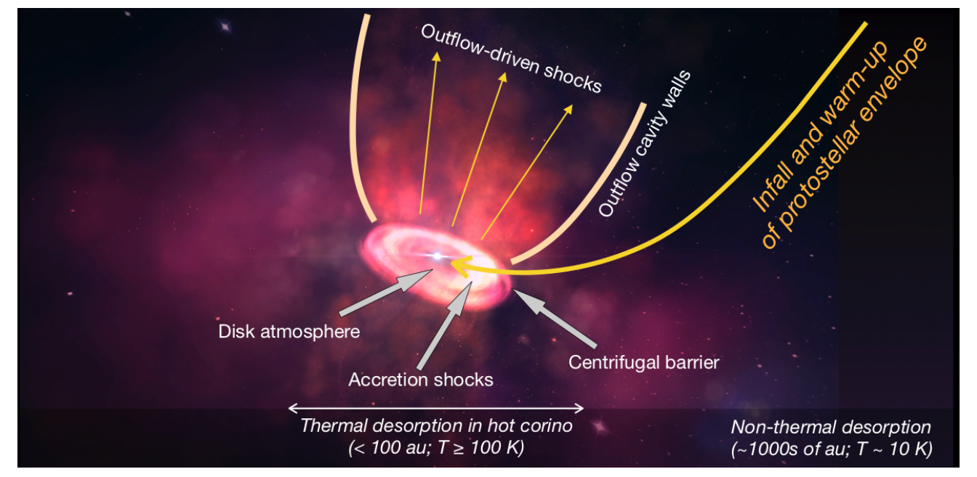
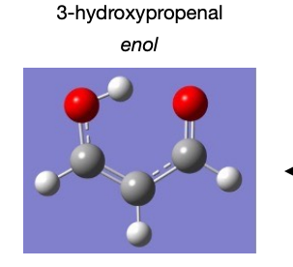
Chemical complexity at the earliest stages of star formation
Hot corino = protostar with a rich spectrum, many lines from complex organic molecules & D isotopologues.
→ PILS survey toward IRAS16293-2422 : extremely rich spectrum + & chemical differences between A & B;
→ Sharp variations of the abundances related to accretion shocks on the forming disk
→ Feeding material from ISM to disks : origin of volatiles and organic matter in the planetary systems ?
ALMA
Jorgensen+2016,2020, Manigand+2021, Coutens+2020, Sakai+2017

Slide 17
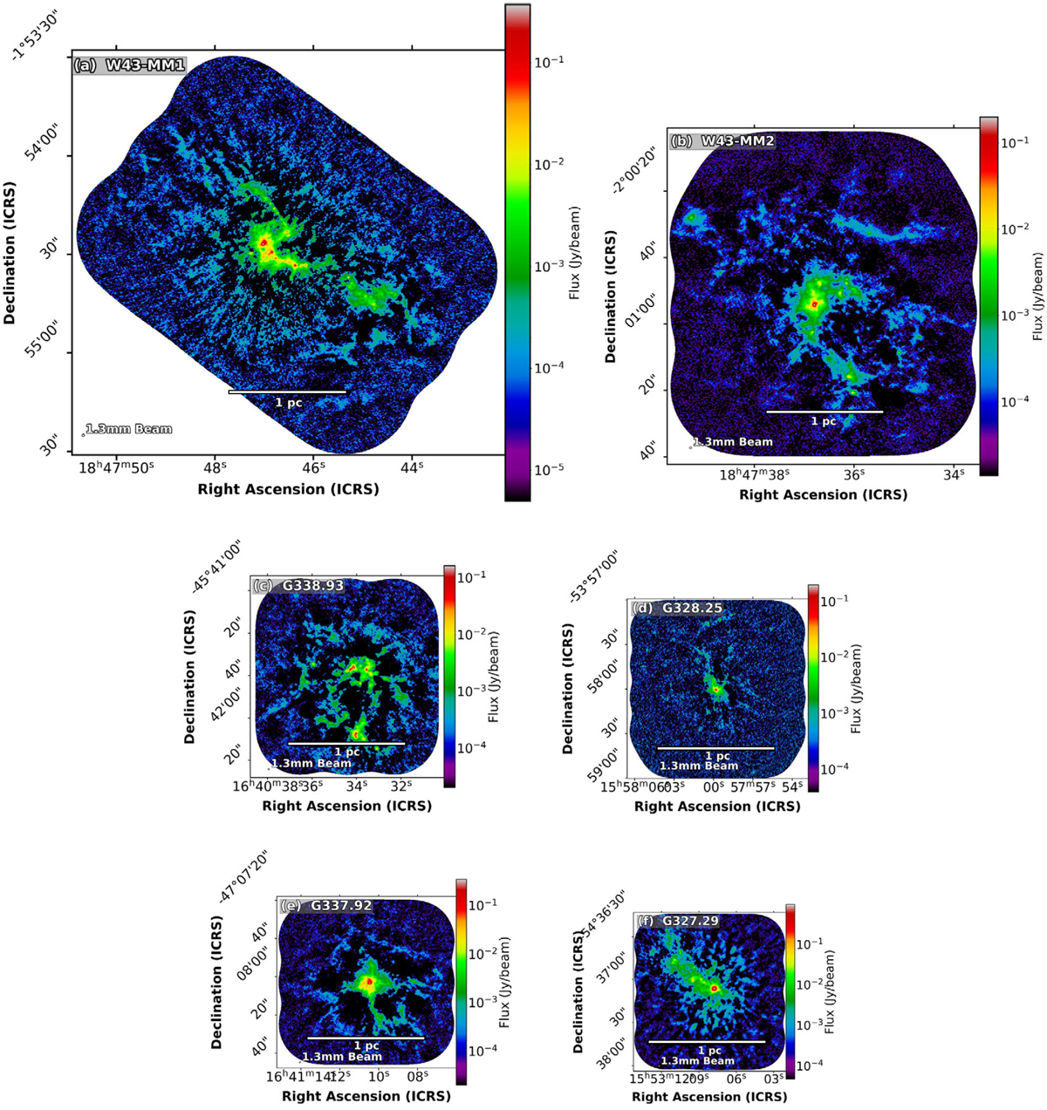
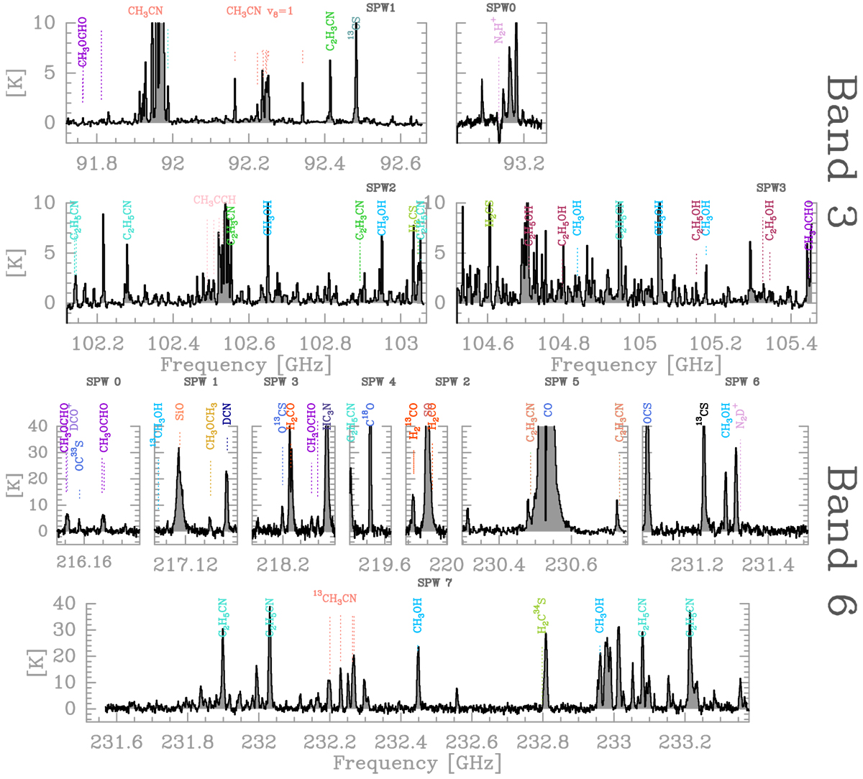
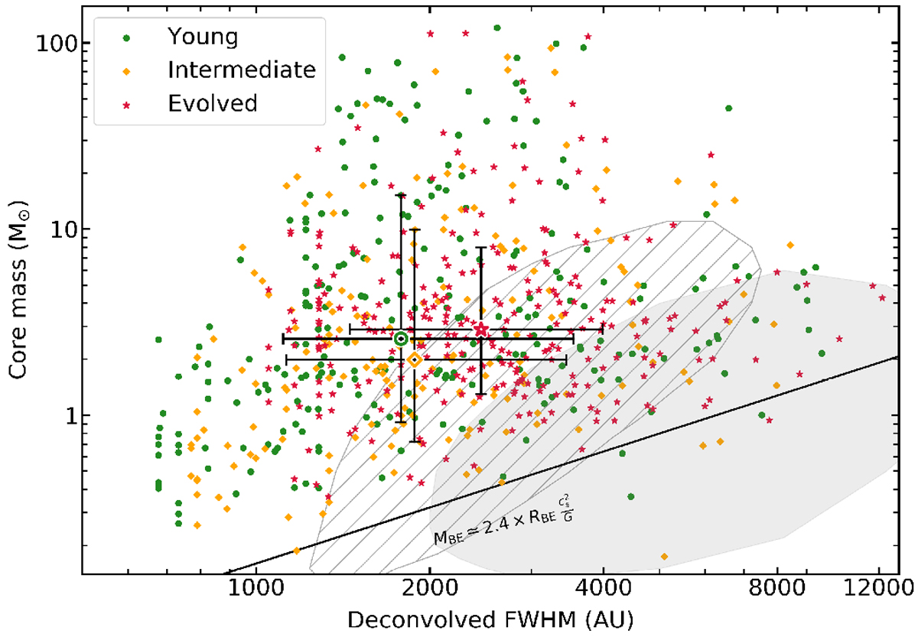
Massive star formation : ALMA IMF program
What is the origin of the stellar mass distribution ?
Survey of 15 massive nearby protoclusters in two continuum bands and several spectral lines (53 pc^2)
filaments dynamics, outflows, core mass distribution, identification and composition of hot cores
Motte+2022,Ginsburg+2022,
Pouteau+2022, Brouillet+2022

Slide 18
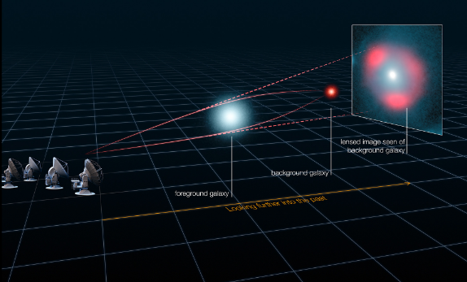
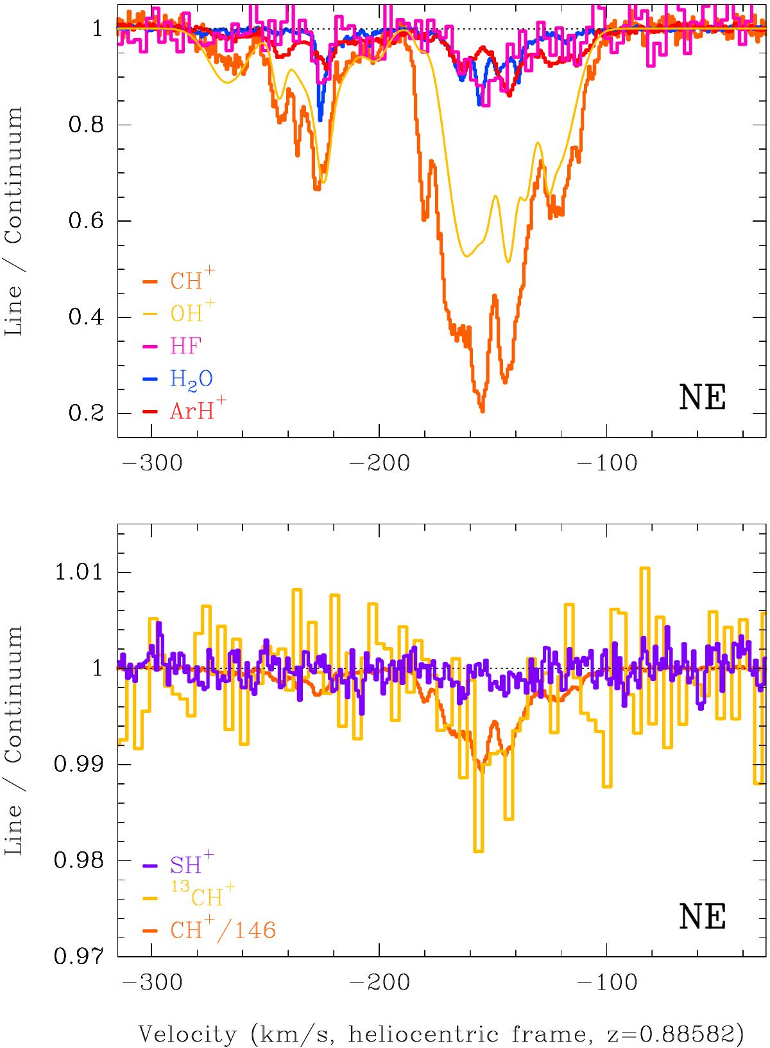
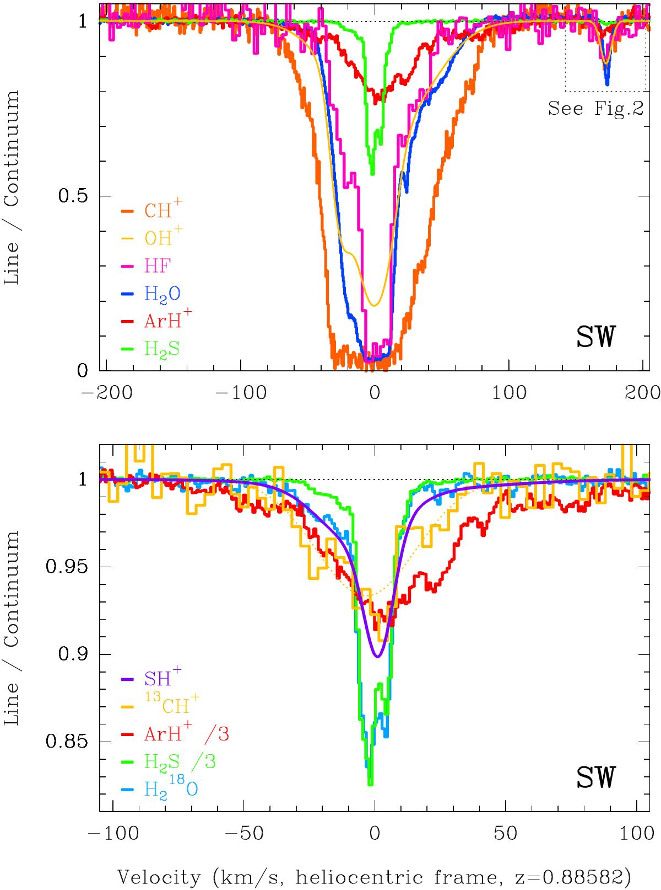
Molecules as diagnostics
z=0.89 galaxy along the line of sight to the PKS1830-211 Quasar
Gravitational lens → Multiple images
A unique opportunity to probe the ISM at z=0.89
Molecular gas content, density, Chemistry, nucleosynthesis, CMB temperature, variation of fundamental constants, etc.
Muller+2017,2020,2021

Slide 19
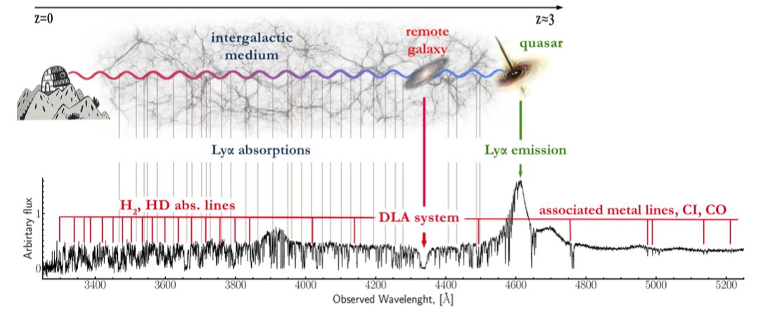
H₂, C⁺,C , CO observations at high redshift
Electronic spectrum of H2 in the far UV
redshifted ➥ visible absorption towards extragalactic sources
from Balashev & Noterdaeme
2022
➥ detection of molecular gas in damped Lyman 𝛼 systems at z ≈ 2
efficient pre-selection techniques in massive spectroscopic surveys (SDSS)
similar physics as in diffuse regions (e.g. Noterdaeme+2007) ( with different metallicity, radiation field, cosmic ionization rate, dust-to-gas mass ratio, …) - baryon cycle -
➥ test of variation of fundamental constants at high z; d𝛼/𝛼 ≤ 10⁻⁶;
coupling of high spectral resolution spectra and theoretical computations to derive the K-factors (Ubachs +2019)

Slide 20
Perspectives for the future
VLT
UV spectra with CUBES (local to high z)
Infrared spectroscopy MOONS, CRIRES+
ELT
HARMONI, MICADO, METIS, … ANDES & MOSAIC
ALMA2030
Broader instantaneous frequency coverage
New frequency bands & new modes
Increased sensitivity
New instruments → Continue & develop activities of laboratory astrophysics for a full and accurate exploitation of the diagnostic capabilities of molecular lines : Fundamental molecular processes gas & solid phases, spectroscopy, molecular physics, grain composition, interaction with radiation and particles, …

Slide 22
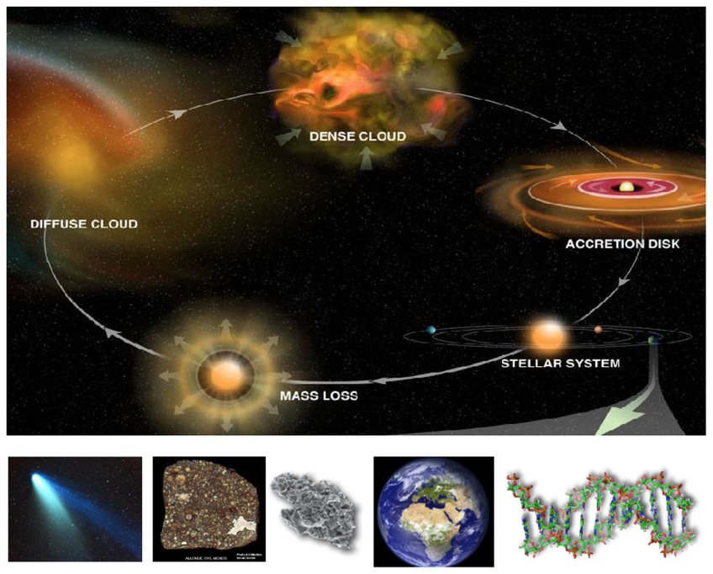

Slide 23
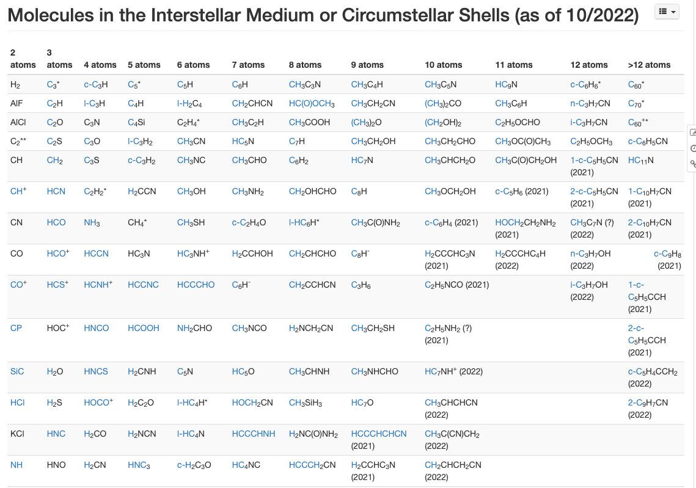

Slide 24
