Slide 1
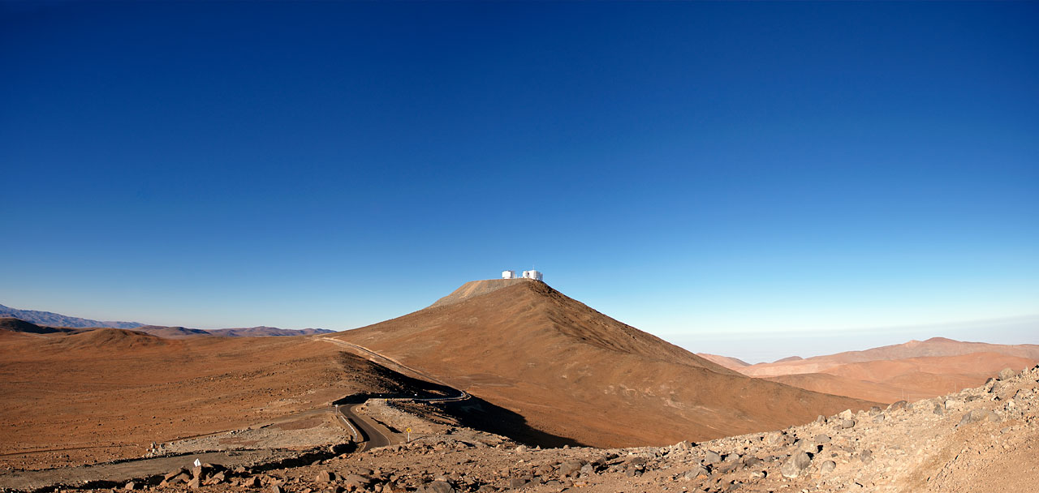
France in ESO’s history

Slide 2
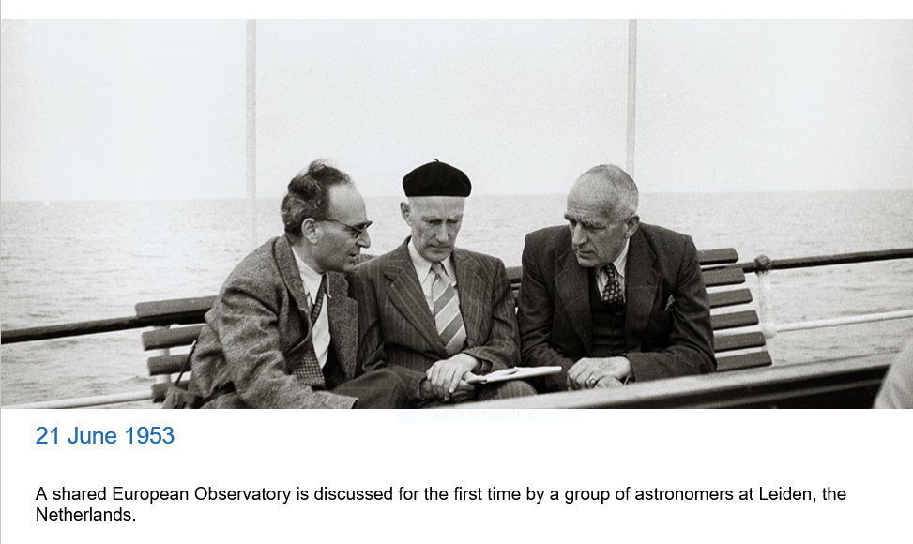
Early discussions for creation of a European Observatory
Notes:
The idea of a shared European observatory was discussed for the first time in late spring 1953 by a group of astronomers in Leiden, the Netherlands. They included Walter Baade and Jan Oort, Adrian Blaauw and Otto Heckmann. Oort would later become President of the ESO Committee and Heckmann and Blaauw ESO’s first and second Directors General respectively. From the start, they intended to build an observatory in the southern hemisphere.
Image: Kourganoff, Oort and Spencer at a Conference
21st of June, 1953 — the beginning of ESO. During a conference at Leiden Observatory, a group of astronomers discussed the idea of a joint European effort in astronomy. The persons in this picture, from left to right: V. Kourganoff, France, J.H. Oort, Netherlands and H. Spencer, Great Britain.

Slide 3
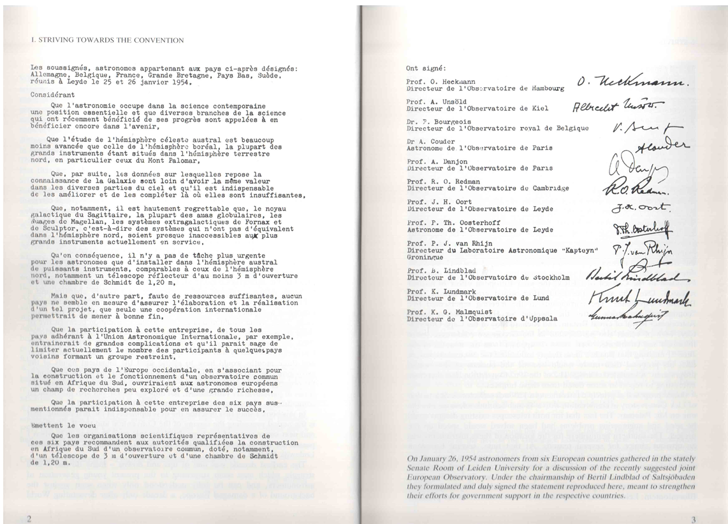

Slide 4
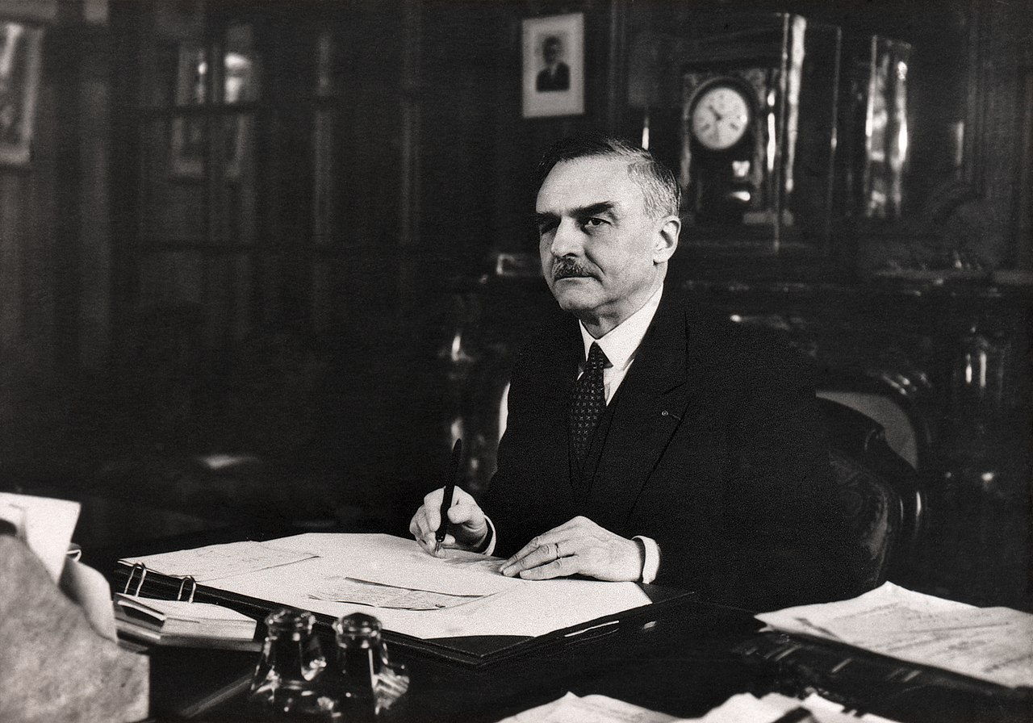
André Danjon
Director Observatoire de Paris, 1945-1963
Notes:
Parallèlement, le gouvernement vient de voter l’attribution de budgets dédiés à la recherche scientifique. Le dossier de Strasbourg figure parmi les premières demandes soumises au ministère qui lui donne une réponse favorable. En 1923, Danjon travaille, cette fois sur une proposition visant à mettre en place un observatoire d’astronomie physique. Ce projet sera à l’origine de la création de l’observatoire de Haute Provence. En 1930, il devient directeur de l’observatoire de Strasbourg et en 1935, doyen de la faculté des sciences de cette ville. Mais la seconde guerre mondiale éclate et la faculté se replie vers Clermont-Ferrand. André Danjon, devenu recteur, entre temps, s’efforce de protéger les étudiants et les professeurs alsaciens, mais Il se fait arrêter et révoquer par les allemands. Après l’armistice de 1945, il est nommé directeur de l’observatoire de Paris. Il y fait preuve du même dynamisme que dans ses postes précédents et devient le chef de file d’une astronomie française en plein renouveau. Non seulement il modernise l’observatoire de Paris, mais il parvient à entrainer les sites provinciaux dans son sillage. Continuant son travail d’enseignant, il forme des générations d’astronomes et de chercheurs, qui bientôt occuperont des postes clef dans ces observatoires.

Slide 5
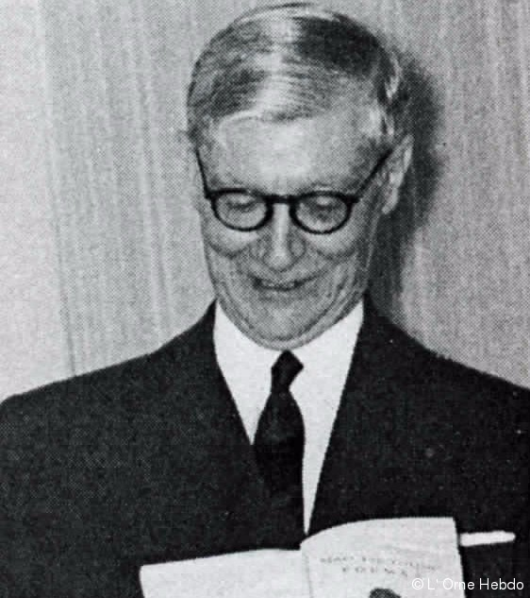
André Couder
Director of Optics laboratory, Obs. Paris
Notes:
Issu de l’Institut de chimie de Paris, André Couder est employé à l’observatoire astronomique de Strasbourg sous la direction d'Ernest Esclangon, avant de rejoindre, à l'initiative d’André Danjon, le laboratoire optique de l’observatoire de Paris en 1925 dont il devient le directeur et où il acquiert vite une réputation mondiale. On lui doit désormais, et jusqu’à sa retraite en 1968, la plupart des parties optiques des instruments français, de l’astrolabe de 6 centimètres d’ouverture au télescope de 193 centimètres qui équipe l’observatoire de Haute-Provence

Slide 6
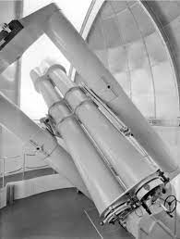
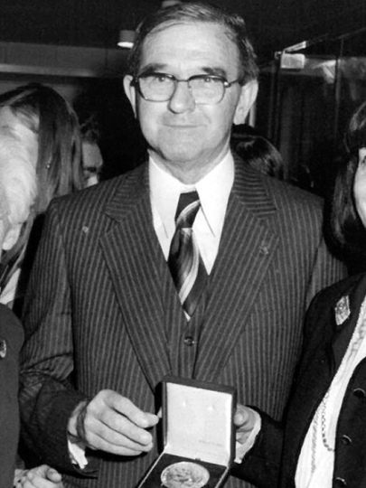
Charles Fehrenbach
Notes:
Measures radial velocities. Looking at Magellanic cloud fields, separate stars from galaxy and from MC, 60km/s difference in velocity; About 2500 stars measured, about 500 from GMC.
Installed in 1960
The Grand Prisme Objectif is a copy of a telescope installed at the Observatoire de Haute Provence in France. One half of the telescope is a 40-centimetre objective prism for obtaining the spectra of many objects at the same time. The other telescope is for guiding. The GPO was first operated in Zeekoegat, South Africa from 1961. The Grand Prisme Objectif was ESO's only refracting (lens) telescope.

Slide 7
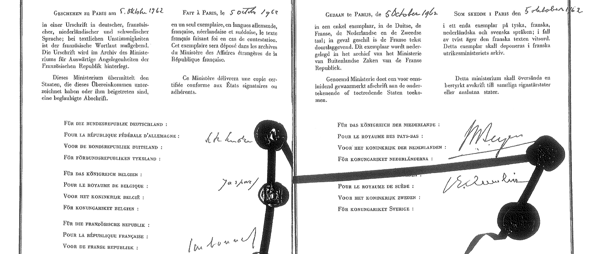
5 October 1962
Founding Members Belgium, France, Germany, the Netherlands and Sweden sign the ESO Convention.
Notes:
On 5 October 1962, representatives from five European countries — Belgium, France, Germany, the Netherlands and Sweden — signed the ESO Convention in Paris. Their signatures represented a formal commitment to establish the European Organisation for Astronomical Research in the Southern Hemisphere, today commonly referred to as the European Southern Observatory.
Link: http://www.eso.org/public/images/final_convention_paper/

Slide 8
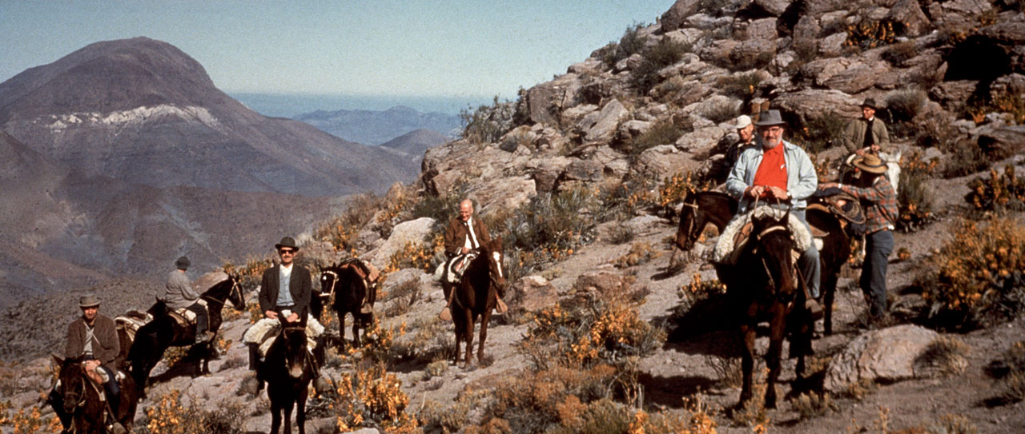
Discovery of the sky in Chile

Slide 9
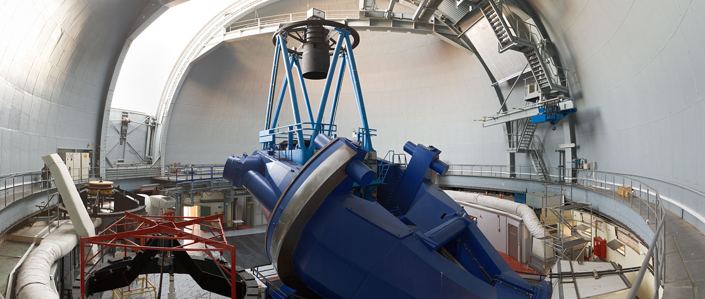
7 November 1976
First light for the ESO 3.6-metre telescope.
Notes:
In November 1976, the 3.6-metre telescope, the jewel in the La Silla crown, envisioned since the inception of ESO, started operations. This had been made possible thanks to a close cooperation with CERN in Switzerland, where ESO’s technical staff had moved in 1970.
About the ESO 3.6-metre telescope: http://www.eso.org/public/teles-instr/lasilla/36.html

Slide 10
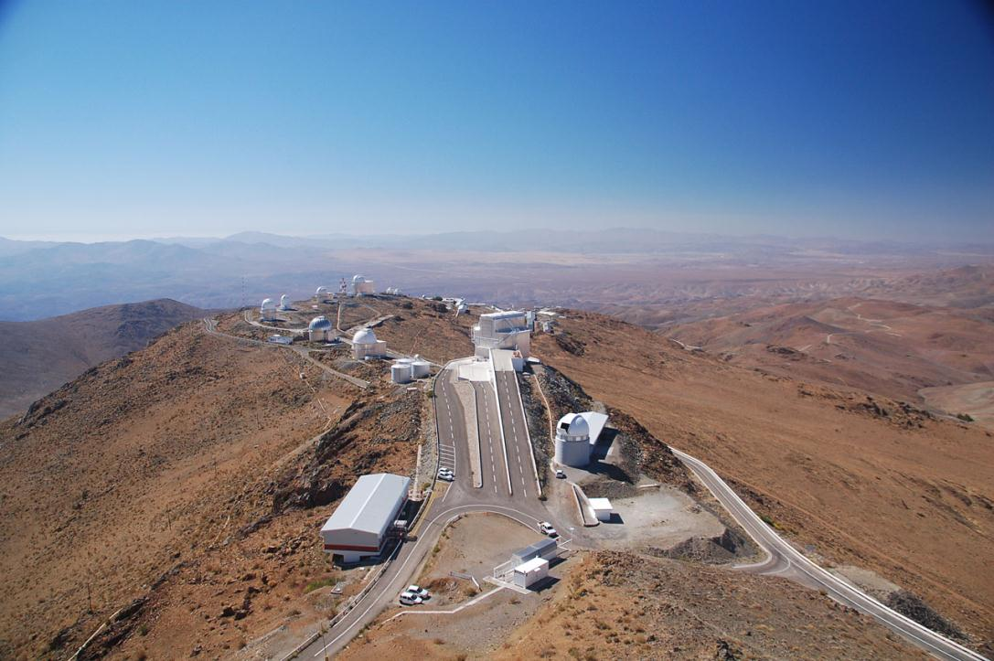
La Silla, ESO’s first observatory site
Notes:
http://www.eso.org/public/images/dsc_0104/

Slide 11
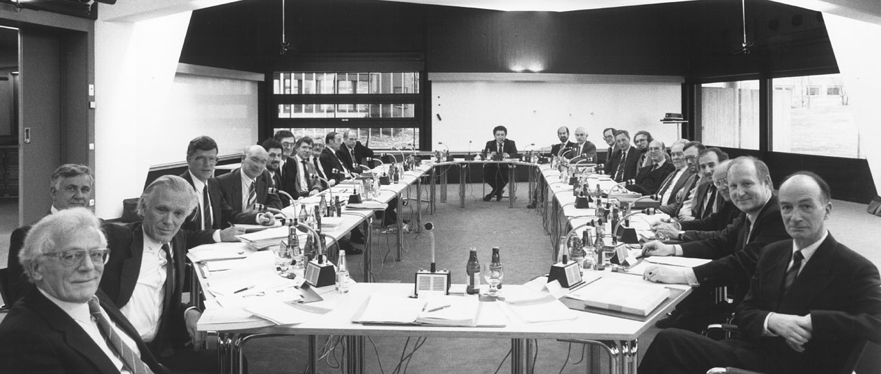
8 December 1987
Decision is taken by the ESO Council to build the Very Large Telescope (VLT).
Notes:
The NTT was key to testing the viability of ESO’s new flagship project: the Very Large Telescope array (VLT), designed to be the world’s biggest optical telescope. The ESO Council approved the project in 1987.
Image:Council approves the VLT
During its Council Meeting in December 1987, the national delegates approved the plan to build the VLT observatory on Cerro Paranal.
Link: http://www.eso.org/public/images/council87/

Slide 12
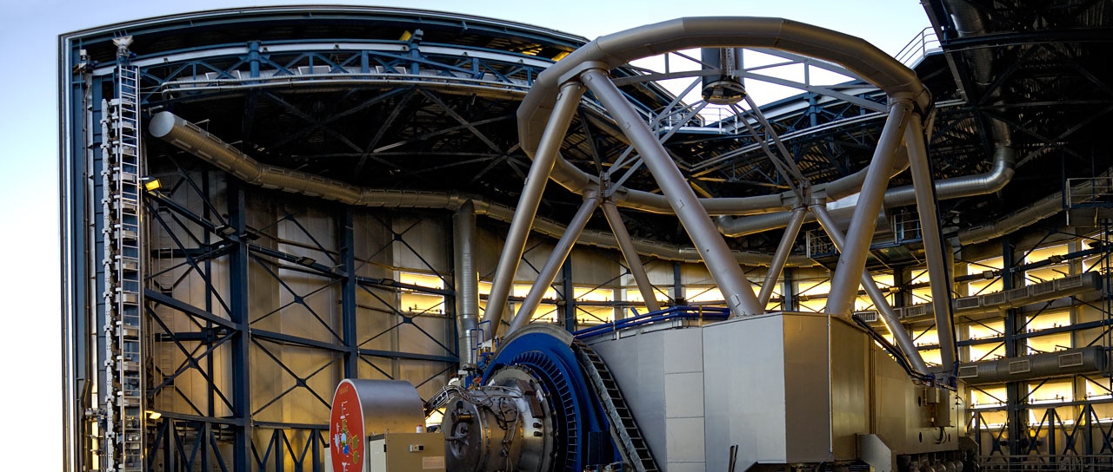
25 May 1998
First light for the VLT’s first Unit Telescope (UT1), Antu.
Notes:
It took ESO ten years to build the highly complex VLT, whose first telescope, named Antu — the Sun in the Mapuche language — saw First Light in May 1998.
Press release: A Great Moment for Astronomy
The European Southern Observatory announces that First Light has been achieved with the first VLT 8.2-m Unit Telescope at the Paranal Observatory. Scientifically useful images have been obtained as scheduled, on May 25 - 26, 1998.
Link: http://www.eso.org/public/news/eso9820/

Slide 13
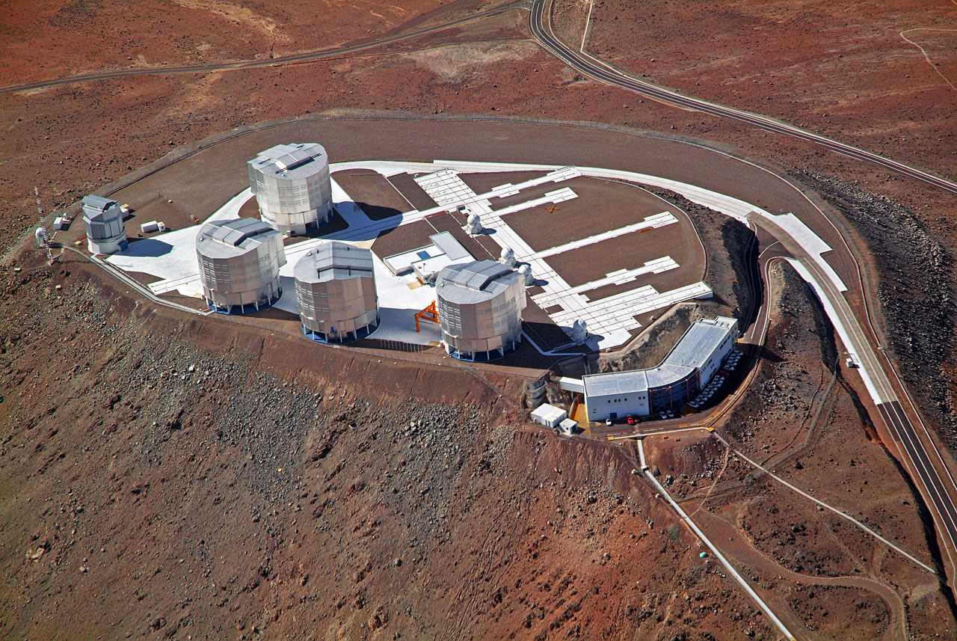
Paranal Observatory

Slide 14
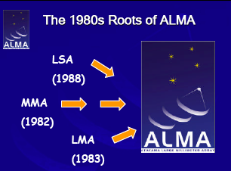
From the roots, the design ended up..
ONE ARRAY consisting of two sub-arrays:
A1) Bilateral antenna array: 50 12m antennas;
A2) Bi-lateral Correlator designed for 64 antennas
B1) ALMA Compact Array (ACA): 4-12m +12-7m antennas
B2) ACA correlator designed for 16 antennas
For the entire mm/submm range! (5000m)
All can be operated as one array
Can be split into 6 independent sub-arrays

Slide 15
ESO’s Strategic Principles
ESO Council Resolution, Dec.2004
Retention of European astronomical leadership into the era of Extremely Large Telescopes
Assure completion of ALMA, and efficiently exploit its superb scientific capabilities
Maintain VLT in world-leading position for another 10-15 years by continued upgrades
Exploit unique capabilities of the VLTI
Lead in the construction of an ELT on a competitive timescale

Slide 16
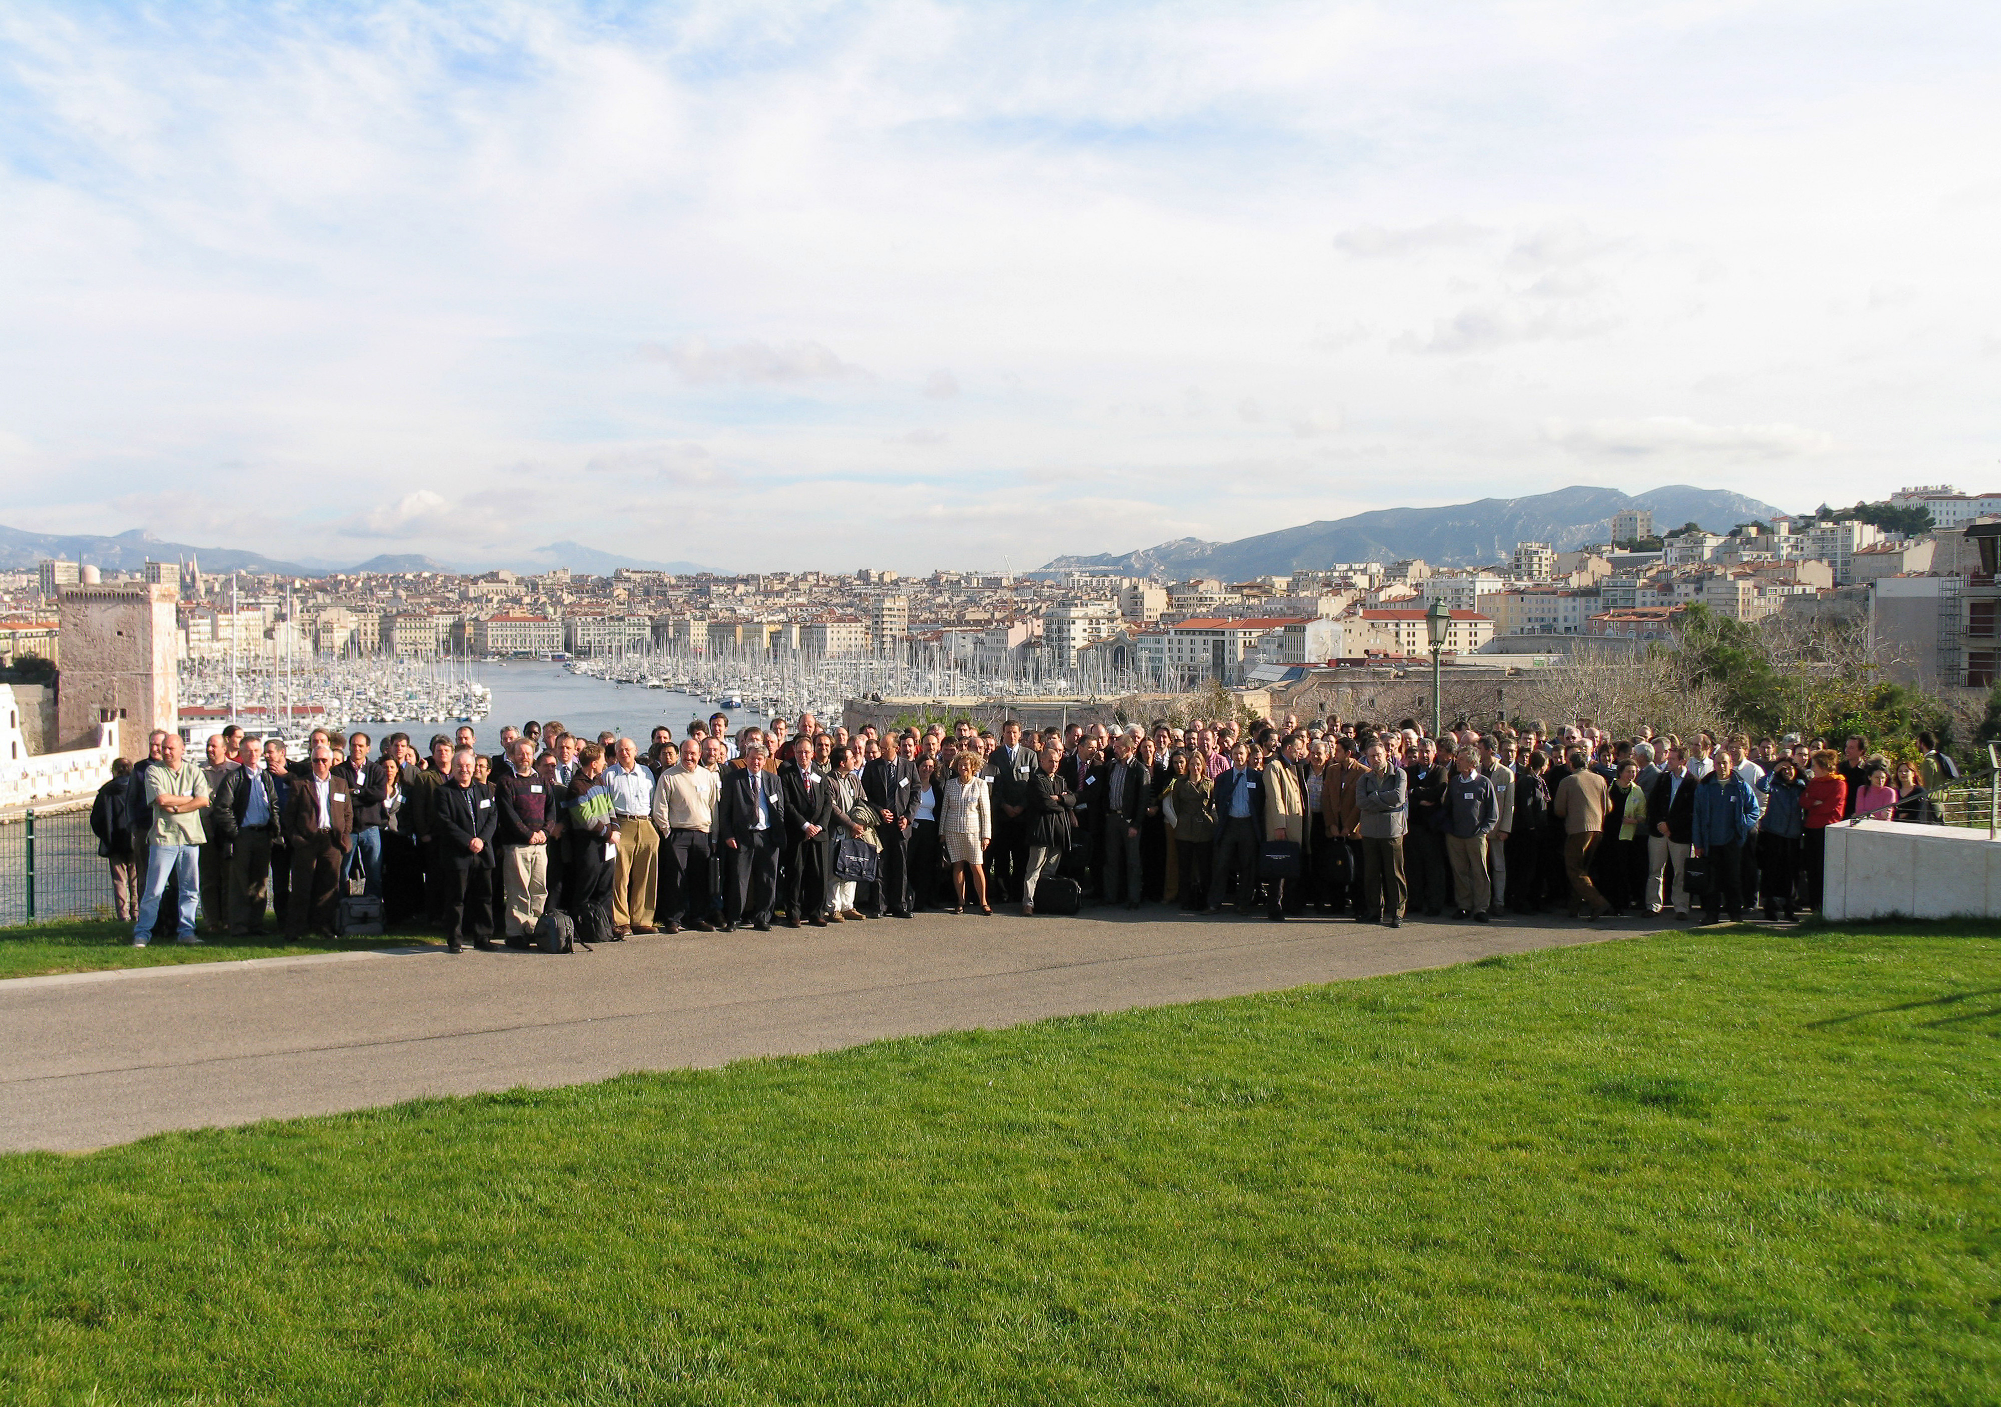
ELT conference in Marseilles,
November 2006

Slide 17
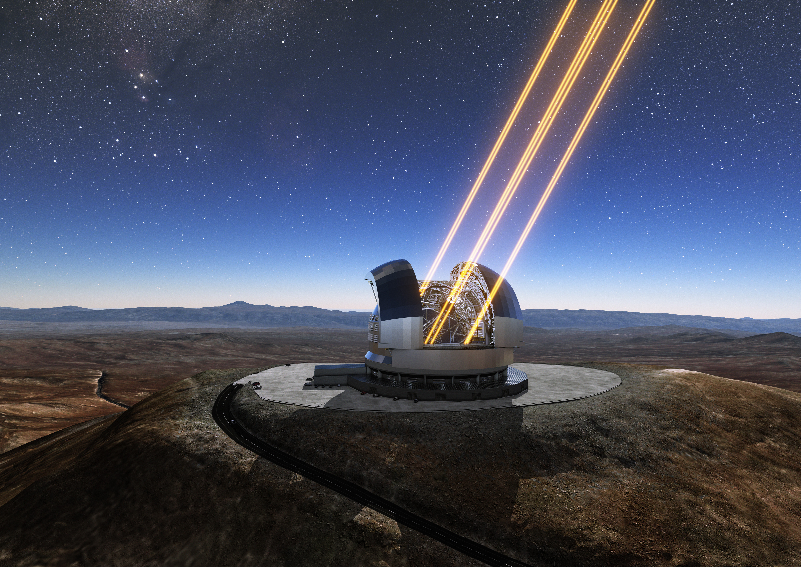
ELT: 5 mirror telescope
M1: 39 m concave mirror made up of 798 hexagonal segments
M2: 4.2 m, largest convex mirror ever produced
M3: 4m, curved, improving image quality
M4: 2.4m flat, largest adaptive mirror ever made, adjusts its shape a thousand times a second with >5000 actuators
M5: flat, elliptical mirror measuring 2.7 by 2.2 metres constructed from six lightweight silicon-carbide segments brazed together. Tiltable mirror, stabilizes the image and sends it to the instruments.

Slide 18
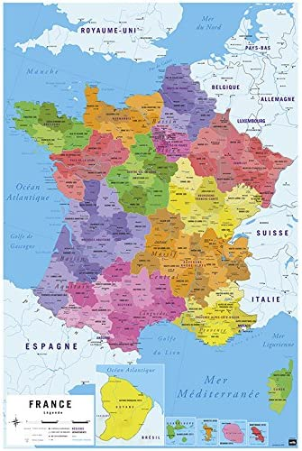
And France in all of this?

Slide 19
French government and ESO
Generally good, even excellent relations, but…some crisis
Difficulties in the early days,Fehrenbach « trick » helped
Crisis in 1993: Only 3 telescopes? No VLTI? Pierre Léna resigned from ESO Council, I replaced him. I launched an audit chaired by Michel Petit, yielding decision to construct VLTI infrastructure but to postpone VLTI. (In the end Riccardo Giacconi and I did our best to reinstate VLTI rapidly).
Crisis in1997: Claude Allègre, Research Minister, attempted to lower the ESO budget.

Slide 20
French government and ESO
Crisis in 2001: opposition to entry conditions for UK
Crisis in 2002: opposition to ALMA (Bernard Bigot,Dir Cab of Ministre Déléguée à la recherche Claudie Haigneré).
Permanent crisis: orchestrated by France’s representative to Finance Committee, Patricia Laplaud
Of all of my years as ESO DG (1999-2007), France only approved the ESO budget in 2007.

Slide 21
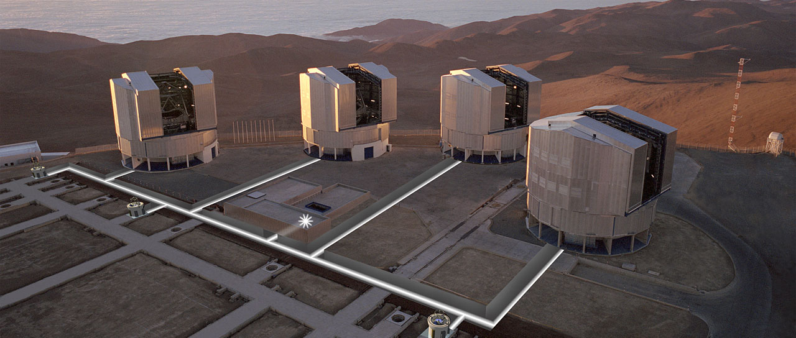
Telescopes and instruments

Slide 22

High angular resolution
Strong influence and participation of France in the search for high angular resolution at ESO.
Antoine Labeyrie, discoverer of speckle interferometry, saw the VLT as an array of 2-4-metre telescopes which deliver coherent light beams to a central “Coudé' laboratory. Pierre Léna, in parallel, established strong links between Paris Observatory and ONERA to develop adaptative optics. This group also trained several future ESO employees. After much highs and lows, their tenacity was in the end rewarded, ESO is now world champion in adaptive optics and interferometry in the near infrared.
In these subjects and particularly in interferometry, fruitful links were created between the French group and the group of Reinhard Genzel at MPE.
The fascinating tale can be read in Pierre Léna’s book, Une histoire de flou.

Slide 23
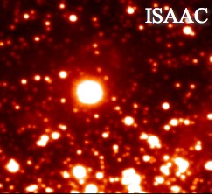
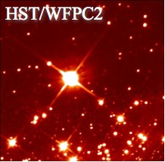
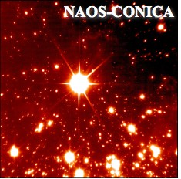
High resolution: from space and ground
8-m telescope
Seeing-limited
2.5-m Space telescope
~4-5 b$
8-m telescope +
Adaptive optics
~0.15 b$

Slide 24
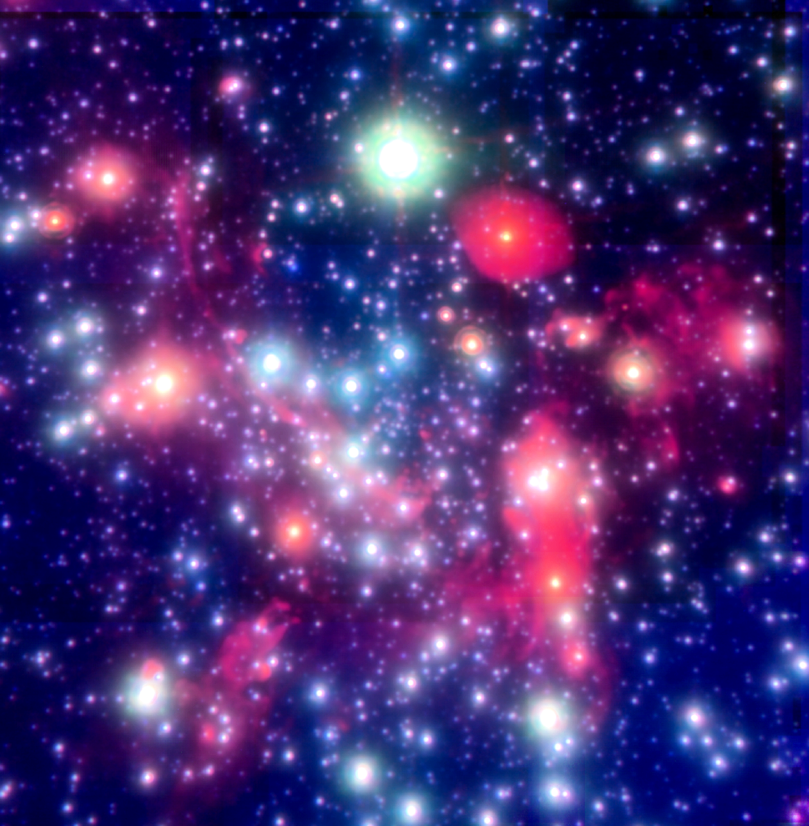
Massive black hole at the galactic center
Galactic
Center
SgrA*
2 light days
Genzel et al. 2005

Slide 25
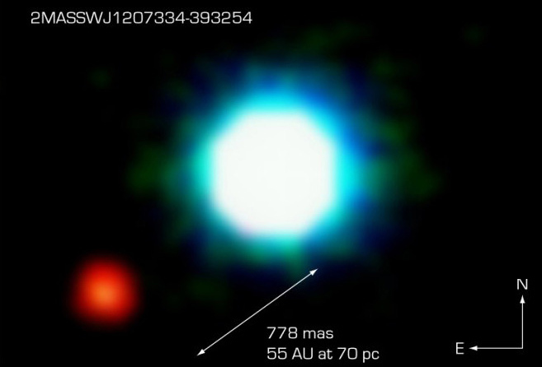
First image of an exoplanet
Chauvin et al. 2004

Slide 26
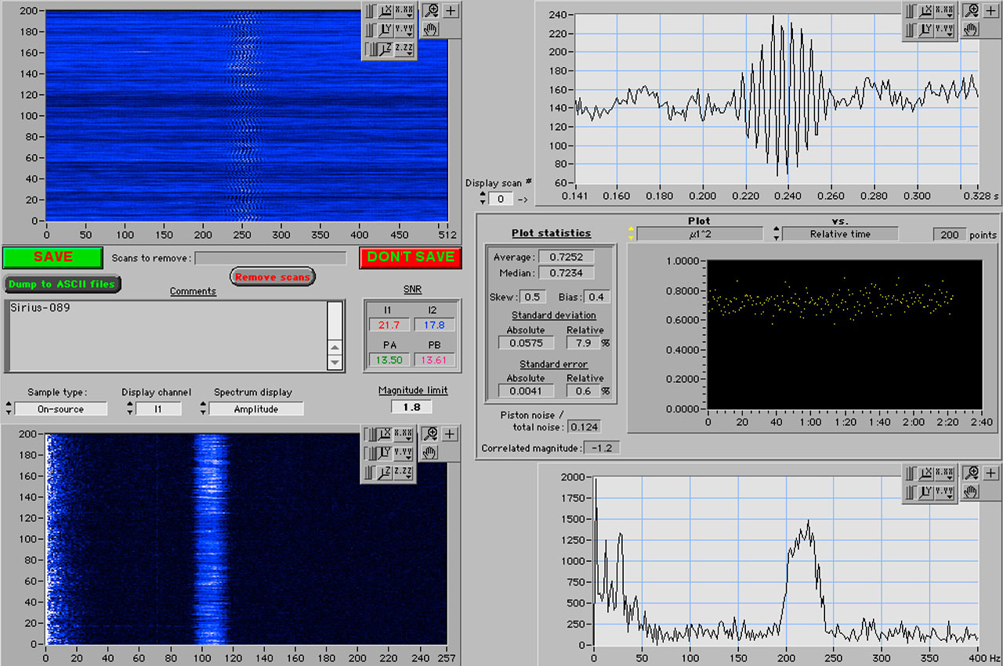
First fringes with 2 Ats of VLTI
18 March 2001
18 March 2001
Notes:
The "first fringes" obtained with the VLTI, as seen on the computer screen during the observation (upper right window). The fringe pattern arises when the light beams from two small telescopes are brought together in the VINCI instrument. The pattern itself contains information about the angular extension of the observed object, here the bright star Sirius. 2001

Slide 27
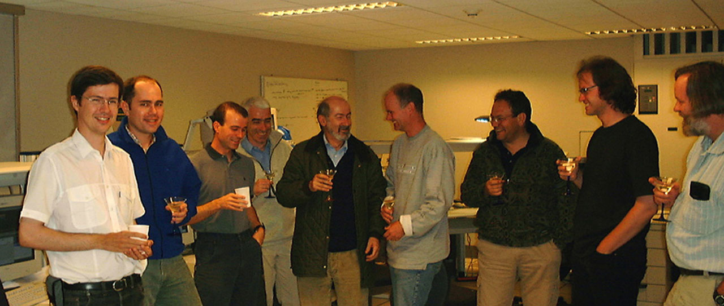
Celebrating the moment of "First Fringes" at the VLTI.
Notes:
Celebrating the moment of "First Fringes" at the VLTI. At the VLTI control console (left to right): Pierre Kervella, Vincent Coudé du Foresto, Philippe Gitton, Andreas Glindemann, Massimo Tarenghi, Anders Wallander, Roberto Gilmozzi, Markus Schoeller and Bill Cotton . Bertrand Koehler was also present and took the photo. 18 March 200118 March 2001

Slide 28
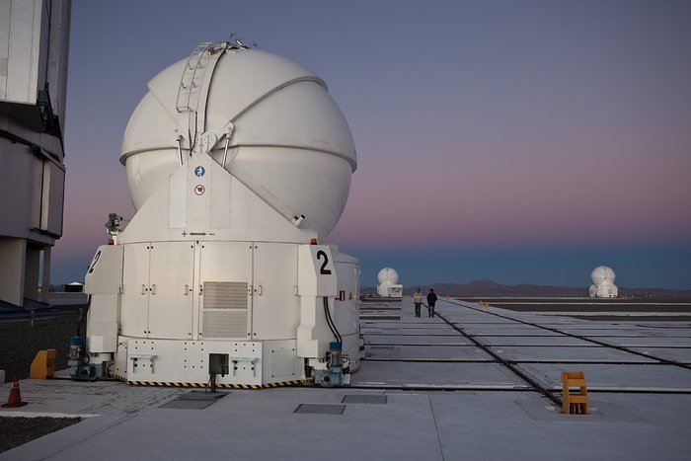
VLTI 3rd Auxiliary telescope, donated by France and Germany
CNRS and Max Planck

Slide 29
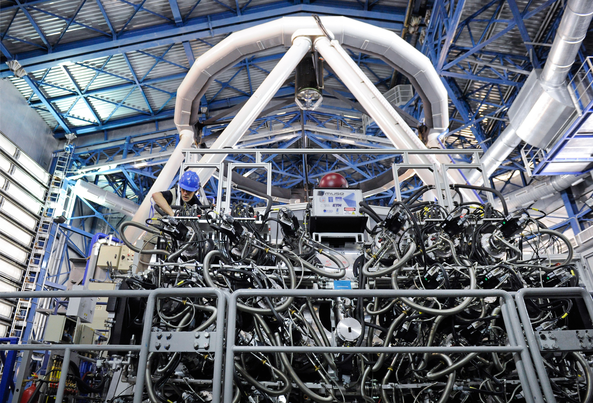
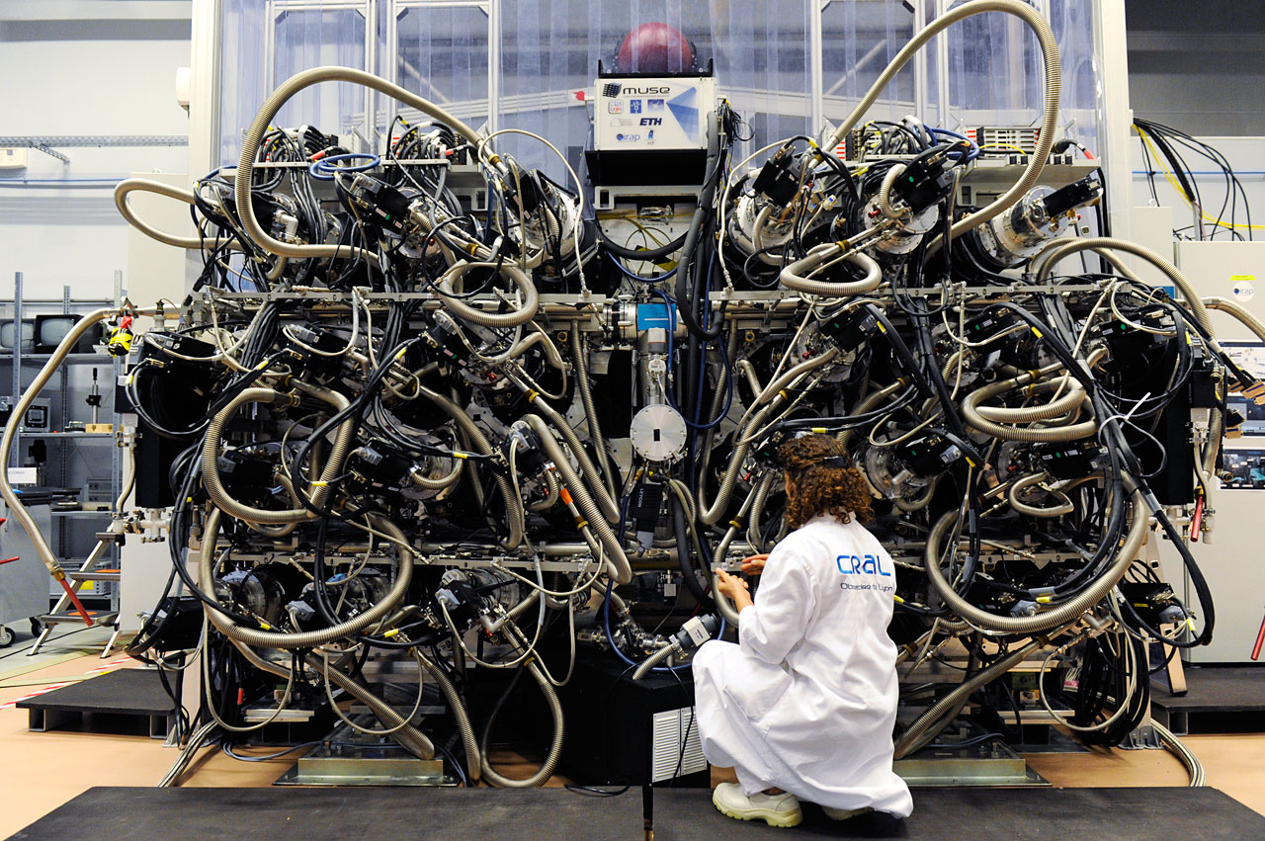
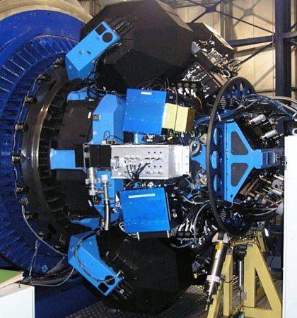
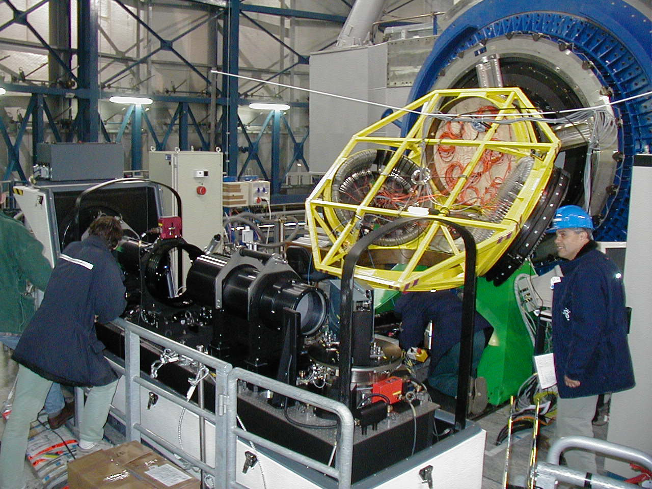
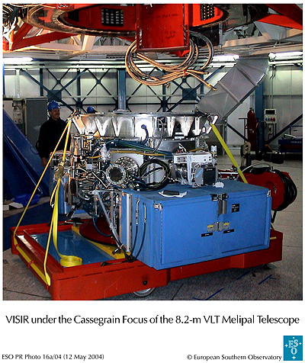
Other instrument strengths in France
High proficiency in multi object and integral field spectroscopy
Pioneer in mid IR

Slide 30
French Contribution
Across La Silla, Paranal and ELT, France has contributed to 57% of all ESO instruments and played a leading role or PI role in 33%
La Silla 3.6m
  TIMMI, COME-ON, COME-ON-PLUS, ADONIS
  HARPS, NIRPS
VLT
  NAOS, VIMOS, FLAMES/GIRAFFE, VISIR, X-shooter, SPHERE, MUSE, (BlueMUSE to follow)
  MOONS, MAVIS, 4MOST
VLTI
  VINCI, MIDI, AMBER, PIONIER, MATISSE
  GRAVITY, GRAVITY+
ELT
  HARMONI, (MOSIAC to follow)
  MICADO, METIS, MORFEO, (ANDES to follow)
Notes:
Leading/PI roles shown in Blue on all the slides
ANDES is the new name for HIRES, MORFEO the new name for MAORY

Slide 31
La Silla 3.6m
TIMMI
  PI: Pierre-Olivier Lagage
COME-ON, COME-ON-PLUS
  Prototypes Pierre Léna lead
ADONIS
  Jean-Luc Beuzit lead
HARPS
  Jean-Pierre Sivan, Jean-Loup Bertaux
NIRPS
  Xavier Delfosse

Slide 32
VLT
NAOS in NACO
  Gerard Rousset / Anne Marie Lagrange
GIRAFFE in FLAMES
  PI: Francois Hammer
VIMOS
  PI: Olivier Le Fèvre
VISIR
  PI: Pierre-Oliver Lagage
X-shooter
  Co-PI: Francois Hammer
SPHERE
  PI: Jean-Luc Beuzit
MUSE
  PI: Roland Bacon
(BlueMUSE to follow)
  PI: Johan Richard
MOONS
  Co-PI: Hector Flores
MAVIS
  Co-I: Benoît Neichel
4MOST (VISTA)
  Co-I: Johan Richard

Slide 33
VLTI
VINCI
  PI: Vincent Coudé du Foresto
AMBER
  PI: Romain Petrov
PIONIER
  PI: Jean-Philippe Berger then Jean-Baptiste Lebouquin
MATISSE
  PI: Bruno Lopez
MIDI
  Co-PI: Guy Perrin
GRAVITY
  Co-Is: Guy Perrin and Karine Perraut
GRAVITY+
  Co-I: Thibaut Paumard, Jean-Baptiste Lebouquin

Slide 34
ELT
HARMONI
  Deputy PI: Benoît Neichel
(MOSAIC to follow)
  PI: Roser Pello
MICADO
  CoI: Yann Clenet
METIS
  Co-I: Eric Pantin
MORFEO
  Co-I: Philipe Feautrier
(ANDES to follow)
  Co-I: Isabelle Boisse

Slide 35
Thematic Sequences
Multi Object Spectrographs and surveys
  VIMOS
  GIRAFFE
  MUSE
  MOONS
  4MOST
AO
  COME-ON
  COME-ON-PLUS
  ADONIS
  NAOS
  SPHERE
  MUSE
  MAVIS
  MICADO
  HARMONI
  MORFEO
VLTI
  AMBER
  VINCI
  MIDI
  PIONIER
  MATISSE
  GRAVITY
  GRAVITY+
MID-IR
  TIMMI
  VISIR
  METIS
High Stability planet hunters
  HARPS
  NIRPS
X-shooter

Slide 36
French Contribution
Laboratories involved: Observatories Paris-Meudon; Marseilles; Service (now Département) d’Ap du CEA; Observatories Lyon; Grenoble
Across La Silla, Paranal and ELT France has contributed to 57% of all ESO instruments and played a leading role/PI role in 35%
France’s participation in ESO budget: 15% now, 19% in 2004.
Notes:
Leading/PI roles shown in Blue.
ANDES is the new name for HIRES, MORFEO the new name for MAORY

Slide 37



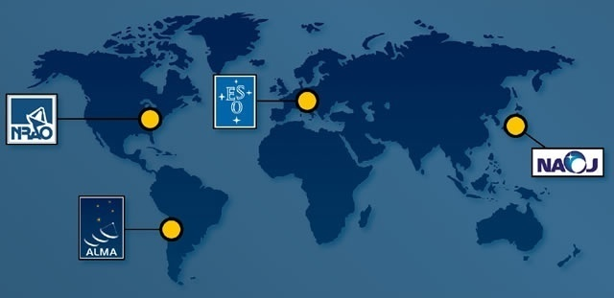
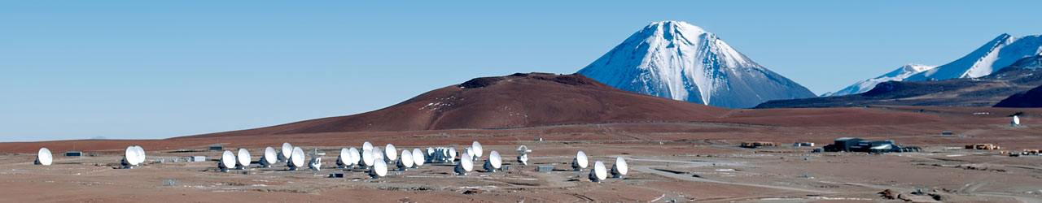
ALMA
Atacama Large Millimeter/submillimeter Array
  54 x 12m + 12 x 7m antenna’s on Chajnantor at 5050m
  7 – 0.35 mm (30-900 GHz) in 10⁺ atmospheric windows
  World’s most powerful radio interferometer
  Cold Universe: formation of planets, stars and galaxies
Global partnership
  North America (37.5%), East Asia (25%) & ESO (37.5%)
  In cooperation with Chile

Slide 38
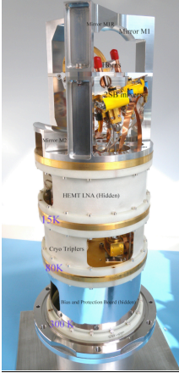
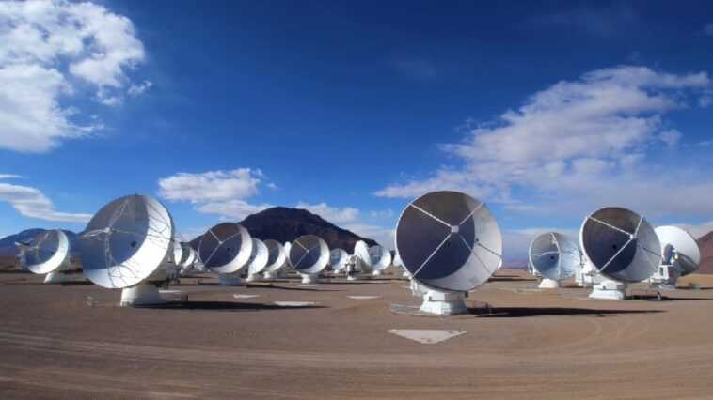
IRAM produced the cartridges of ALMA Band 7 (275–373 GHz)nd
And expert help and advice at various stages of construction, commissioning and calibration
And the observatoire de Bordeaux digitizers, filters
and a correlator

Slide 39
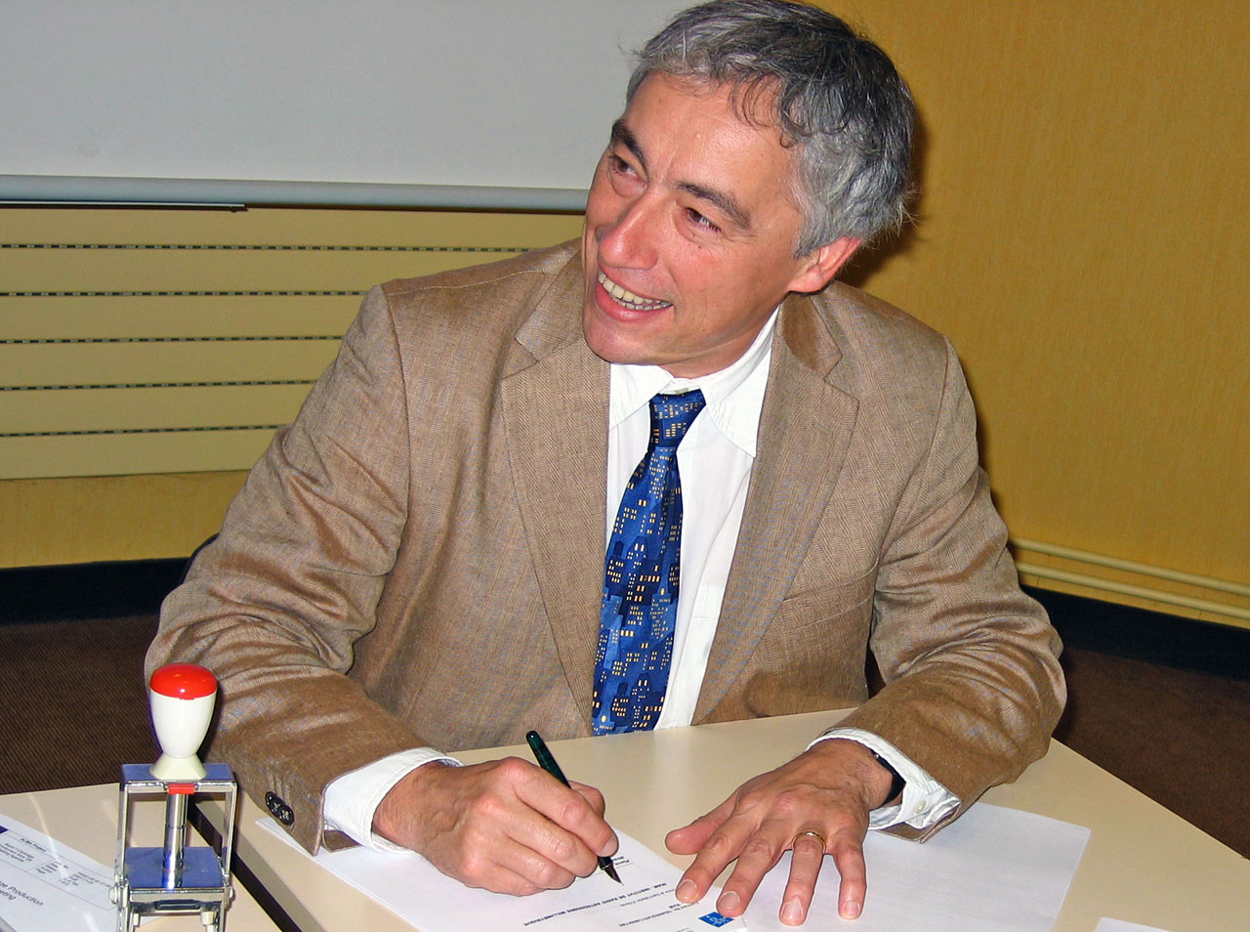
Pierre Cox signing the contract for the Band 7 receivers
Notes:
Dr Pierre Cox signing the contract for the ALMA Band 7 receivers. The ALMA Board announced on 14 November 2012 that Dr Cox has been appointed as the next Director of ALMA, the Atacama Large Millimeter/submillimeter Array. He will take up duty on 1 April 2013, for a period of five years. 14 November 2012, 17:00

Slide 40
Industry

Slide 41
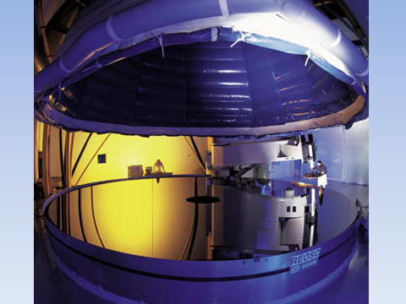
Last VLT mirror (12/1999), at REOSC
Notes:
8m wide but 20 cm thick Polished at REOSC south of Paris
8.5 nano meter surface error

Slide 42
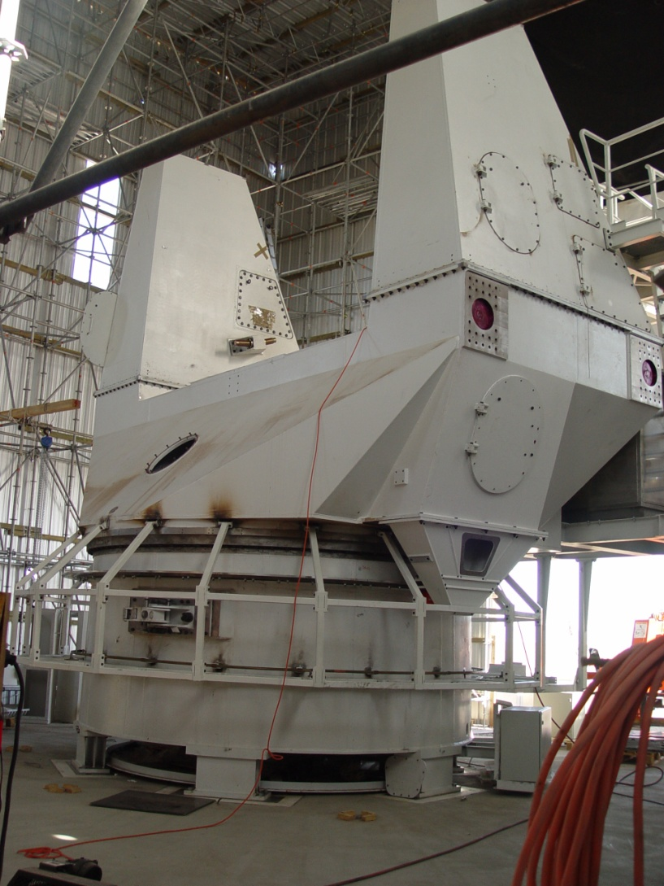
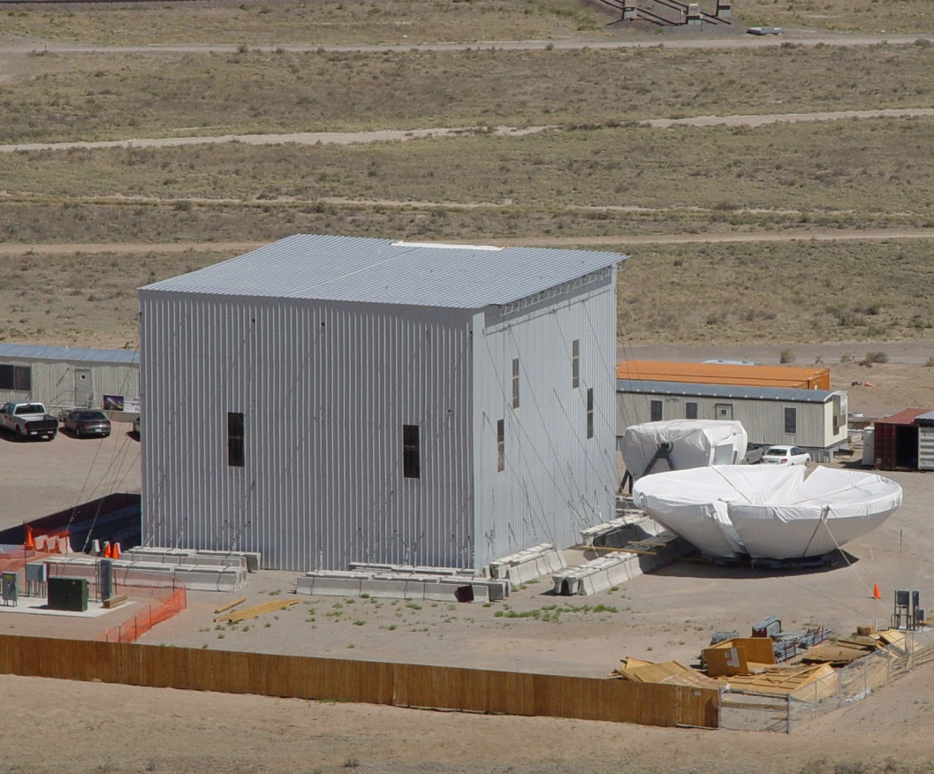
Alcatel/EIE Antenna
(prototype of AEM antennas)
Assembly shelter erected March-April
Major Antenna parts on site (including Bus and Cabin)
Assembly of antenna completion in September 2003
Preliminary acceptance granted end December2003

Slide 43
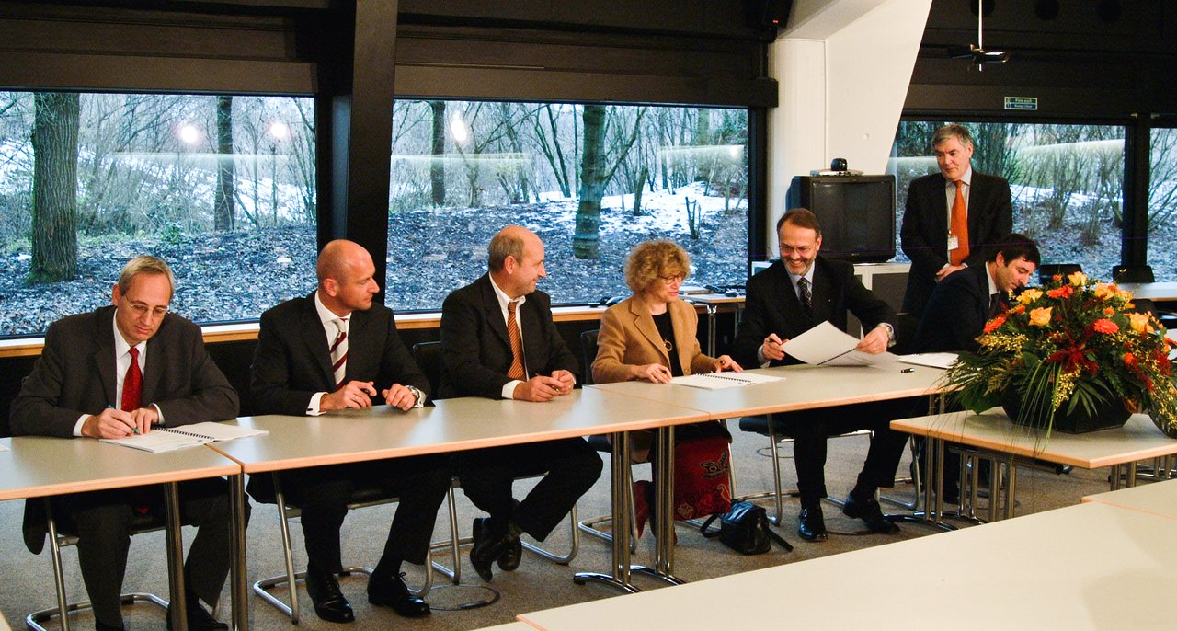
Contract for European ALMA antennas
Notes:
On 6th of December 2005 ESO signed the contract with Alcatel Alenia Space, European Industrial Engineering (Italy) and MT Aerospace (Germany) consortium that resulted in providing ALMA with more than 25 antennas. The contract, worth 147 million euros, was the largest contract ever signed in ground-based astronomy in Europe.

Slide 44
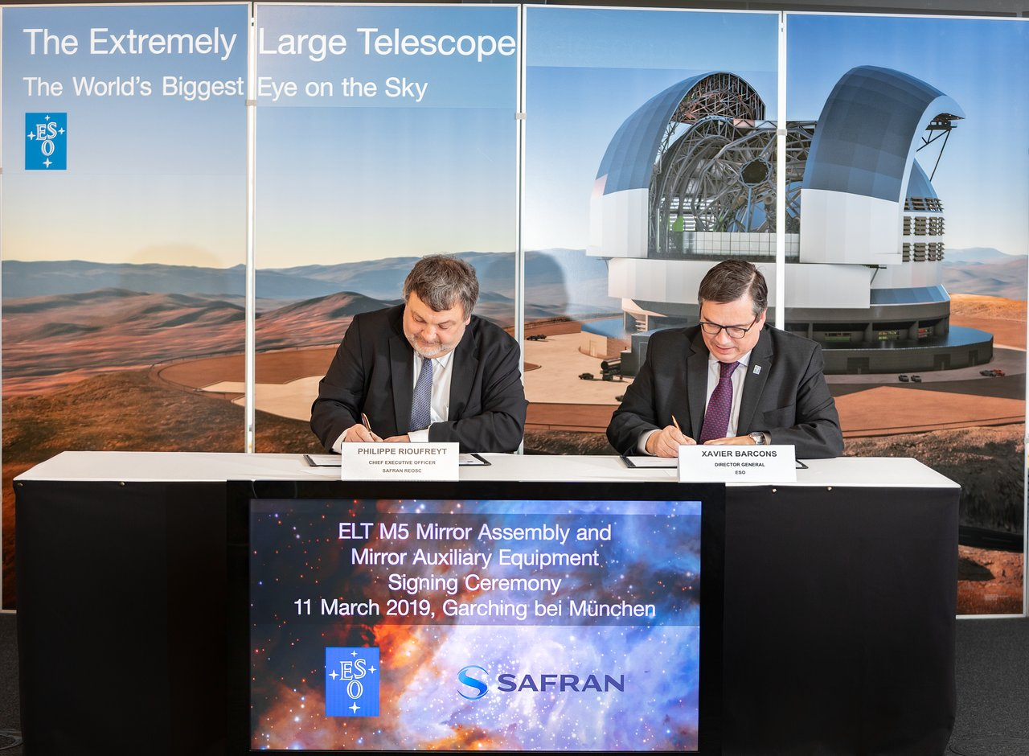
Safran Reosc contract with ESO for the supply of Mirror 5 of ELT
Notes:
ESO's Director General Xavier Barcons and Philippe Rioufreyt, CEO of the French optics company Safran Reosc, sign a contract for the supply of Mirror 5 (M5) of ESO's Extremely Large Telescope (ELT). Safran Reosc will provide the mirror along with the auxiliary equipment required for its handling, transport, operation and maintenance. The signing took place during a ceremony on 11 March 2019 at ESO Headquarters in Garching, Germany.

Slide 45
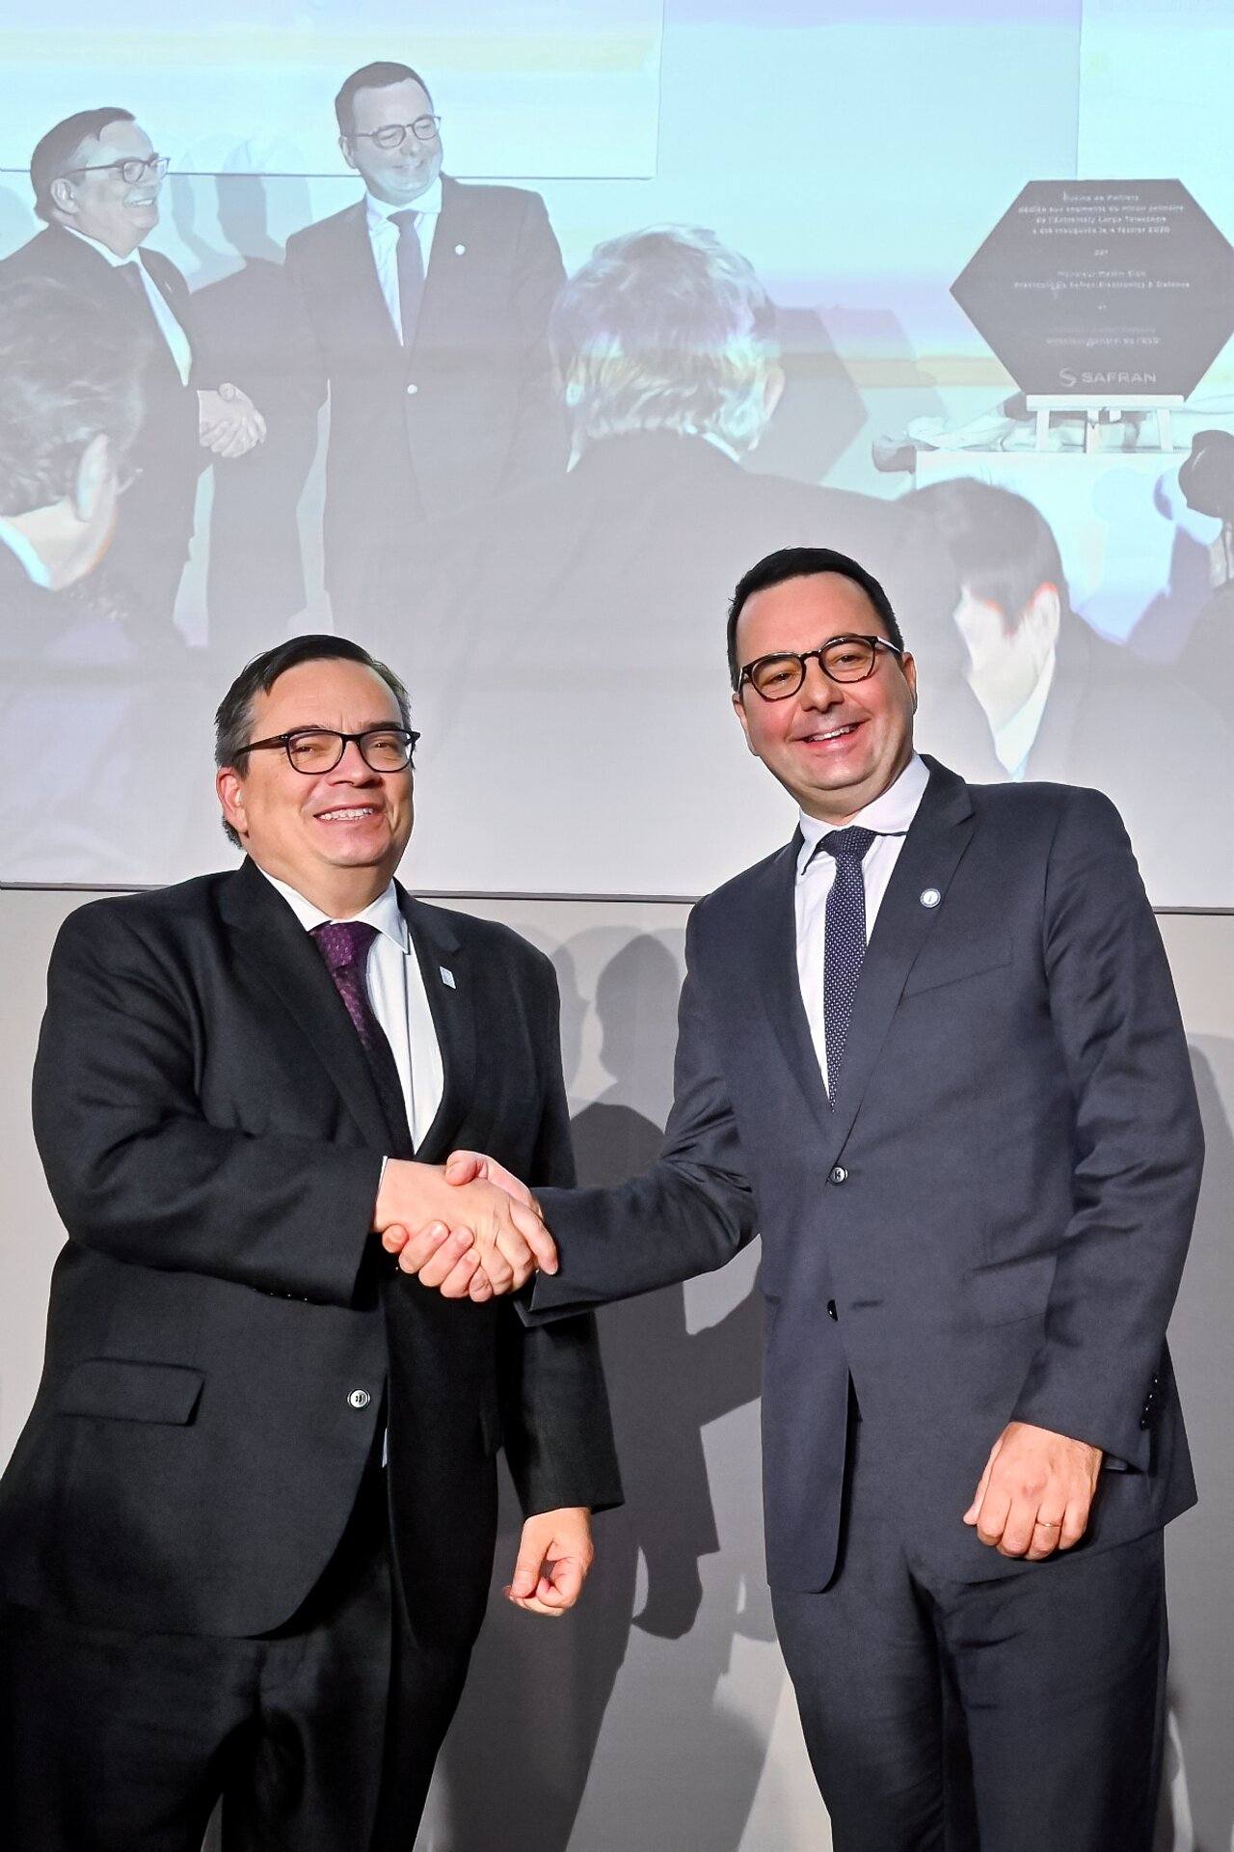
Inauguration of polishing plant for ELT segments of Safran, Feb. 2020
Notes:
ESO Director General, Xavier Barcons, and CEO of Safran Electronics and Defense, Martin Sion, shake hands at the inauguration ceremony of the new polishing plant for segments of the ELT Main Mirror of Safran in Poitier, France on 4 February 2020.

Slide 46
People and talents

Slide 47
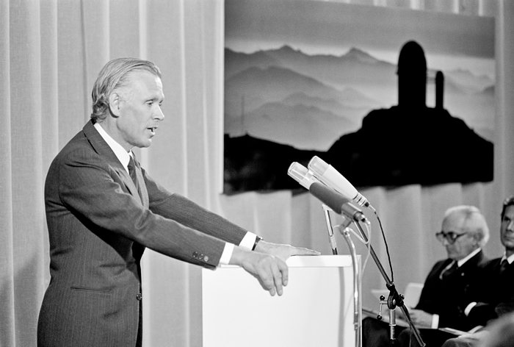
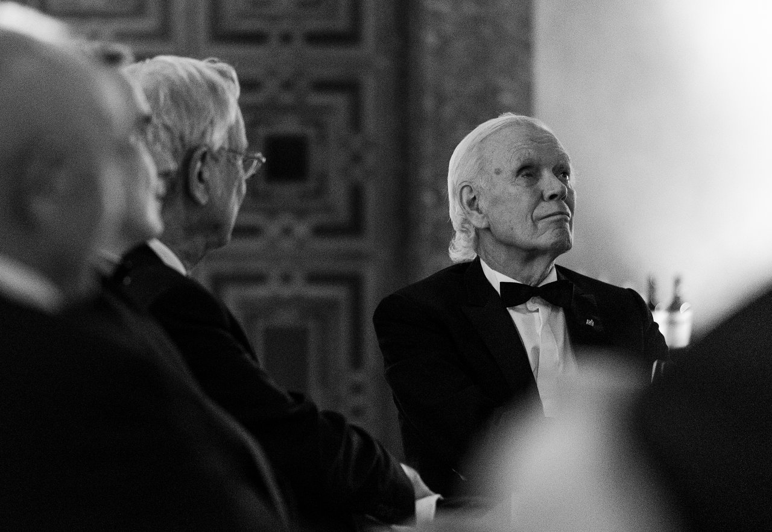
Lo Wotjer
ESO DG, 1975-1987
Notes:
Prof. Lodewijk Woltjer, ESO Director General from 1975–1987. Photo taken during the European Southern Observatory 50th anniversary gala, held in the Residenz, Munich, on 11 October 2012.
Lodewijk Woltjer welcoming guests to the ESO Garching Headquarters inauguration in 1981.
Credit: ESO

Slide 48
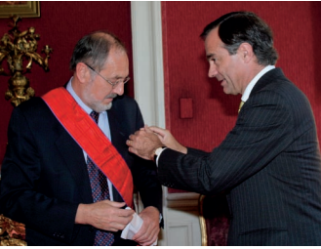
Daniel Hofstadt
Starting as electronics engineer in 1972, he assumed new duties, becoming responsible for technical research service. He was also involved in the installation of all telescopes arriving those years to LSO, including the 3.6-m telescope and the NTT. A few years later, he became chairman of the management team at LSO
In 1995, he moved to the Vitacura office in Santiago to assume further responsibilities, as the ESO representative in Chile. He took up this new role while the VLT was under construction. Pivotal role, next to DGs, in regaining hold of the Paranal land, and later getting permission to build ALMA.
Huge preparatory work for ALMA, in particular for the environmental study.
This homage from the Ministry of Foreign Affairs is the culmination of a long and fruitful career of Daniel Hofstadt within ESO, since 1972 when he first joined the organization as electronic engineer at La Silla Observatory to work on the advancement of instrumentation of the telescopes. June 2005.

Slide 49
Some essential french figures in ESO
Daniel Hofstadt
Jacques Breysacher
Jacqueline Bergeron
Daniel Enard
Jean-Marie Mariotti
Danielle Alloin
Guy Monnet
Norbert Hubin
Michèle Péron
Bernard Delabre

Slide 50
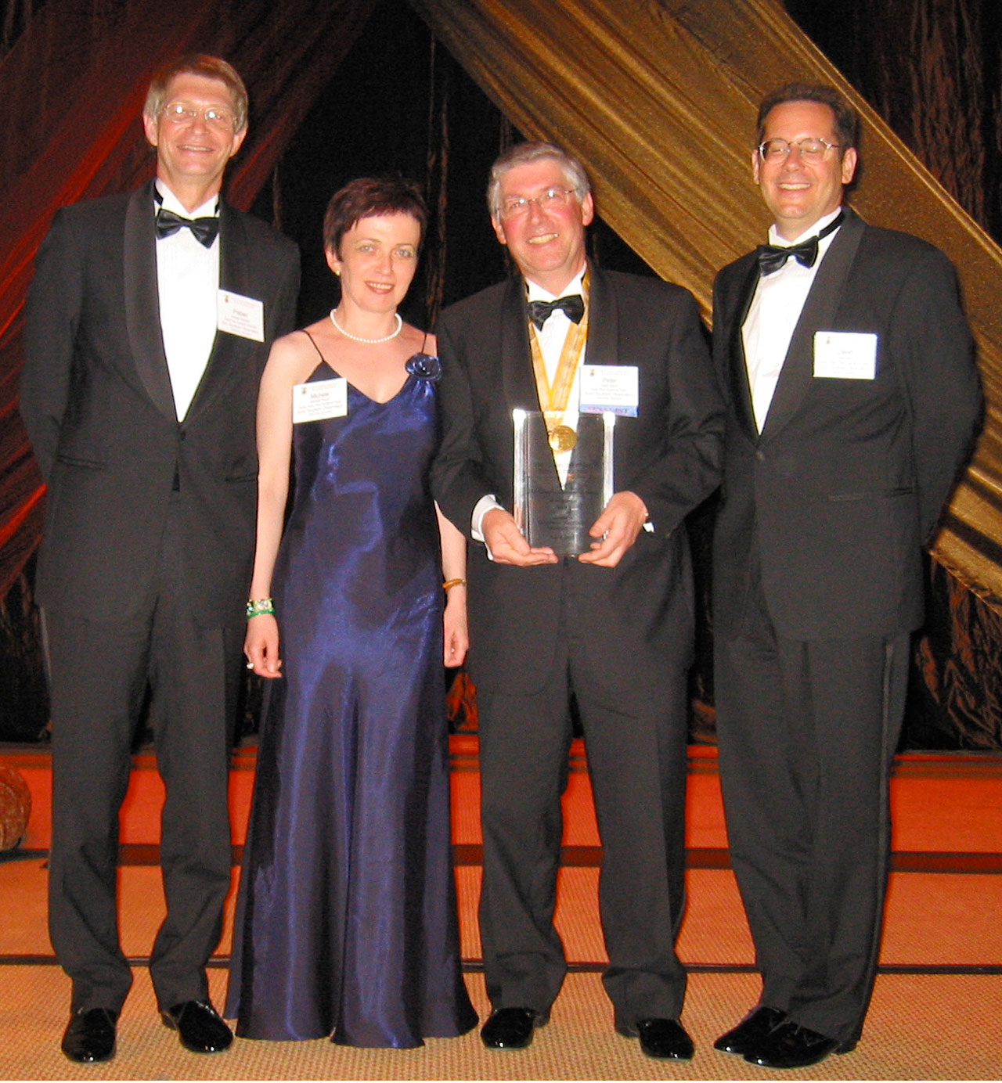
Michèle Péron
With Preben Grosbøl, Peter Quinn
and David Silva
Notes:
Receiving the Computerworld 21st Century Achievement Award for Science on behalf of ESO: (Head of the ESO Data Management Division) and David Silva.
7 June 2005

Slide 51
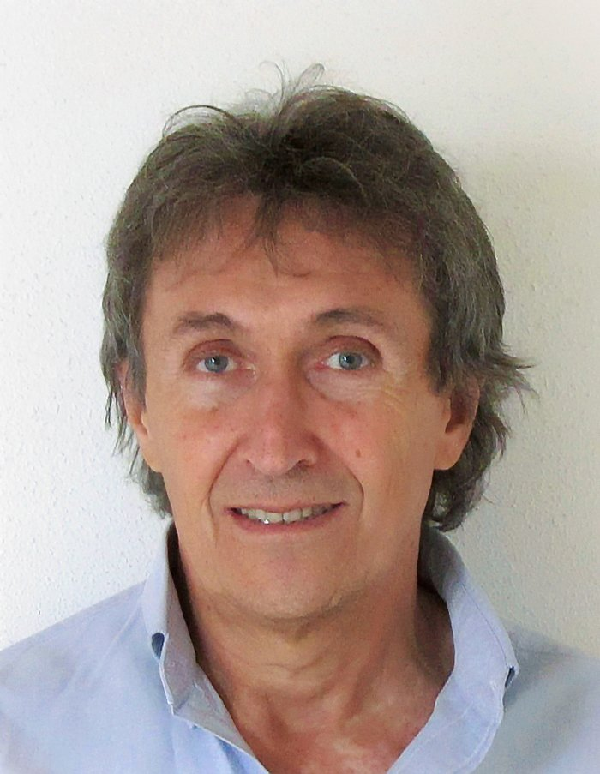
Bernard Delabre
Notes:
Bernard Delabre is an optical engineer at ESO. He was the winner of the 2017 Tycho Brahe Prize.
He has been involved in the design of the optics of nearly all the instruments built by ESO over the past 35 years, including HARPS at La Silla, and UVES, MUSE, ERIS, HAWK-I, and CUBES at the Very Large Telescope. He has been the chief optical designer of a number of telescopes including the Extremely Large Telescope, for which he invented the beautiful five-mirror solution.

Slide 52
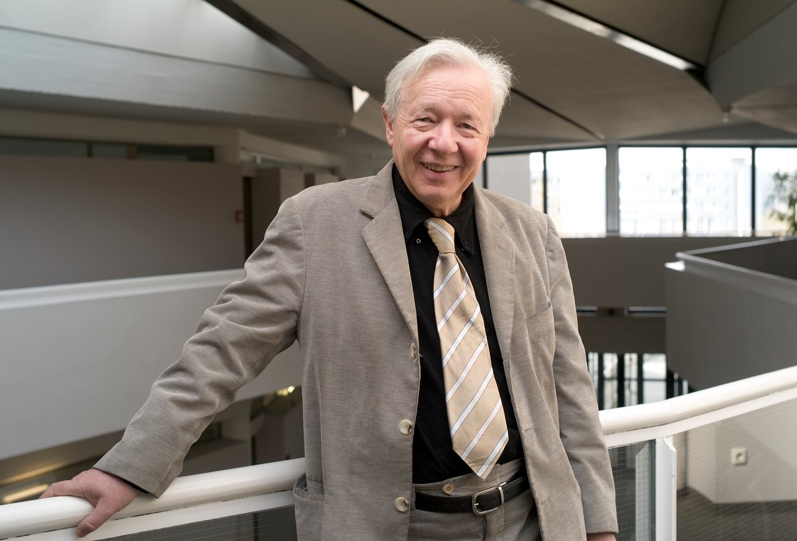
Guy Monnet
Notes:
Guy Monnet is the winner of the 2019 Tycho Brahe Medal of the European Astronomical Society (EAS). This award specifically recognises his fundamental contributions to the implementation of 3D spectroscopy on optical and infrared telescopes, and his international leadership on the instrumentation programmes of large observatories. Both of these achievements are demonstrated by the work he did at ESO; as the first head of the Instrumentation Division, he oversaw the completion of the first generation of instruments for the Very Large Telescope (VLT), the largest and most ambitious instrumentation programme of any ground-based observatory.

Slide 53
Some figures in France important for the link to ESO
Daniel Kunth and Michel Dennefeld
Pierre Léna
Antoine Labeyrie
Laurent Vigroux
Anne-Marie Lagrange
Stéphane Guilloteau
Bernard Lazareff
Robert Lucas
Alain Baudry
Patricia Laplaud
Mme Laplaud
Notes:
, the STC appointed a Working Group on Scientific Priorities for the VLT Observatory, ably chaired by Dr. L. Vigroux, to reconsider the most urgent science to be done with the VLT
M. DENNEFELD, Chairman of the UC

Slide 54
