Slide 1
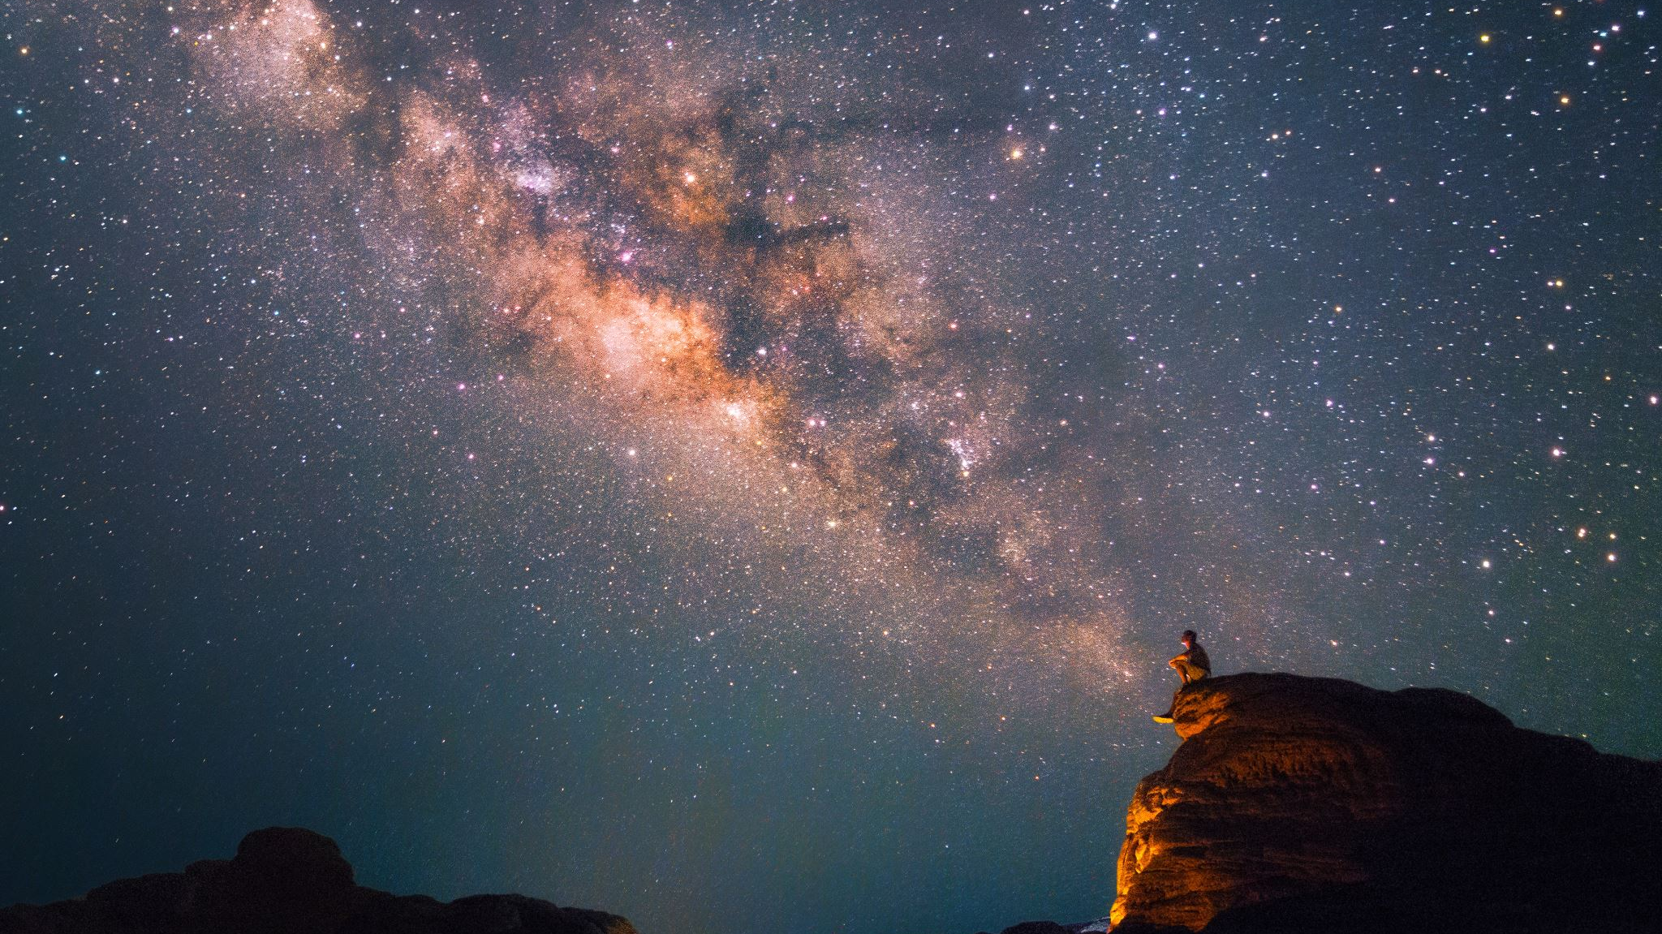
60 ans de l’ESO (OES?) 60 years of ESO
François R. Bouchet
Le 3 novembre 2022

Slide 2
Welcome !
Happy to welcome you all at the Institut d’astrophysique de Paris (IAP) to celebrate together many years of amazing successes of ESO.
I am particularly happy that IAP researchers have been noteworthy contributors to some of them. Four come to mind (showing my own biases, and this is certainly very unfair to so many other distinguished contributors):
« Cosmic temperature independently measured », inc. Pasquier Noterdaeme & P. Petitjean was within the ESO top 5 for many years (see in May 2008 https://www.eso.org/public/news/eso0813/); it is still # 9 now at https://www.eso.org/public/science/key-discoveries/ …
“New Quasar Studies Keep Fundamental Physical Constant Constant”, inc. P. Petitjean & B. Aracil, stayed quite a long time in the top 10, see https://www.eso.org/public/news/eso0407/ of 31 March 2004
On a different front, Roger Ferlet activated the CES spectrograph at La Silla, which was for long the best high-spectral resolution spectrograph of the world, and he performed the first measurement of the isotopic ratio of the interstellar lithium. Alfred Vidal-Majar and him first detected in absorption the gaseous part of the dust disk around Beta Pictoris and found spectral variations which they interpreted (in 1987 !) as exocomets.
And it is worth remembering that La Silla hosted EROS, the (first?) collaboration between particle and astro physicists to try detect the dark matter by microlensing . BTW the first microlensing event is at the 4th rank of the 1994 global citation index !
I am looking forward to now be reminded of all other achievements, including on the instrumental and managerial fronts, to help us prepare successfully for the next wave of successes.
Notes:
Lithium, crucial for primordial nucleosynthesis and chemical evolution of galaxies

